Slide 1
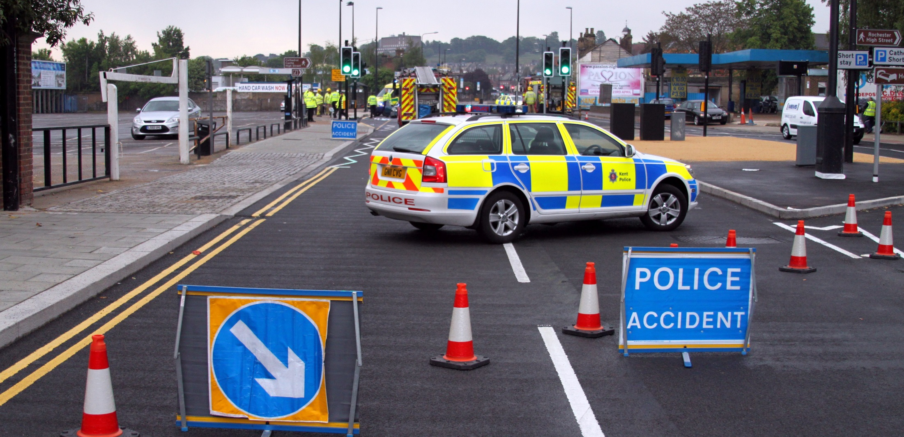
Responding to users’ needs in official statistics
Weather, statistical significance and presentation in road safety statistics
Daryl Lloyd, Road Safety Statistics
RSS webinar 26th April 2017

Slide 2
The story of the good ship HMS Transport Statistics
General style and layout
Use of infographics
Commentary and topics
Explanation behind the trends
Listen to users’ views

Slide 3
Once upon a time, publications were boring and drab…(a bit like listening to One Direction)

Slide 4
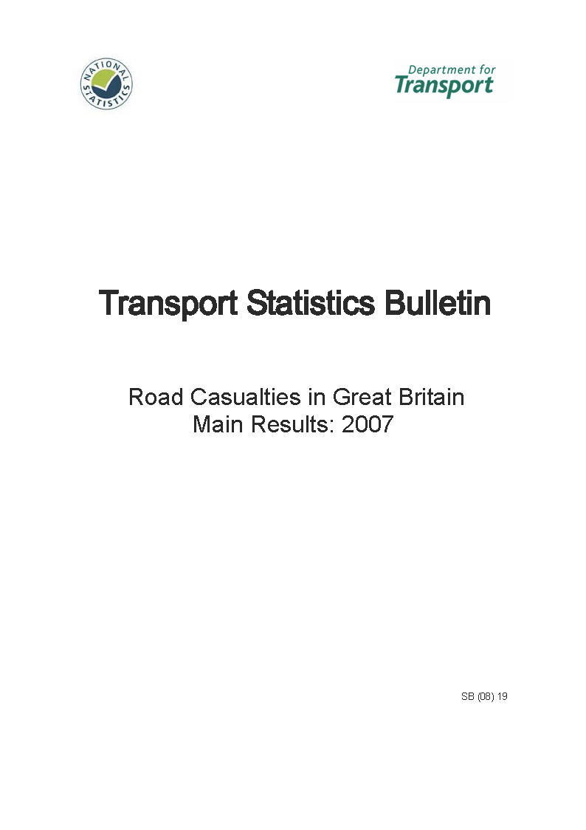

Slide 5
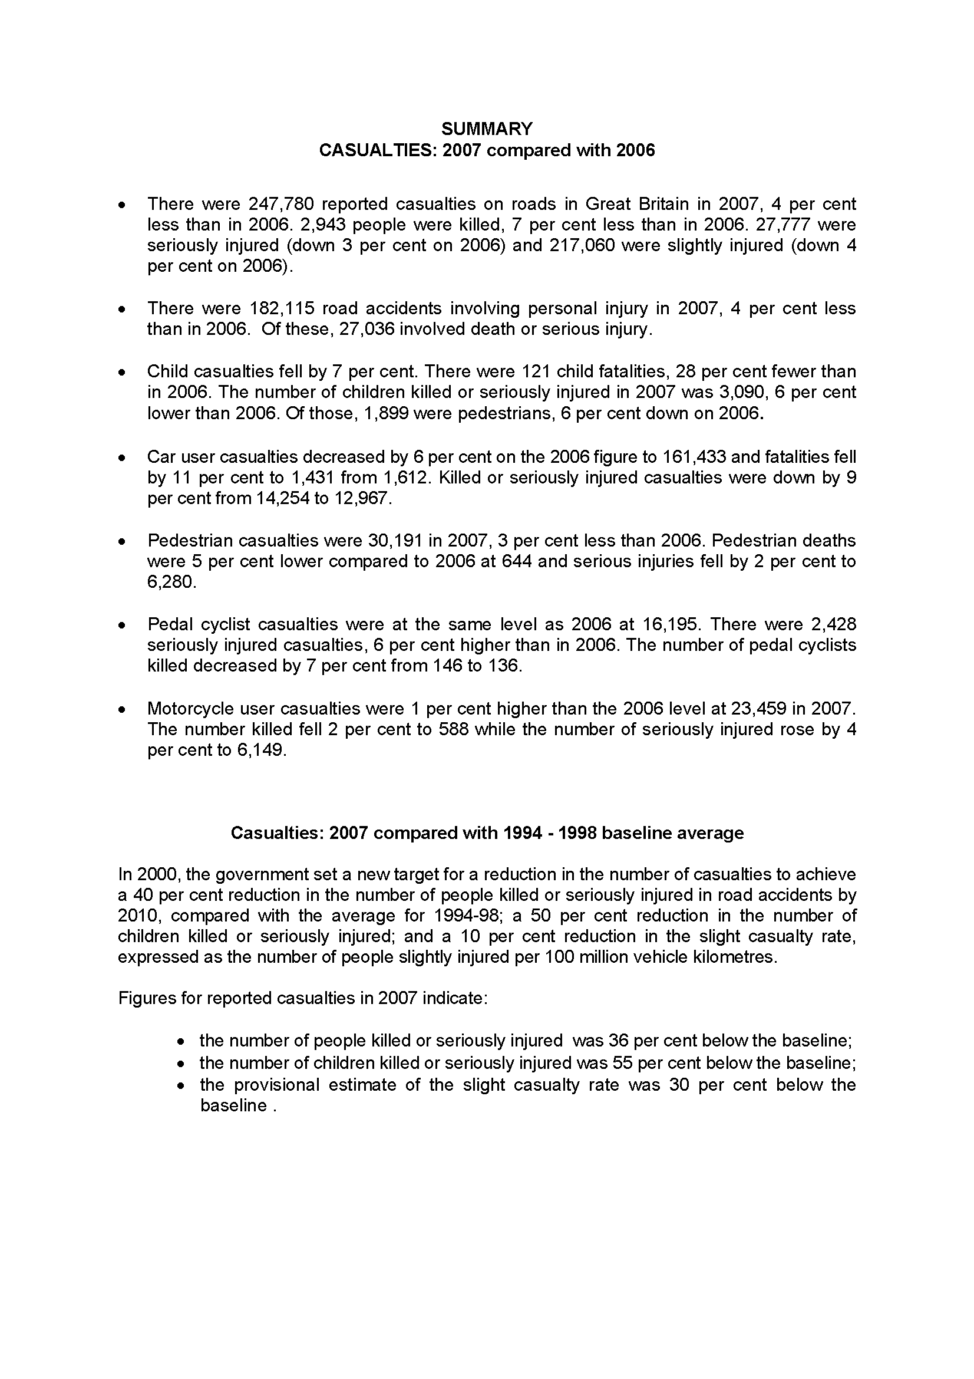

Slide 6
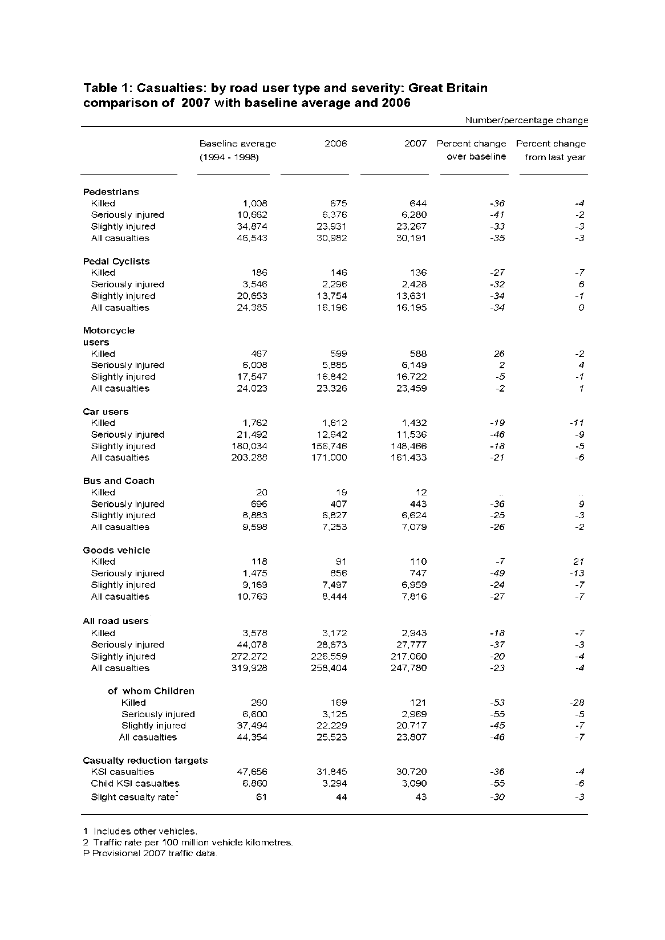

Slide 7
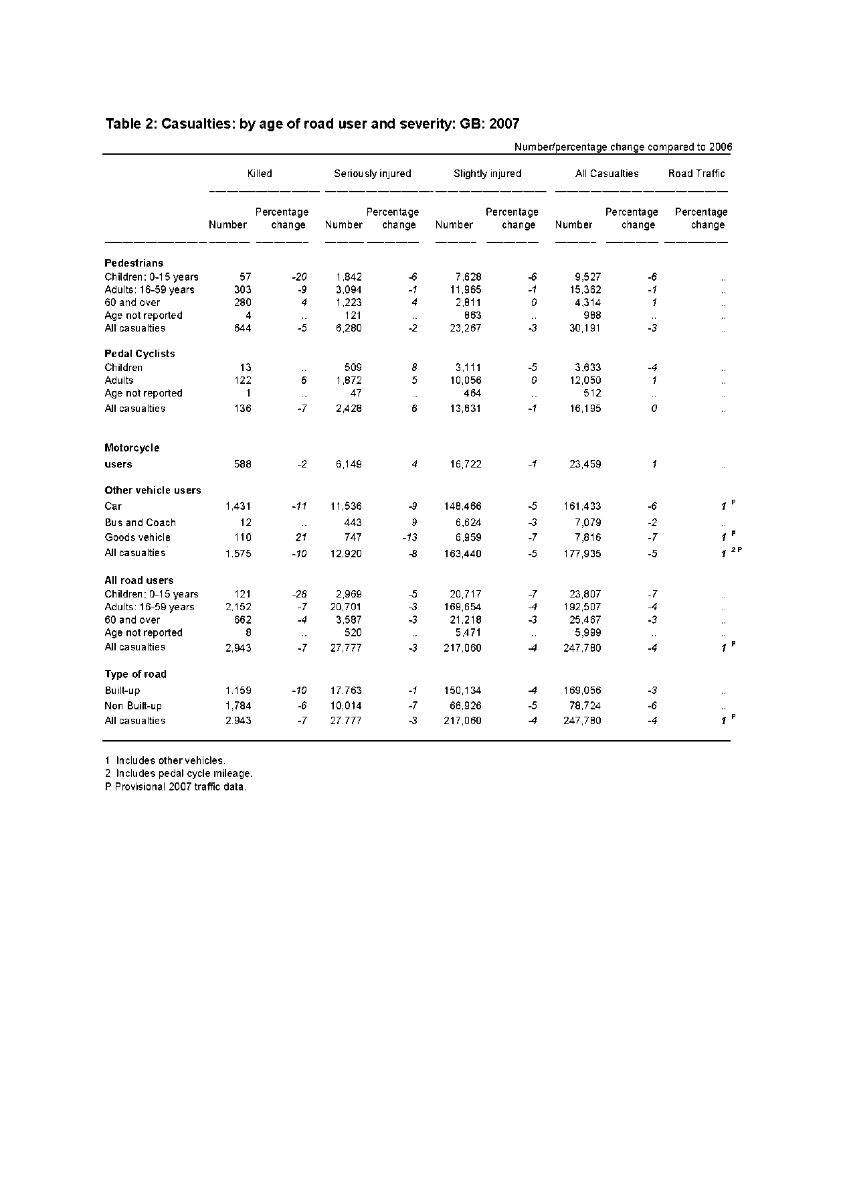

Slide 8
Things did get a little better when the annual report came out later in the year….

Slide 14
First step for improvement
Adopted more corporate and professional templates across the whole of DfT Statistics
Moved away from just describing the trend to explaining the trend and providing context

Slide 15
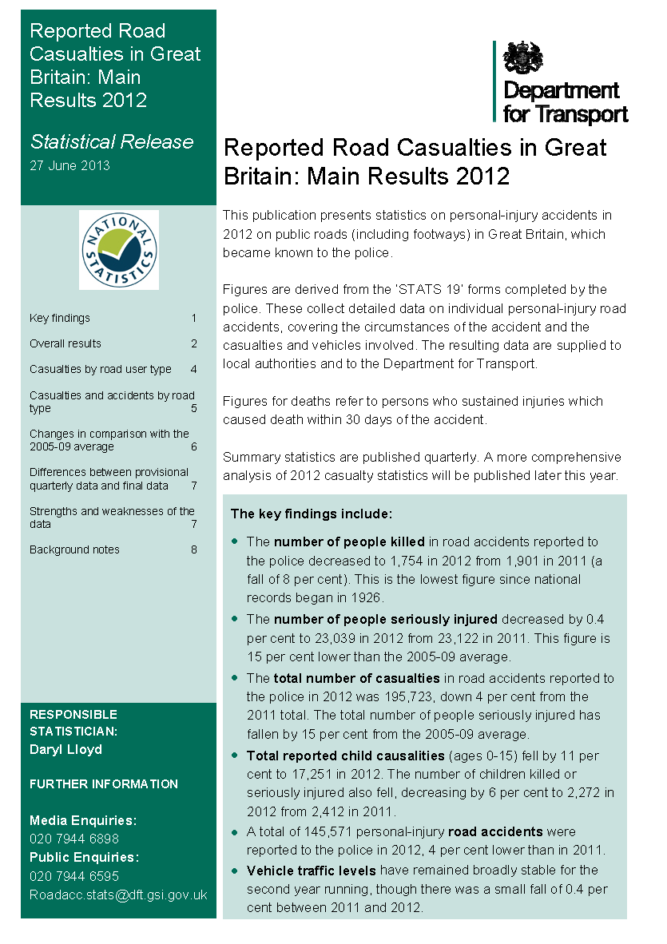

Slide 16
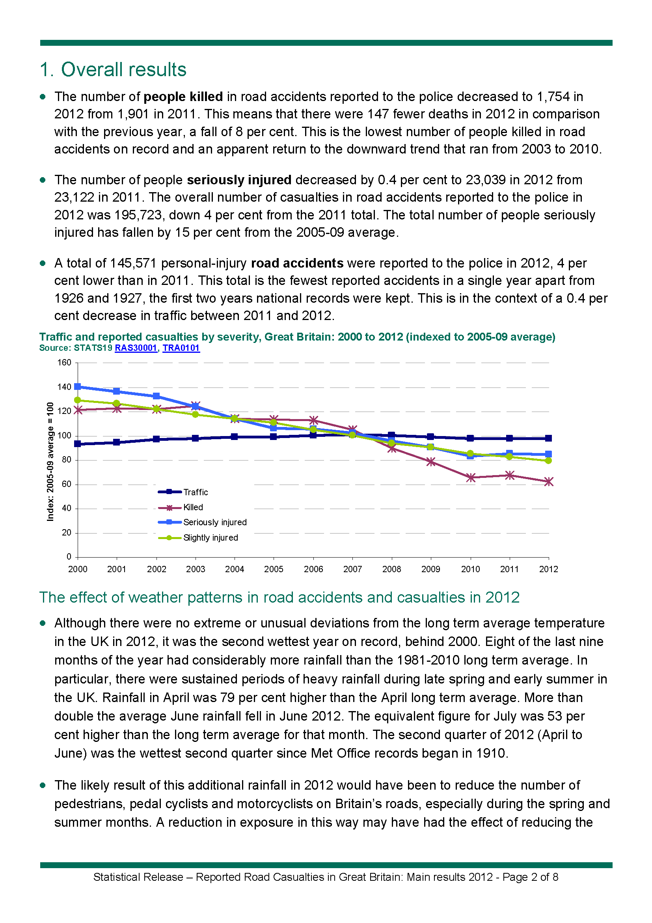

Slide 17
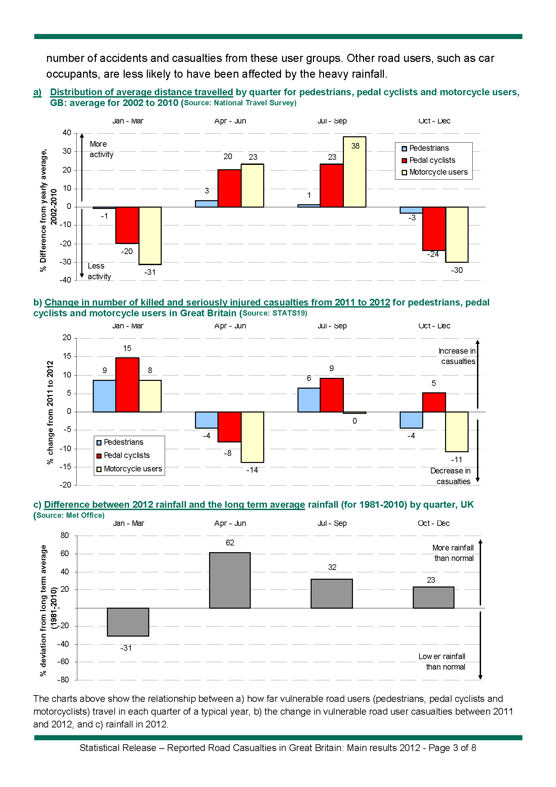

Slide 18
How far people travel (using the National Travel Survey)
Casualty numbers change as…
exposure changes, which is influenced by…
changes in how wet or dry it was
Change in casualty numbers from same quarter in previous year
Change in precipitation from same quarter in previous year

Slide 19
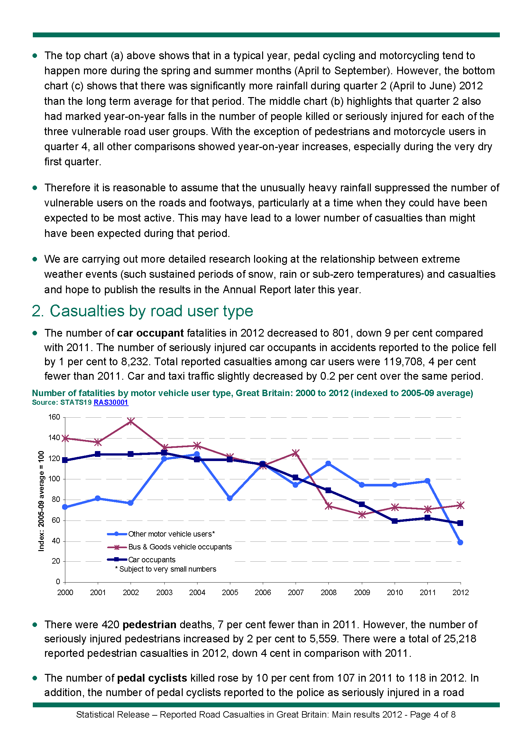

Slide 20
And then improved it yet again (this time using professional design software)

Slide 21
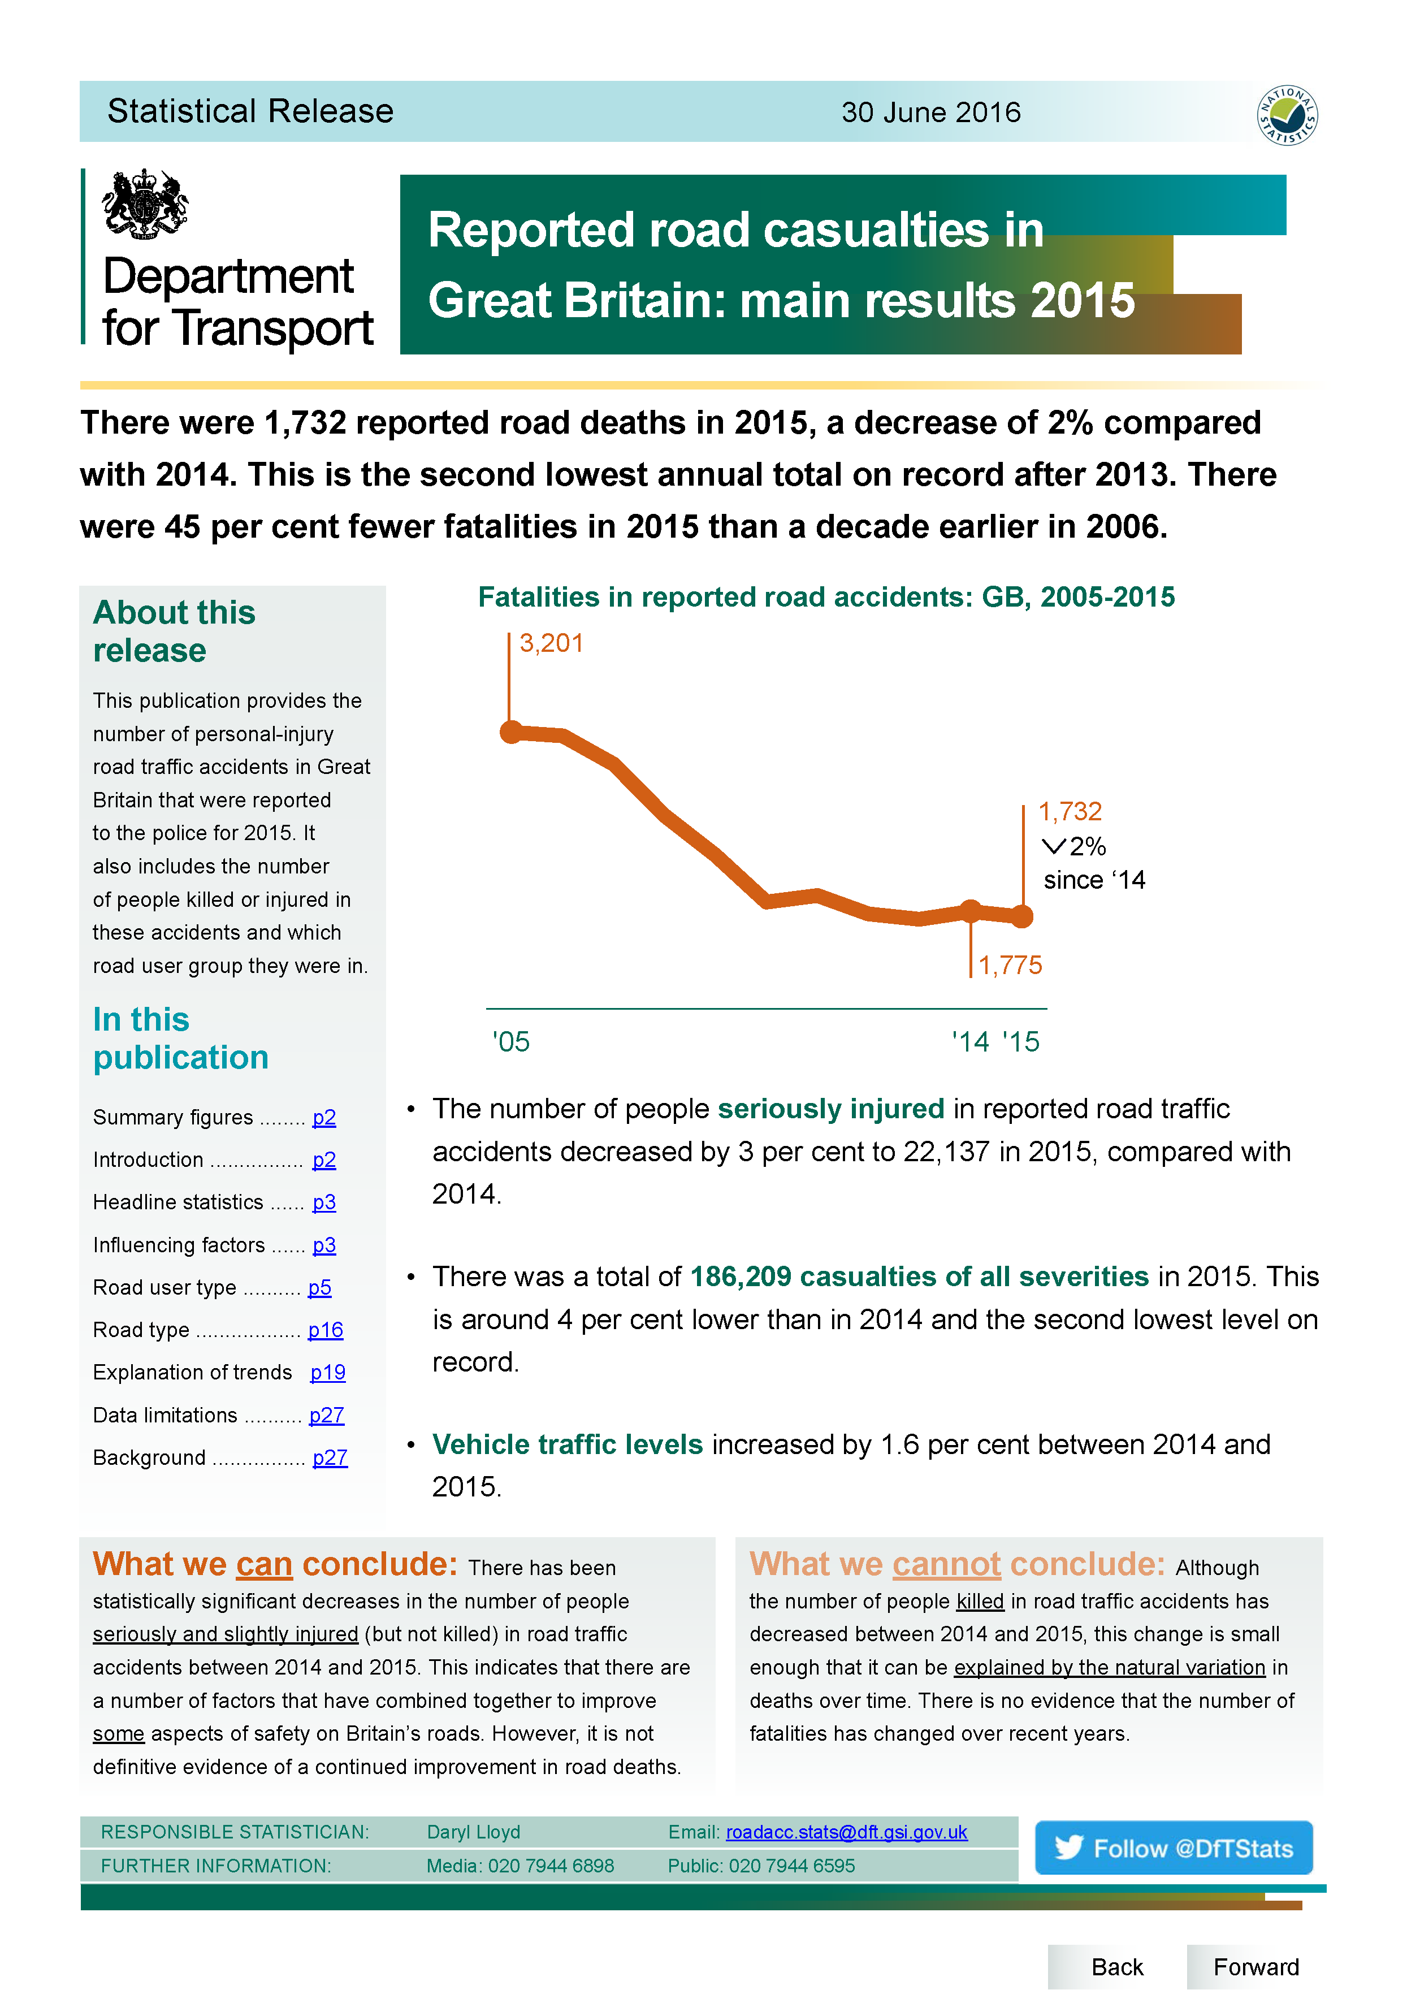

Slide 22
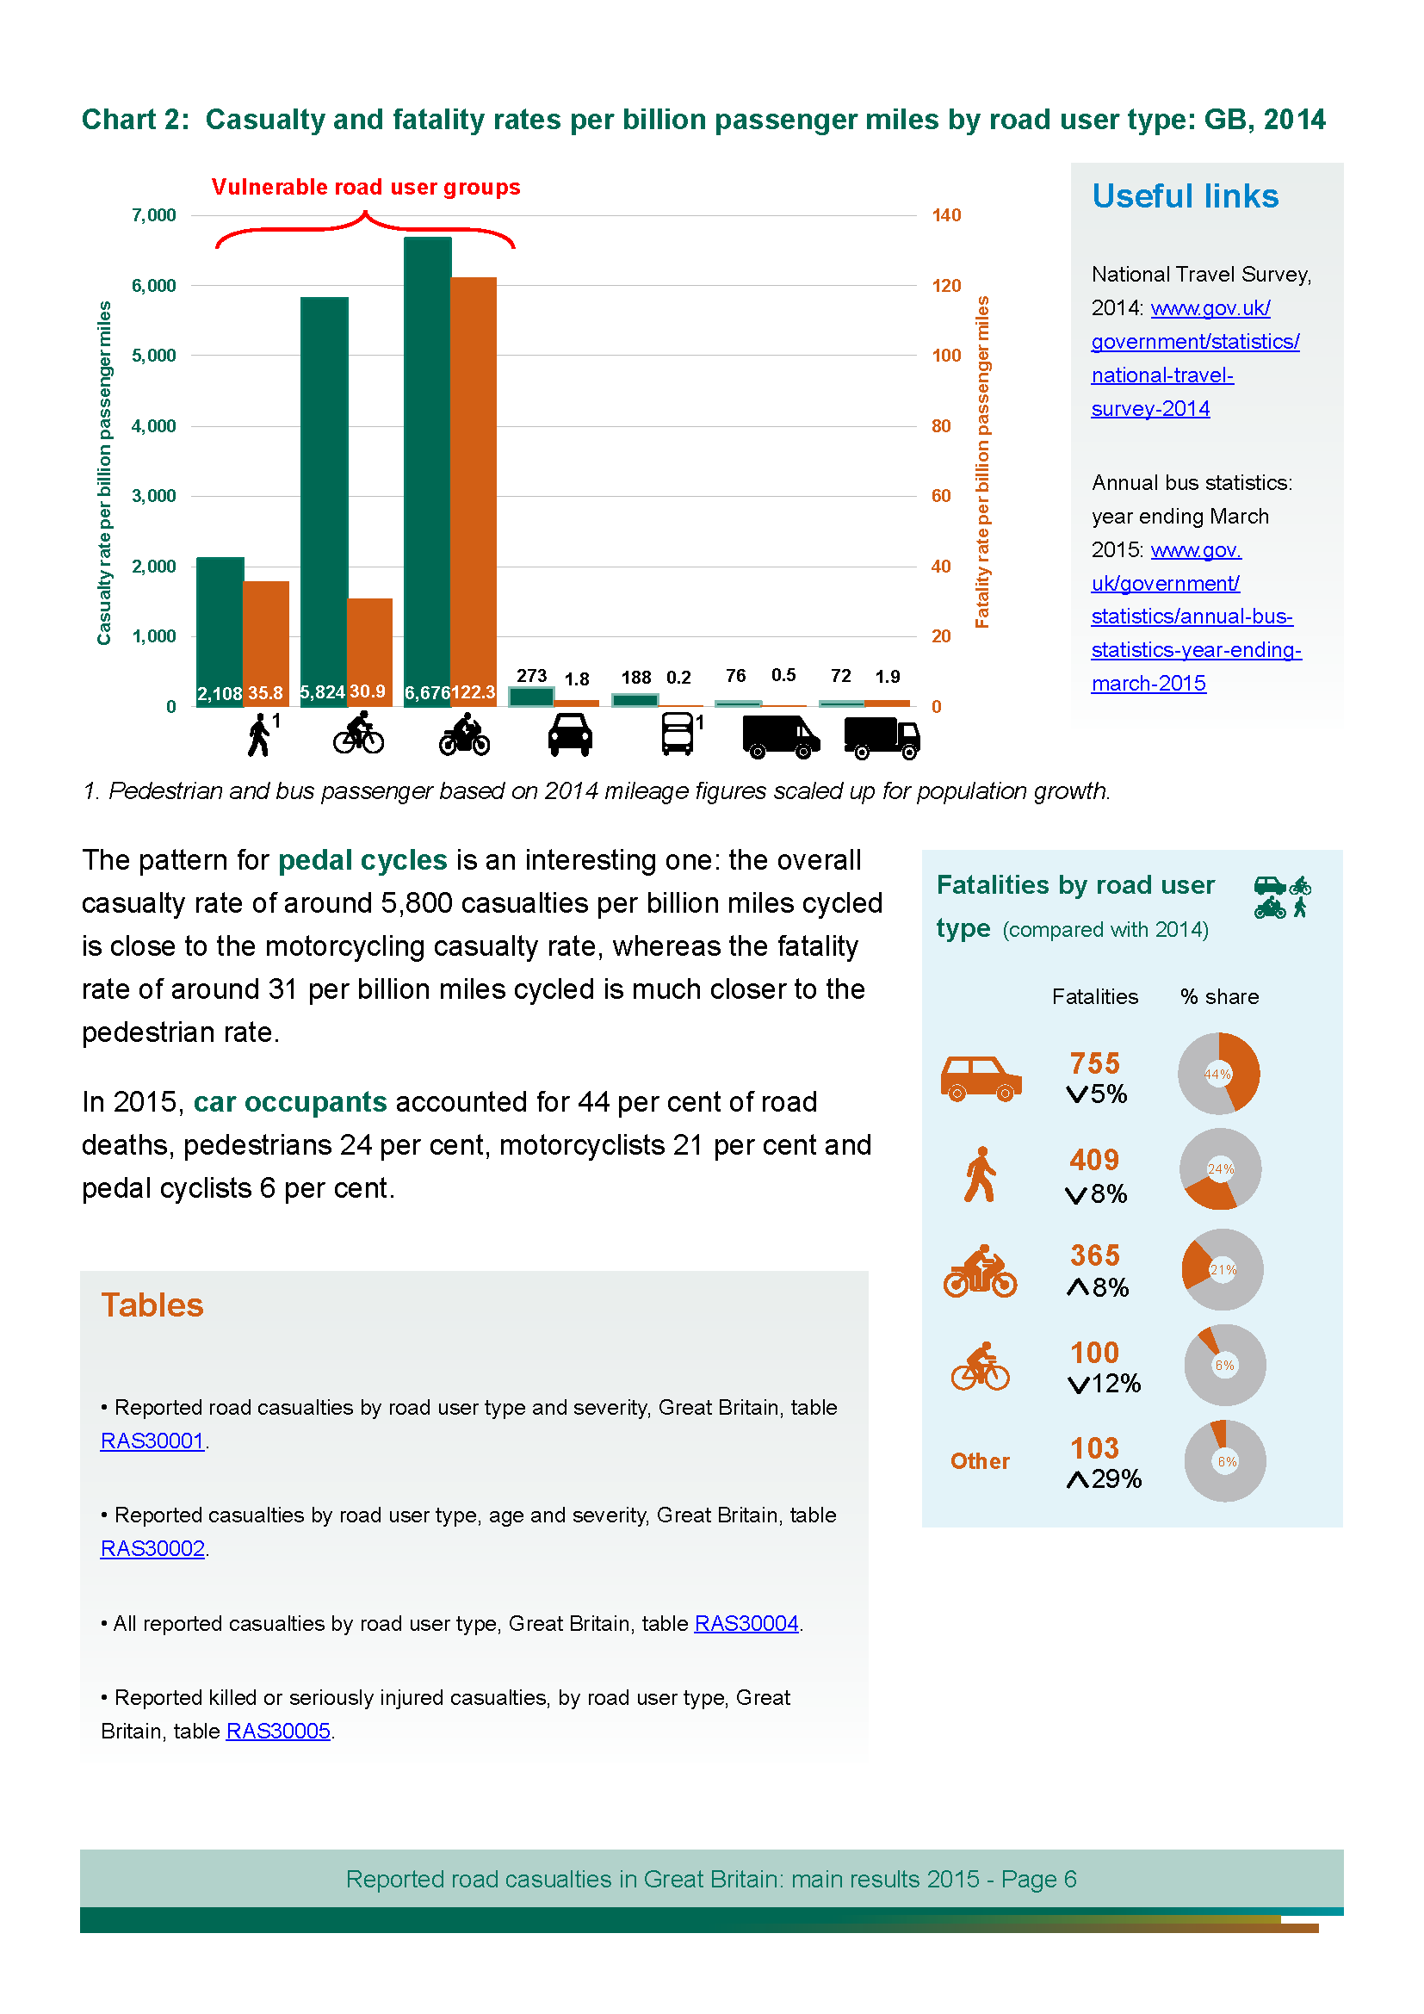

Slide 23
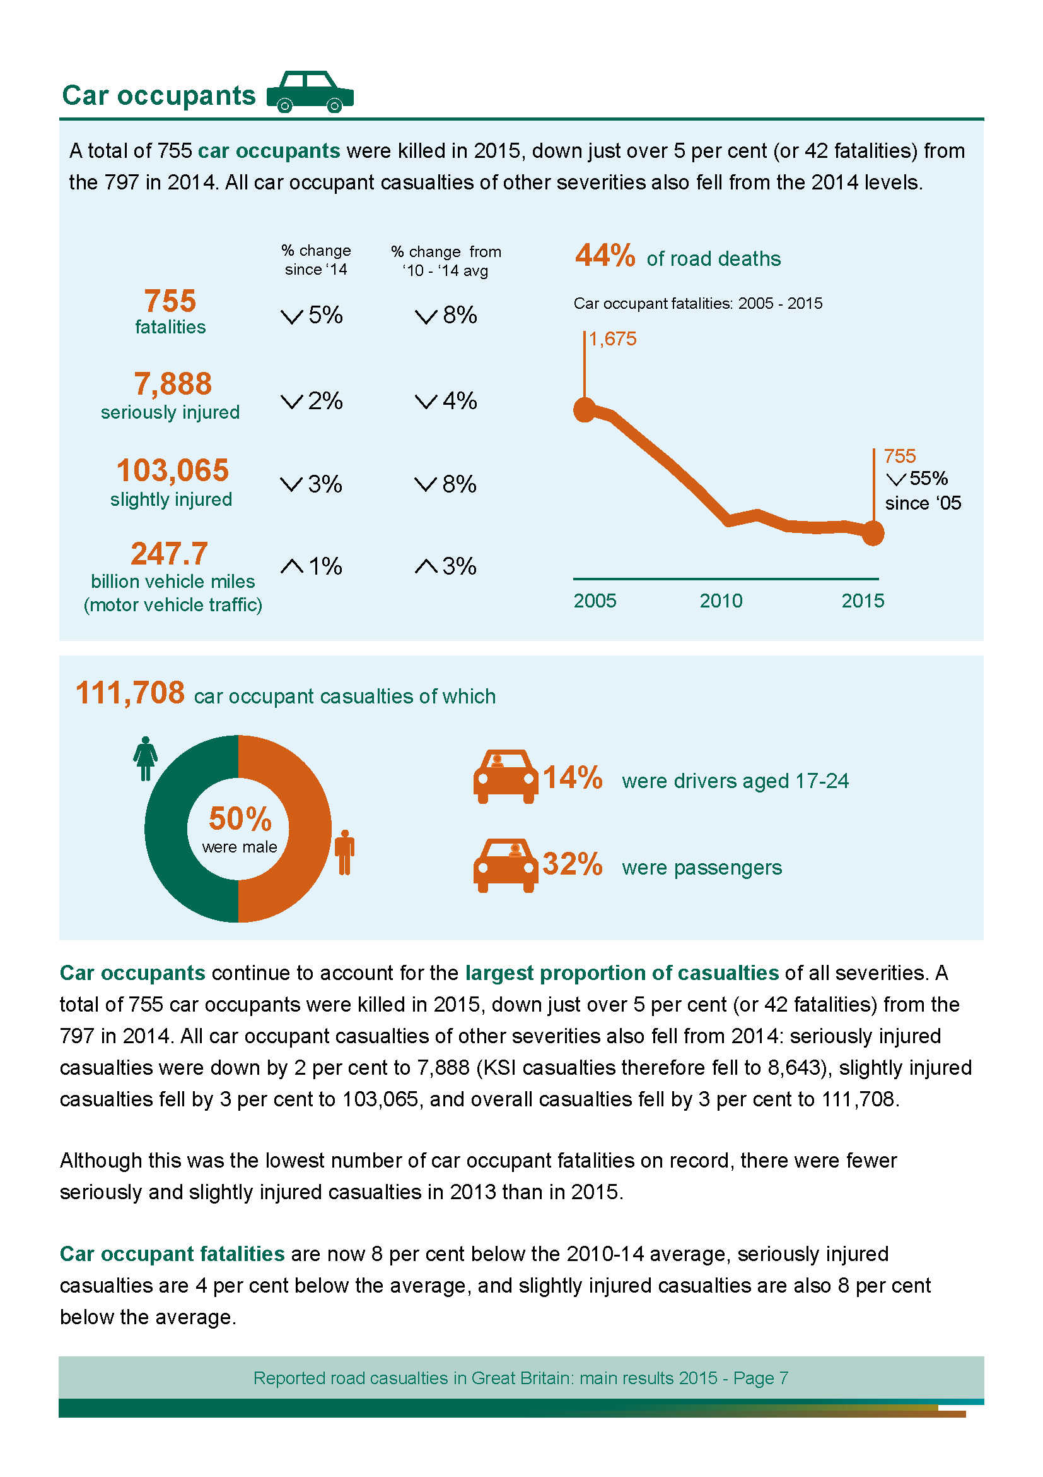

Slide 24
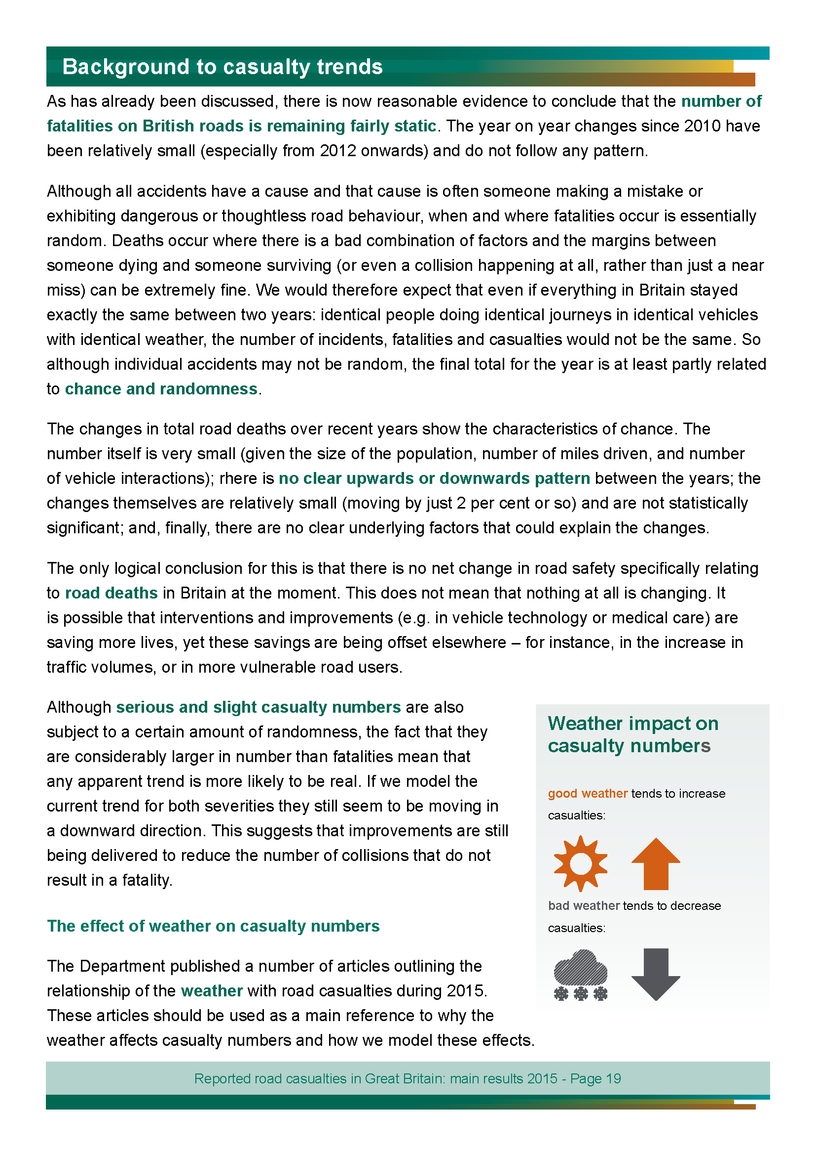

Slide 25
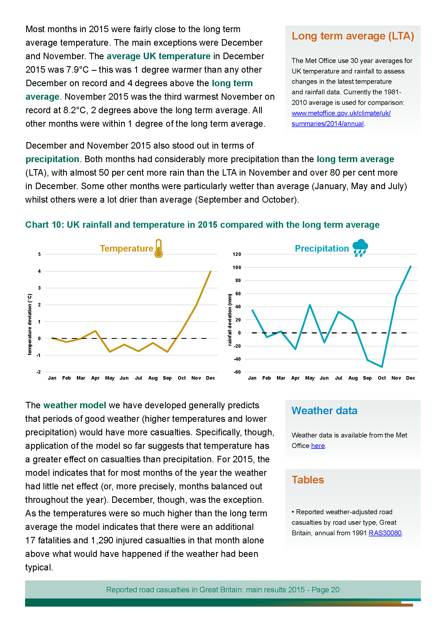

Slide 26
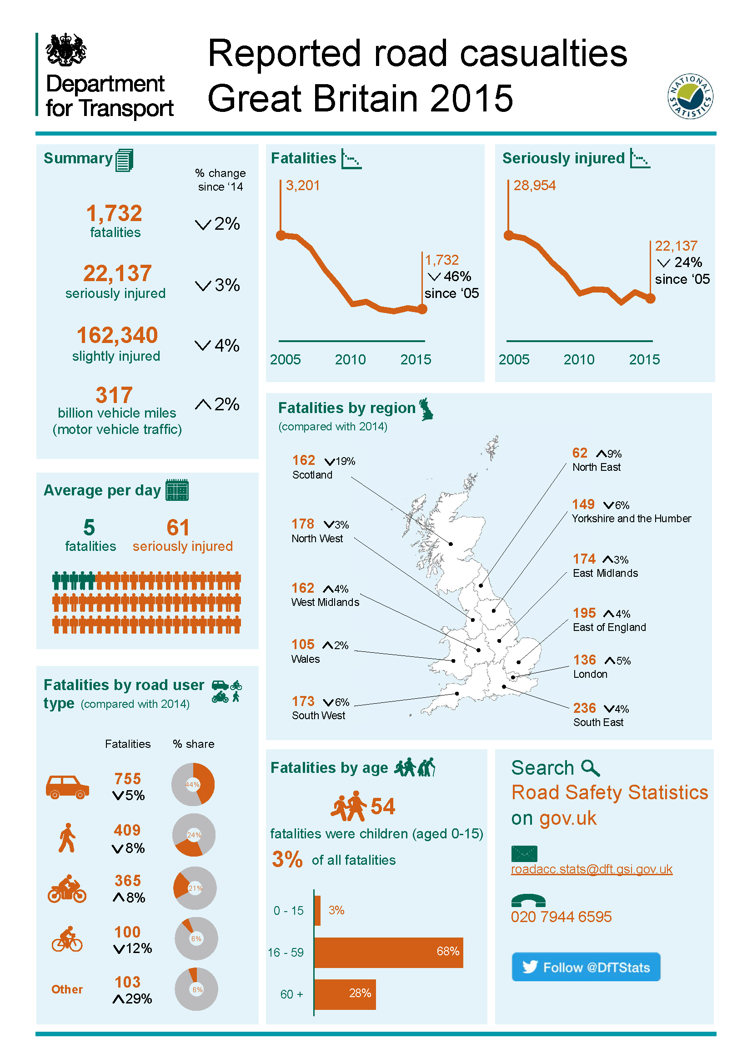

Slide 27
Using infographics
Infographics can be highly effective and an excellent way to communicate key messages
But…it is important to make them simple and consistent – developing a corporate identity and style helps with this
It also helps readers to compare sections of the same publication

Slide 28
This section is repeated for each of the road user types, in the same style and layout.

Slide 29
Need to wary of what infographics you use
It is very easy to fall into the trap of “any infographic is better than none”
And it is easy to create a poor infographic or one that detracts from your message or publication

Slide 30

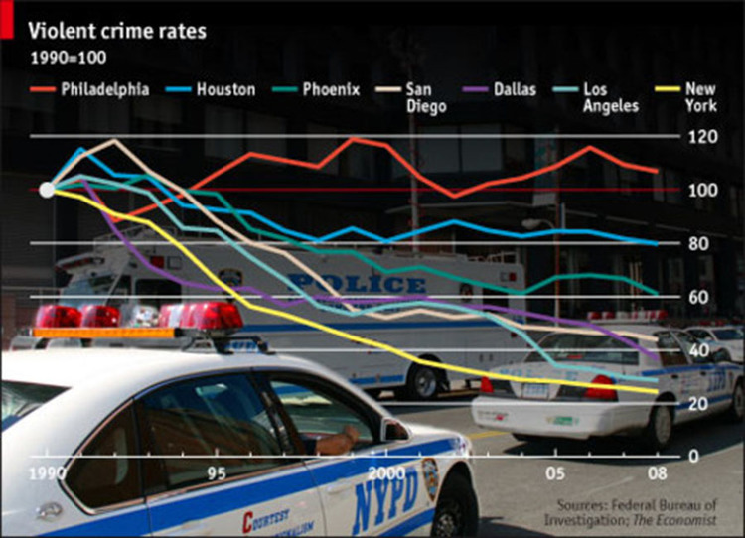
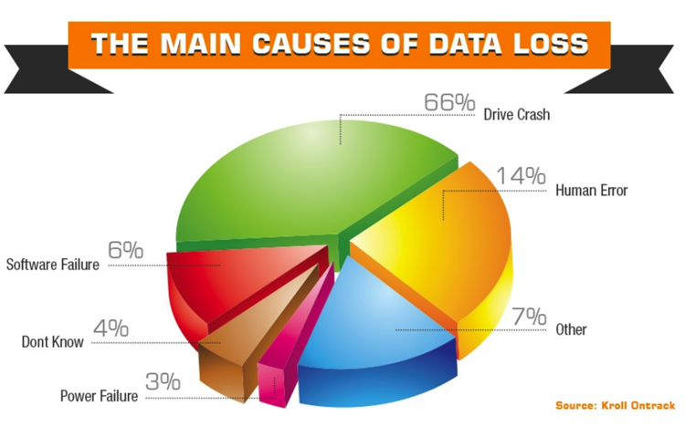



Slide 31
But need to wary of what infographics you use
It is very easy to fall into the trip of “any infographic is better than none”
Compare the 2015 and 2016 editions of DFID’s Statistics on International Development publication

Slide 33
Rules
Rule 1: Make it look interesting and engaging

Slide 34
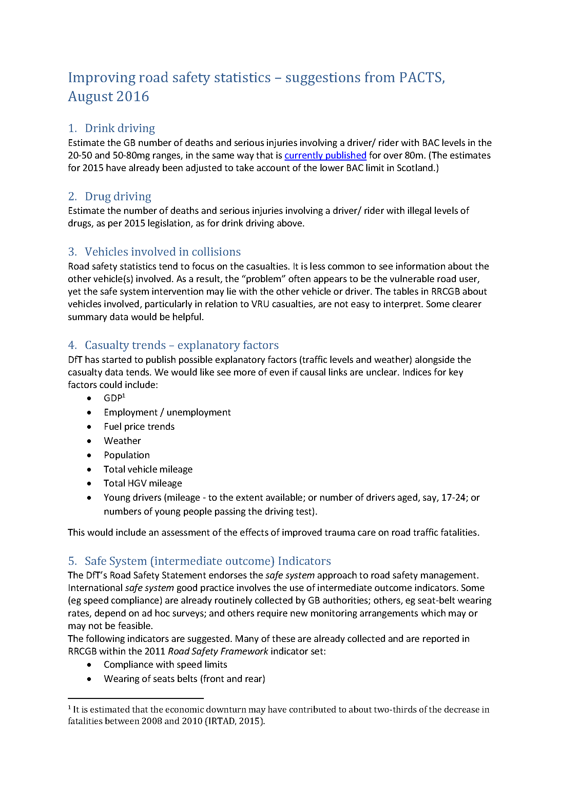

Listen to your users

Slide 35
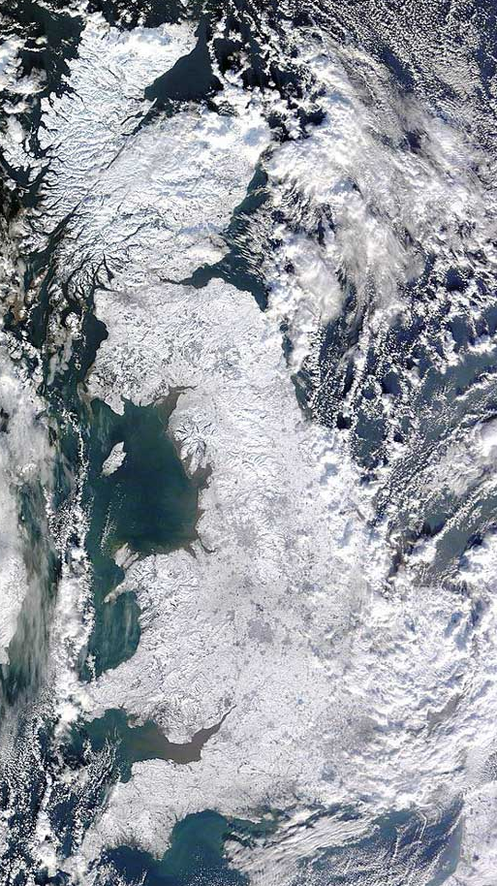
How does the weather affect road casualties?
Fatalities in reported road accidents: GB, 2005-2014
Notes:
A large decrease in road deaths in Great Britain between 2009 and 2010 followed by an increase in 2011, took many by surprise.
It was later recognised that significant and extended snowfall throughout Britain at the start and end of 2010 was likely to have suppressed the number of users on the roads leading to a reduction in traffic, accidents and casualties in these periods.
This was not picked up at the time of publishing the 2010 figures, but we have made an effort to explain the likely weather effects since.

Slide 36
Direction of the estimated temperature and precipitation effects on road casualties by severity and road user type
Above average temperature in Jan leads to more cyclist/motorcyclist fatalities
Below average precipitation in Sep leads to fewer motorcyclist fatalities
Notes:
Produced one of these models for each casualty severity and road user type.
The table shows the direction of the estimated temperature and precipitation effects – up arrows (above average temperature or precipitation leads to more casualties), down arrows (above average temperature or precipitation leads to less casualties).
These estimated effects were used to produce the weather-adjusted road casualty series in the next slide.

Slide 37
Weather-adjusted series
Actual and weather-adjusted fatalities in reported road accidents: GB, 2010-2014
Notes:
With support from the ONS time series branch a statistical model including monthly road casualty data and Met Office data was developed to produce a weather-adjusted fatalities series. Weather-adjusted road casualty series enables changes that are the result of weather to be removed from the series - this enables us to examine changes that are due to other factors such as road safety interventions and behavioural change.
This series represents the number of road deaths we would have expected in each year had the weather been average.
2010 – colder temperatures in 2010 led to fewer road deaths than we would expect so adjusted upwards whereas 2011 was warmer leading to more road deaths than we would expect.
If weather conditions had been average then we would not have seen an increase in road deaths between 2010 and 2011, but very similar numbers.
We’ve had good feedback from our users on this weather-adjusted series who think that it has improved their understanding and interpretation of the statistics.
We’re also part of an international group looking into how the weather effects road casualties and have shared our methodology with the different countries sitting on this group.

Slide 38
Publication – articles, conferences, international reports
Notes:
Made a lot of effort to publicise our work including getting an article in the RSS significance magazine.

Slide 39
Statistical significance – do changes mean anything?
Lots of things change over time
But how should users interpret these changes?
How meaningful are like with like comparisons?
But…these are complete counts, so surely all changes are statistically significant?
Not really – road collisions, accidents and casualties have a random element (although they have usually been caused by behaviours)
Therefore it is important to represent the randomness

Slide 40
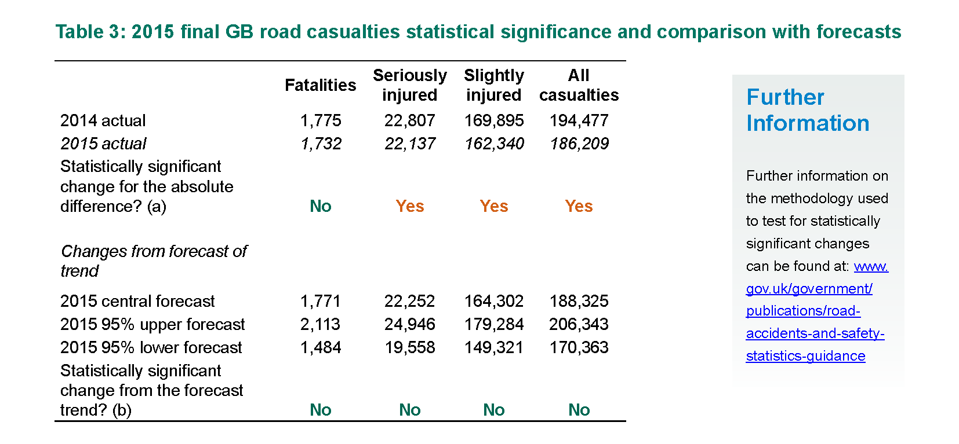
Statistical significance – what do we provide?

Slide 41
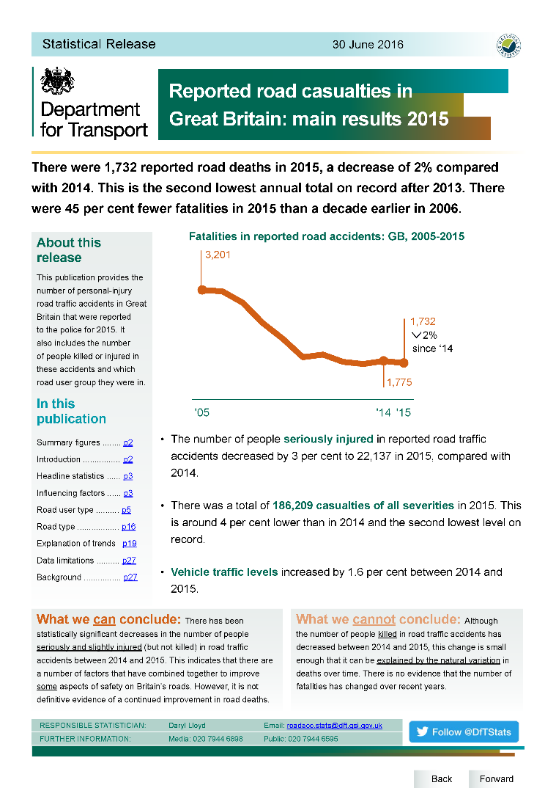
Make sure that the take-home message is clear and upfront

Slide 42
Rules
Rule 1: Make it look interesting and engaging
Rule 2: Listen to what your users are interested in and answer the questions they have
Rule 3: Explain WHY patterns exist and what that means to users
Rule 4: Give clear and simple explanations about technical aspects – uncertainty is particularly important

Slide 43
Credits
Leads for publication templates in Transport Statistics
Leads for visualisation and infographics in Transport Statistics
David Mais (DfT) and Jenny Davies (ONS) for the weather modelling work
David Mais and Alice Marshall for creating the road safety publication layouts, charts and infographics (and Alice for improving the DFID SID publication format)
Ministry of Justice Data Lab for the “what we can / cannot say” boxes (as highlighted by Full Fact)

Slide 44
Rules
Rule 1: Make it look interesting and engaging
Rule 2: Listen to what your users are interested in and answer the questions they have
Rule 3: Explain WHY patterns exist and what that means to users
Rule 4: Give clear and simple explanations about technical aspects – uncertainty is particularly important
Rule 5: If you see someone using a good technique / explanation / presentation STEAL IT!

Slide 45
Questions?
Contacts:
  Daryl Lloyd – daryl-lloyd@dfid.gov.uk
  David Mais – david.mais@dft.gsi.gov.uk
  Neither Daryl nor David work on road safety any longer, but you can get the team on:
  roadacc.stats@dft.gsi.gov.uk

