Slide 1
Innovation and Development in Official Statistics: communicating for users
#DigitalDay
Michael Hardie,
Office for National Statistics

Slide 2
Overview
What was ‘Digital Day’?
What did we do?
Feedback and engagement with users
What did we learn?
What did we do next?

Slide 3
What was ‘Digital Day’ ?
Routine publication of Internet Access Households and Individuals statistical bulletin - 7 Aug 2014
Conclusion of work on monitoring e-commerce, in response to EU Task Force chaired by Lord Young of Graffham
Supported by new products and activities to engage with users in innovative ways to paint a detailed picture of the changing use of digital technology

Slide 4
User personas
Extensive user research by ONS identified 3 types of users:
Expert Analysts need reliable, high quality data, usually in spreadsheet format.
Information Foragers want high level summaries, narratives and charts to keep up with the latest economic and population data.
Inquiring Citizens want simply-worded, visually engaging summaries, charts and infographics. They engage with social media and browse the ONS site on a smartphone or tablet.
Digital Day aimed to meet the needs of all 3 user groups, with particular focus on inquiring citizens as potential new users of our data

Slide 5
What did we do?
Published 4 releases
Internet Access Households and Individuals statistical bulletin 2014
Short story on Digital Economy
Monitoring e-commerce – an explanatory paper proposing a set of indicators to monitor e-commerce, with a dashboard and interactive graphic
E-commerce: Measuring, Monitoring and Gross Domestic Product

Slide 6
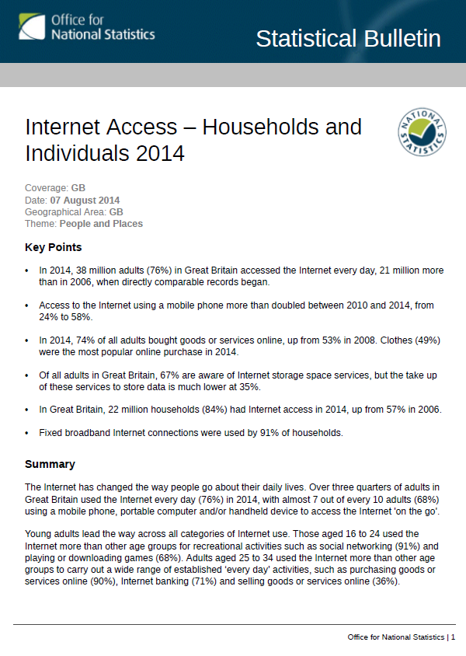
Statistical bulletin
Regular annual release
Presents the latest statistics on the public’s use of the Internet, including:
the percentage of the adult population who use the Internet daily
the types of purchases made online
their awareness of Internet storage services
Wide range of users

Slide 7
Digital economy short story
Setting the scene for Digital Day with headline messages from the 3 releases

Slide 8
Monitoring e-commerce
ONS paper recommended monitoring e-commerce through the following approaches:
Indicator set
Dashboard
Interactive graphic

Slide 9
Indicator set
Key performance indicators
headline figures on e-commerce performance (monetary value of sales and proportion of turnover)
Business engagement
businesses activity associated with e-commerce (differences by size of business, industry, access to websites, broadband etc.)
Engagement by households and individuals
activity associated with e-commerce (including adoption of mobile devices and engagement with social media)

Slide 10
Dashboard
Dashboard outlining key indicators for e-commerce
Innovative way of displaying large amounts of data in a digestible format for users

Slide 11
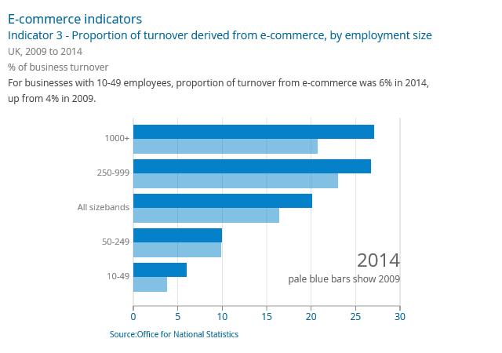
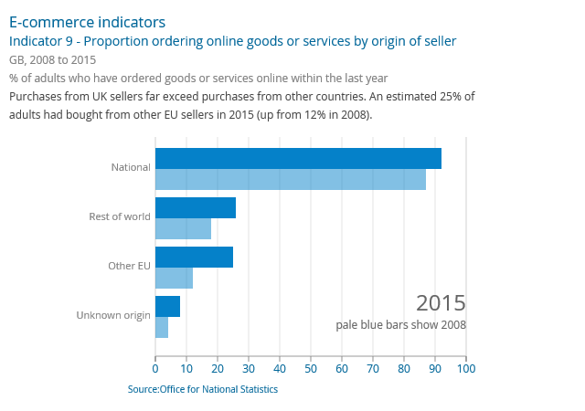
Interactive indicators

Slide 12
E-commerce: measuring, monitoring and gross domestic product
Technical paper looked at official sources of e-commerce data, estimates produced from these sources, and e-commerce from a measuring Gross Domestic Product (GDP) perspective.
Aimed to fulfil the needs of expert analyst users

Slide 13
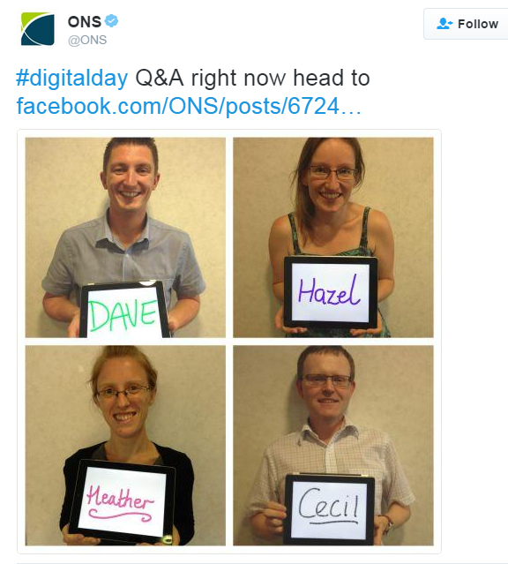
What else did we do?
Facebook Q&A held with 71 users signed up to take part, receiving approx 1000 views
Tweets with infographics released at intervals throughout the day
Launched “Consultation on Measuring the Digital Economy” which received 33 responses

Slide 14
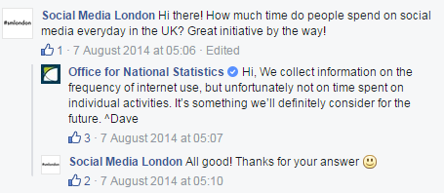
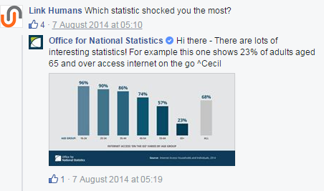
Facebook Q&A
71 users registered for the Q&A session, which received approx 1,000 views

Slide 15
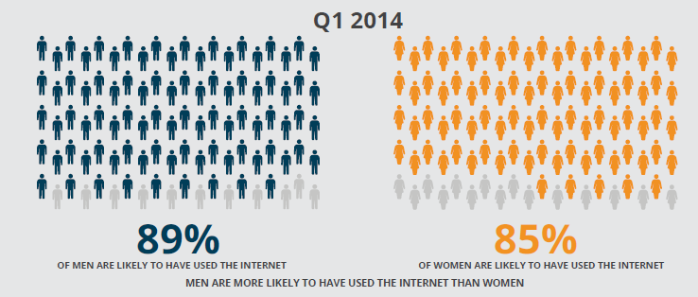
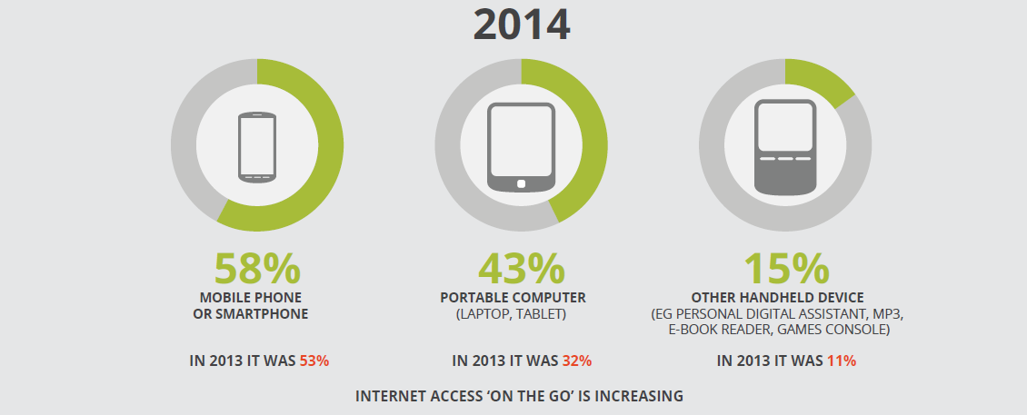
Infographics

Slide 16
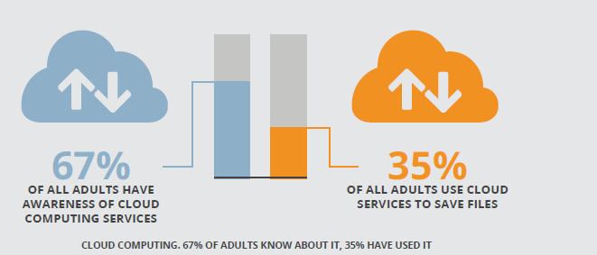
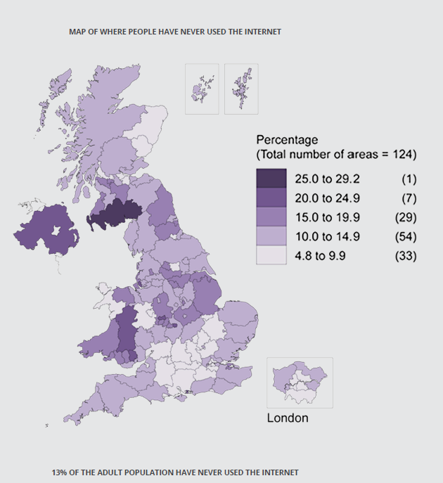
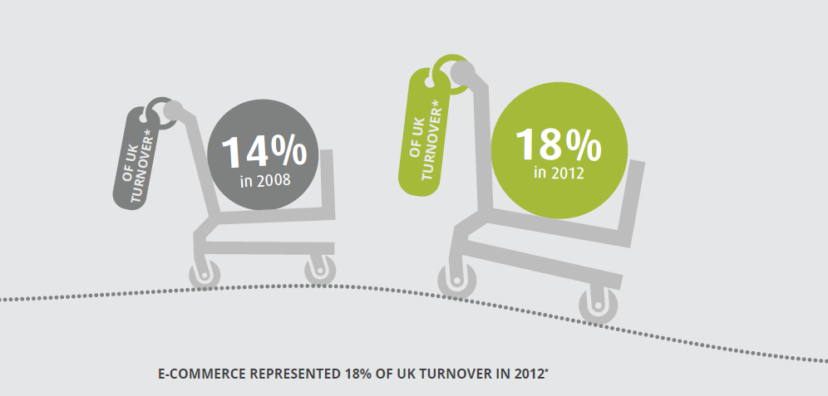
Infographics

Slide 17
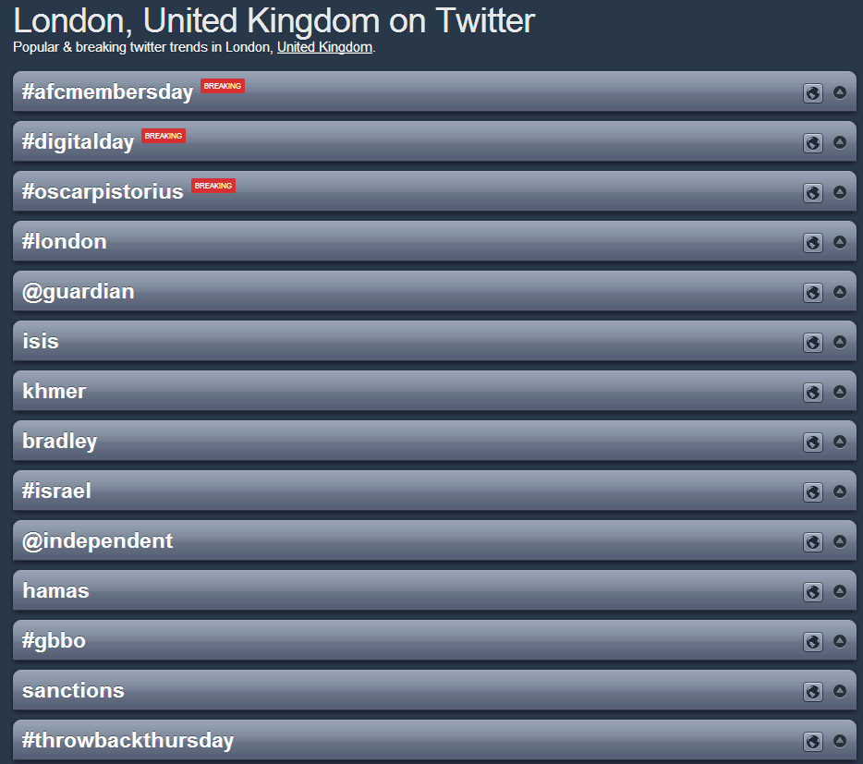
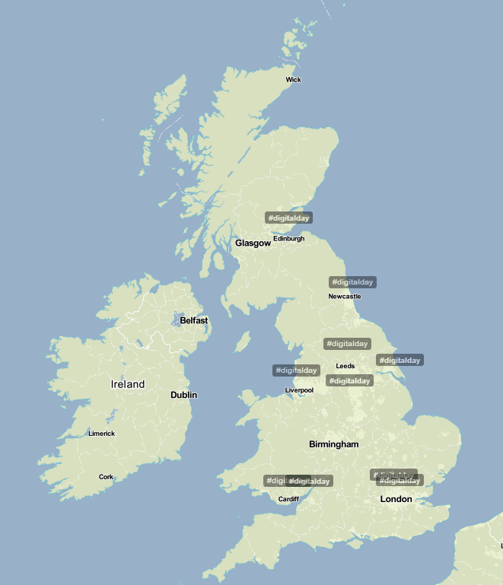
#digitalday – trending on Twitter across the UK

Slide 18
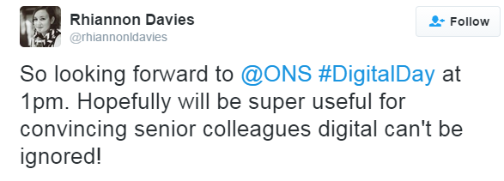
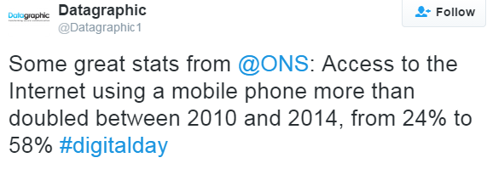
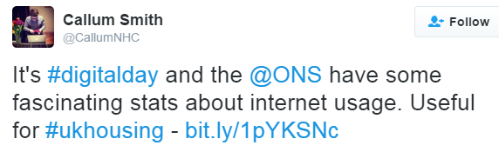
Feedback and engagement with users

Slide 19
What did we learn?
Variety of ways to communicate our statistics – no ‘one size fits all’
Being innovative and taking risks can pay off
Giving a ‘face’ to the numbers appears to increase engagement with users
Link releases to a specific day to maximise coverage
Get support from across office – experts from digital, social media, design etc

Slide 20
What did we do next?
Building on this success and consultation feedback
Introduced coverage of micro enterprises for E-commerce survey – a key user interest
Held user group which endorsed the proposed indicator set
Held e-commerce user event which helped identify further gaps in meeting user needs
Now investigating possible method for producing regional results for e-commerce survey

Slide 21
E-commerce user event
ONS and BIS hosted an event - ‘How e-commerce is changing the shape of business’
Attended by over 100 users and producers of e-commerce statistics
The day included engaging discussions about how e-commerce is changing the shape of business within the UK and internationally
Objectives of the day were to:
share what we know about e-commerce by UK businesses
raise awareness of the importance and coverage of these statistics
hear from users about the range of uses to which our statistics are put
discuss future plans and priorities with a range of users
discuss the potential future of e-commerce
Experience from Digital Day helped with promoting the event and engaging with users on social media

Slide 22
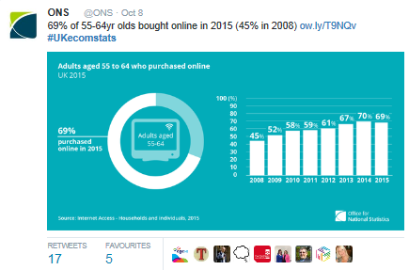
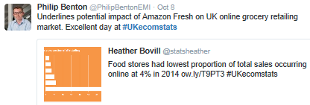
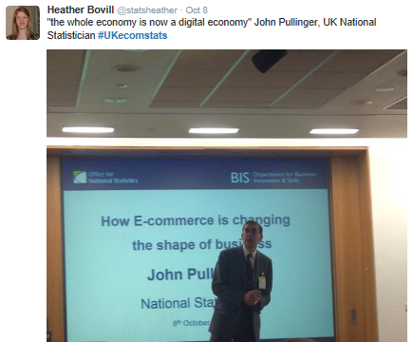
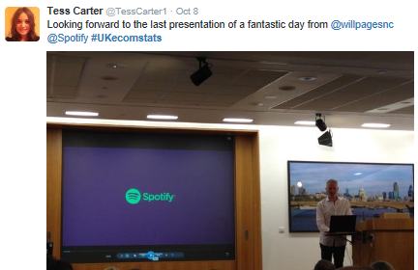
E-commerce user event

Slide 23
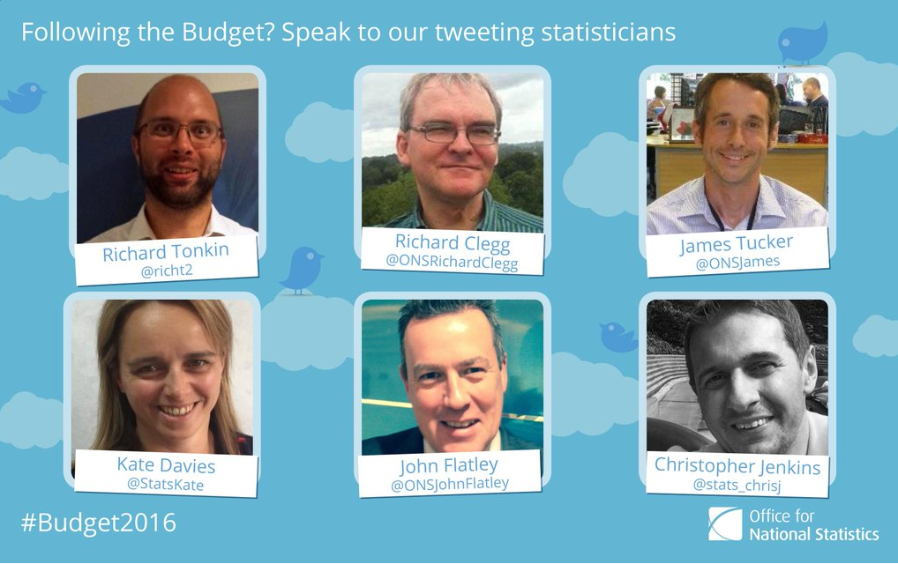
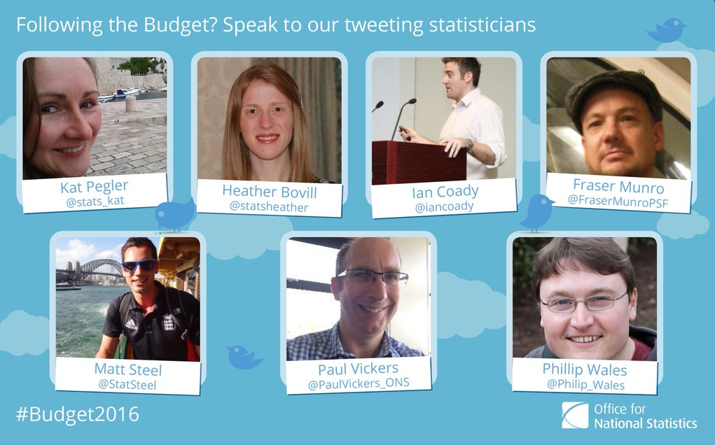
ONS initiatives
Since Digital Day, ONS has increased their social media presence
Now with over 20 ‘tweeting statisticians’ providing a face to accompany the figures

Slide 24
Any questions?
michael.hardie@ons.gsi.gov.uk

