Slide 1

English Indices of Deprivation 2015
RSS Professional Statisticians Forum, 26th April 2017
Baljit Gill, DCLG
Acknowledgements: Dr Tom Smith and Professor Michael Noble (OCSI)
www.gov.uk/government/statistics/english-indices-of-deprivation-2015
Indices.deprivation@communities.gsi.gov.uk
Notes:
The Department for Communities and Local Government (DCLG) published the Indices of Deprivation 2015 in September 2015
The work was conducted by Oxford Consultants for Social Inclusion (OCSI)
NatCen Social Research input to the user engagement for the update, working with OCSI

Slide 2
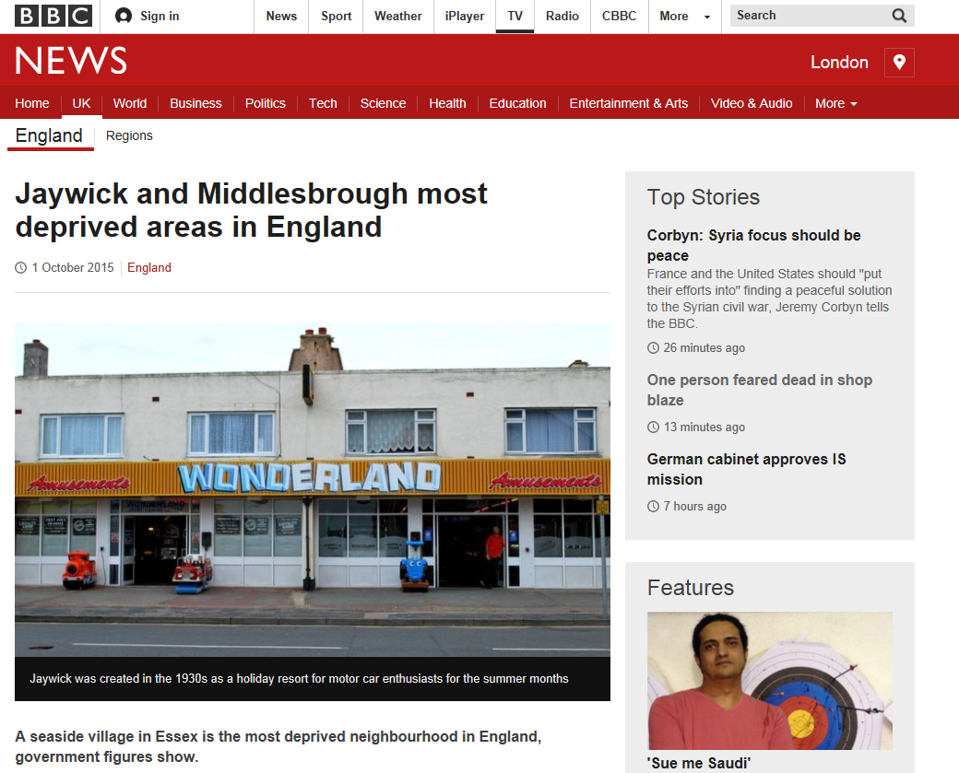
What I’ll cover
What I’ll cover:
Intro to the Indices
Quality and QA
User engagement
Clear communication

Slide 3
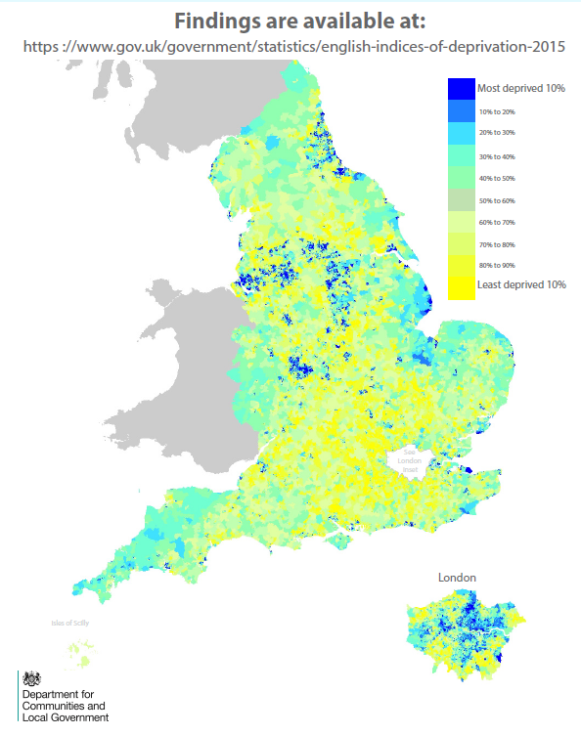
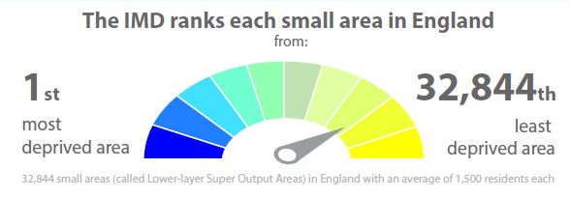
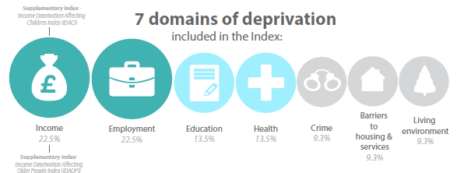
The Index of Multiple Deprivation measures relative deprivation at neighbourhood level
Notes:
Examples of uses:
(Area-based) targeting
for funding/interventions
Evidence for policies and strategies eg JSNA
Funding bids
Tracking deprived areas
Assessing inequalities (eg Slope Index of Inequality in PHOF)
Why people like it
“Authoritative, independent, Government-endorsed”
Accessible; decisions are open to scrutiny
Speedy, efficient allocation

Slide 4
Domains and indicators
Criteria for inclusion of indicators
Measures major features of that deprivation
Up-to-date, and can be updated
Statistically robust at LSOA level, consistent across England

Slide 5
Overview of the methodology used to construct the Indices of Deprivation 2015

Slide 6
Remit: Review and update of the Indices of Deprivation 2010
Review the
ID 2010 indicators / potential changes to the basket in each domain
Assess the current data landscape, changes to previous sources, new sources
Review whether the statistical methods are still justified, assess alternatives
Produce the updated Indices of Deprivation 2015
DCLG’s ambitions:
Publish the most accessible Indices to date
Better informed users: reduce queries
Address some users’ quality concerns
User engagement as part of the update process: understand needs, consult
National Statistics status
DCLG commissioned Oxford Consultants for Social Inclusion (OCSI), with NatCen
Notes:
The Department for Communities and Local Government commissioned Oxford
Consultants for Social Inclusion (OCSI) to review and update the English Indices of
Deprivation 2010.
• review the indicators included in the Indices of Deprivation 2010 to determine if
they remain fit for purpose, and where there is a clear rationale for doing so,
identify potential changes to the basket of indicators in each domain;
• assess the current data landscape, identify changes to (or outdatedness of)
previously used sources, as well as any new sources;
• review whether the statistical methods used in the production of the Indices of
Deprivation 2010 are still justified and assess if alternative methods are
available and the strengths and weaknesses of any such alternatives;
• produce the updated Indices of Deprivation 2015.

Slide 7
Ensuring and communicating the reliability of the Indices
(See Technical Report ch 5 and appendices)
Putting things in perspective: communicating how the design the of the Indices methodology ensures quality
    Diversity of indicators
    Appropriate and robust indicators, based on well understood data sources
      1st : Existing high quality open data sources of National Statistics quality
      2nd: Established and well-understood administrative data sources
      3rd: Modelled estimates derived for the Indices developed and quality assured by leading experts
    Estimation techniques to improve reliability of small area data
    Effect of ranking domain scores (for standardisation)
    Exponential transformations: domains don’t completely cancel each other
    Lower weight to domains with modelled indicators
Proportionate QA: Setting the level of QA in proportion to the risk and public interest in the outputs: Administrative Data Quality Assurance Toolkit
Quality Assurance steps

Slide 8
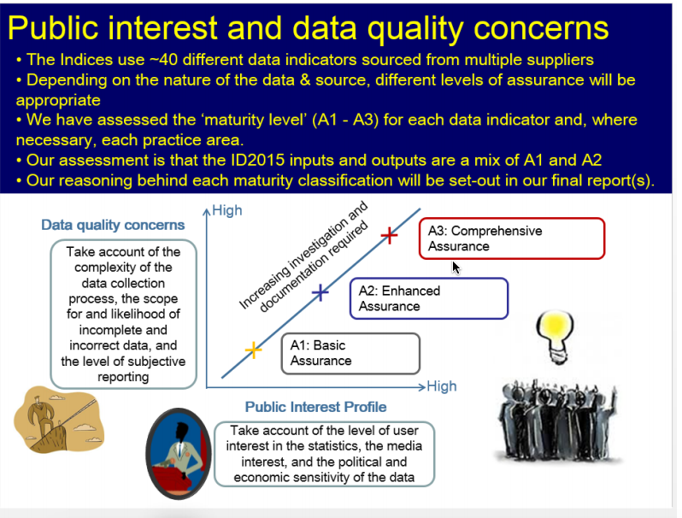
Setting the level of quality assurance using the Administrative Data Quality Assurance toolkit
IMD
Low risk of quality concerns
Medium public interest
Domains
Low risk of quality concerns
Lower/medium public interest
Input Indicators
Low to medium quality concerns
Lower public interest
Enhanced assurance
IMD
Specific datasets:
  crime domain,
  acute morbidity,
  housing affordability

Slide 9
Quality Assurance steps
  Appropriate and robust indicators, based on well understood data sources
Minimise impact of potential bias and error in input data
Views of data users
Audited, replicable and validated processing steps to construct the indicators, domains and IMD
Real world validation of the data inputs and outputs
Internal and external QA checks
Additional enhanced assurance of specific data sources
Roles and responsibilities of the research team and data suppliers

Slide 10

User engagement and what we learned
User Survey
Scoping stage
(248 responses)
User Events
Pre/early consultation stage
(150 attendees, 3 events)
Government Consultation
(100 responses)
What the data is used for, how it is accessed and how well it is understood
Ideas for updating and strengthening the Indices
Broad support for methods and potential new indicators + some suggestions
Majority surveyed find indices easy to use (90%) and easy to interpret (83%)
Most use LSOA (94%) and LA level data (78%)
But they need
  non-technical guidance and summaries
  spreadsheets and underlying data
  information on tools and resources
  advice on using data, especially:
    changes over time
    aggregating geographies
Notes:
What works well
Embedding engagement into development work (within a contract) combines expertise and brings meaningful engagement at pace
Surveys allow more open and inclusive user engagement in the early stages of development – rather than wait for formal consultation stage
Helps to have a good user email list
One survey can pitch to general and very technical audience
You can present a technical paper within it and invite ideas
Nice to be able to quantify eg the majority find Indices easy to use (90%)
Formal consultation is important; gives balance but options offered are limited
Face to face is invaluable:
People hear about/discuss upcoming consultation
producers are more available to users, and should get out of London
understand the issues users face, gives colour to survey and consultation
gives good grasp of how to improve outputs eg make more accessible, clear, easy to use. Could test examples.
Could understand appetite for future development and priorities – more blue skies
What works less well
Examples of uses help make the case - including £ involved – but the strongest examples can come from stakeholder engagement, rather than a survey
But tended to be hearing from those who already use the indices, and need to make bespoke efforts to reacy specific groups eg academics

Slide 11
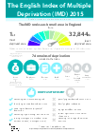
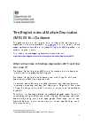
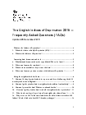
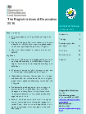
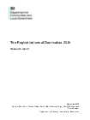


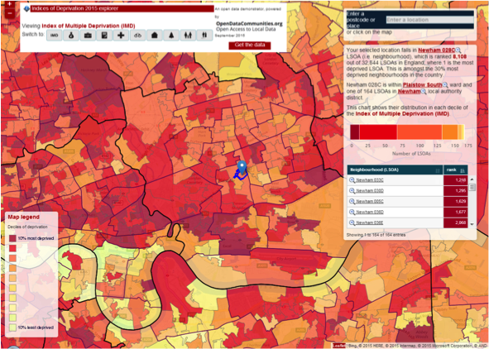
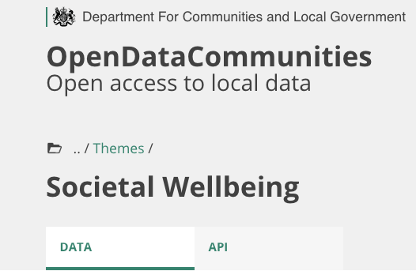
Clear communication
Research/Technical reports
Infographic
Guidance
FAQs
Stats Release
Lay user Expert
Explorer
Data in xls csv
Open (linked) data
Underlying data

Slide 12
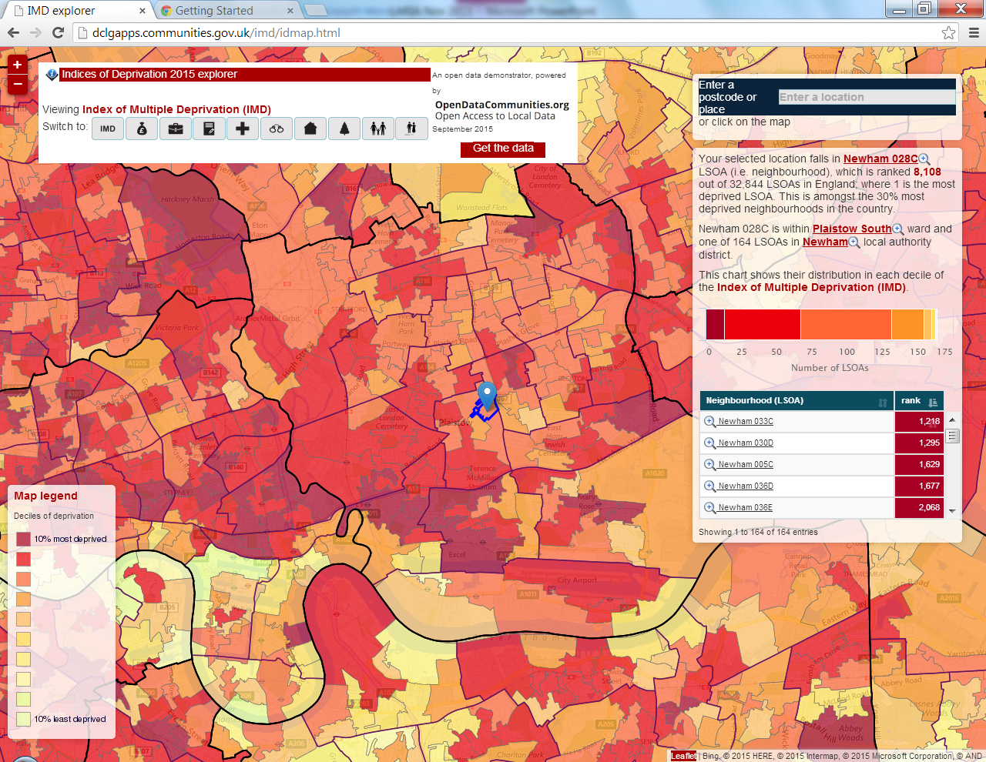
Indices of Deprivation Explorer http://dclgapps.communities.gov.uk/imd/idmap.html

Slide 13
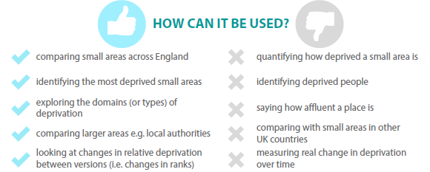
How can the Indices be used?

Slide 14
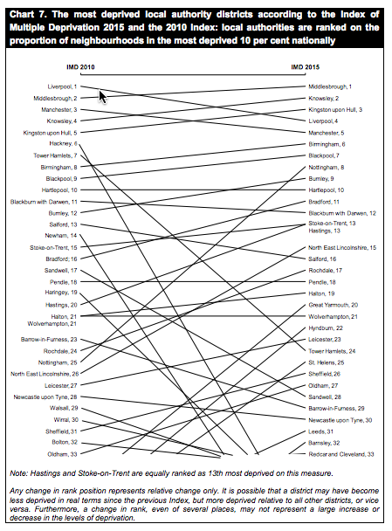
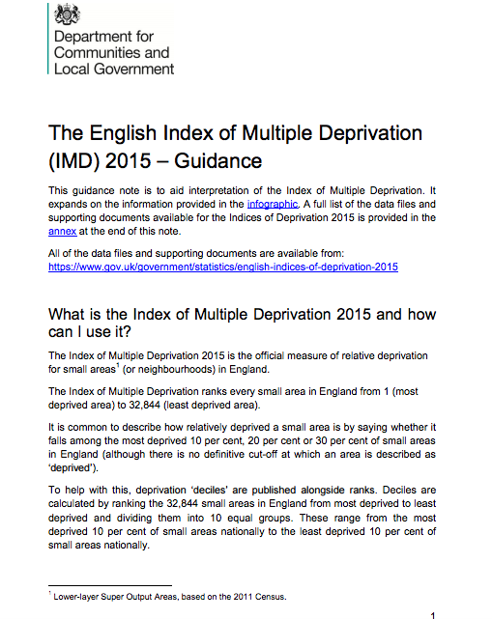
Taking the lead: explaining ‘change over time’

Slide 15
Links and register to receive updates
English Indices of Deprivation 2015 published September 2015 https://www.gov.uk/government/statistics/english-indices-of-deprivation-2015
    (See FAQs for links to mapping tools/resources)
More about the Indices including previous versions https://www.gov.uk/government/collections/english-indices-of-deprivation
Register to receive alerts, email ‘subscribe’ to indices.deprivation@communities.gsi.gov.uk
Queries and feedback: indices.deprivation@communities.gsi.gov.uk

