Slide 1
Development of Welsh Index of Multiple Deprivation (WIMD) 2014 statistical outputs
Luned Jones
Knowledge and Analytical Services
Welsh Government
20 April 2016
Stats.inclusion@wales.gsi.gov.uk
Notes:
1

Slide 2
Outline
Brief overview
What is WIMD
Uses of WIMD
WIMD Products
New WIMD Interactive Tool
Recent work and future plans
Lessons learned

Slide 3
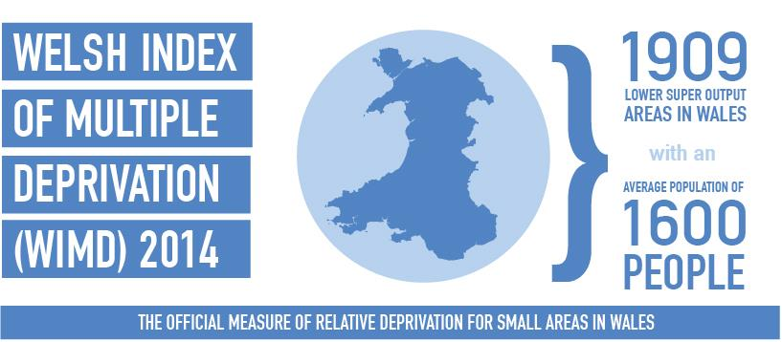
What is WIMD?
Notes:
What is WIMD?
WIMD - The Welsh Index of Multiple Deprivation - is the Welsh Government’s official measure of relative multiple deprivation for small areas in Wales. It is designed to identify those small areas where there are the highest concentrations of several types of deprivation. Deprivation is the lack of access to opportunities and resources which we might expect in our society.
it does this by ranking small areas according to their relative deprivation levels across 8 ‘types of deprivation’ (which I’ll come back to on next slide) or domains of deprivation to produce an overall index.
WIMD 2014 was published in November 2014 – culmination of around a three year program of work.
There were 1909 LSOAs in Wales, with an average population of 1600 people.

Slide 4
Indicators - Overview
Income-Related Benefit Claimants
Employment and Support Allowance
Tax Credit Recipients
Supported Asylum Seekers
Job Seekers Allowance
Central Heating
Housing
Income
Employment
Incapacity Benefit
Overcrowding
Flooding
Death Rate
Cancer Rate
Air Quality
Air Emissions
Physical Environment
WIMD
Overall Index
Health
Long Term Limiting Illness
Proximity to Waste Disposal Sites
Low Weight Births
Petrol Stations
Leisure Centres
Adults with No Qualifications
18-19 Year Olds Not Entering Higher Education
Criminal Damage
Theft
Burglary
Community Safety
Schools
Access to Services
Libraries
Education
KS4 Level 2 Inclusive
GP Surgeries
KS2 Average Points
Anti-Social Behaviour
Violent Crime
Fires
Pharmacies
Repeat Absenteeism
KS4 Capped Points
Post Offices
Food Shops
Notes:
Not going to talk through slide in detail, but it gives you a flavour of what’s included in the index.
8 domains……
And then within each of the domains are a number of indicators…….. Eg education…….

Slide 5
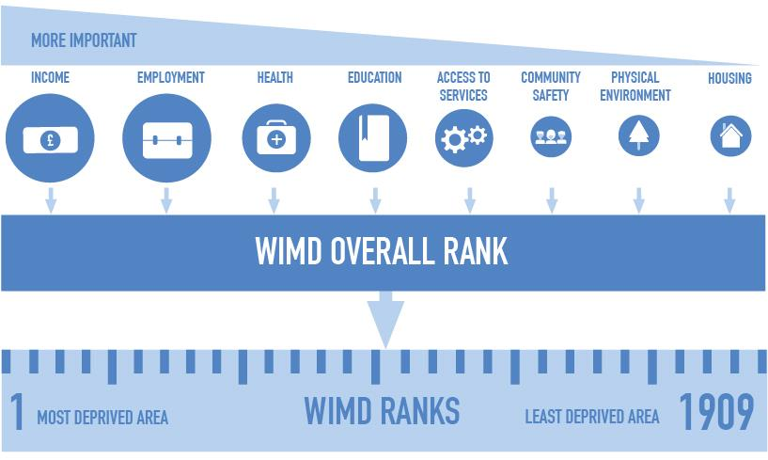
How the index is calculated
Notes:
The Index is produced as a set of ranks, with a rank of 1 assigned to the most deprived small area.
The Index is constructed from a weighted sum of the deprivation score for each domain. The weights reflect the importance of the domain as an aspect of deprivation, and the quality of the indicators available for that domain.
the income and the employment domains are given a weight of 23.5% each………
As you will be aware, ranks are a relative system of measurement; we can know which areas are more (or less) deprived than others, but not by how much. This was one of the key messages to communicate during publication.

Slide 6
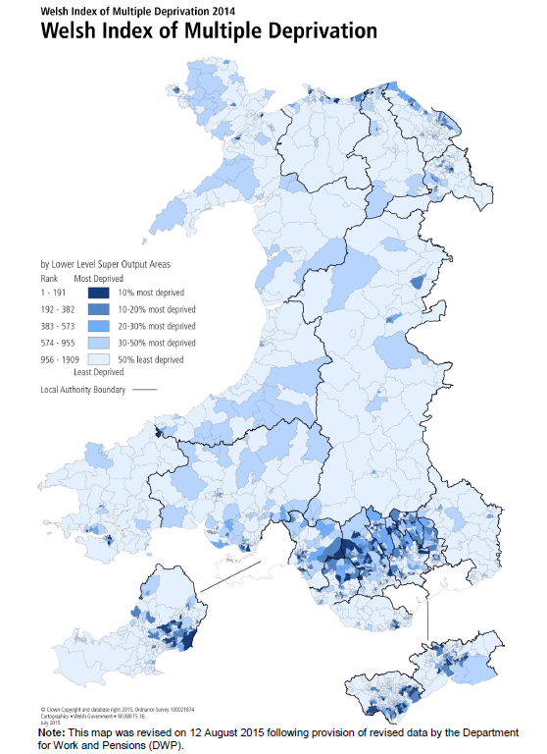
Deprivation Map
Notes:
This is an excerpt from the main WIMD report – a map showing deprivation levels across Wales.
In some ways the main product of WIMD
Largely similar picture to WIMD 2011
Pockets of deprivation highlighted in South Wales Valleys and large cities, North Wales coastal and border towns

Slide 7
Why do we create an Index of Multiple Deprivation ?
Tackling poverty - key Welsh Government objective
A number of policies support this aim
Communities First
Flying Start
LIFT programme
Tackling Poverty Action Plan and Child Poverty Strategy
But it is a cross-cutting agenda with many areas of policy across the Welsh Government feeding into this key aim
Notes:
Why do we need an Index of Deprivation?
……….
Communities First is our community focussed tackling poverty programme. The programme provides funding for Lead Delivery Bodies within local authority areas known as Communities First Clusters to narrow the economic, education/skills and health gaps between our most deprived and more affluent areas.
Flying Start is part of our early years programme for families with children under 4 years of age living in disadvantaged areas of Wales. ……..
Other areas of policy – mitigating the impact of welfare reform; prevention of homelessness; affordable homes; Regeneration (Vibrant and Viable places)

Slide 8
How is WIMD used?
Welsh Government
Development and monitoring of the Communities First programme
Calculation of school families
Underlying data used in identifying areas in which to put Flying Start services
Used extensively to measure health inequalities
Used by Wales European Funding Office to assess project applications
Local Government
Housing renewal initiatives
Local/Area profiles
Funding bids
Needs assessments
WLGA and health improvement work
Academia, Third sector, health organisations, other public services (e.g. police and fire services) etc.
Notes:
These are a few of the MAIN uses of previous indexes of WIMD.
Examples of the use of WIMD within the Welsh Government:
Development and monitoring of the Communities First programme;
The underlying indicator data has been used in identifying areas in which to put
Flying Start services;
Widely used by a wide range of organisations.

Slide 9
Governance
Steering Group
Advisory Group
Dissemination Group
Domain Groups
Notes:
7 domain groups – included WG analysts, academic, other analysts as relevant eg Education – analyst from local authority, analyst from ESTYN, academic from Cardiff University
Responsible for making technical recommendations – indicators to be included.
Dissemination group – main focus on dissemination and communication eg publication products, importance of guidance materials etc
Advisory group – advise the steering group – mostly external users
Steering group – main decision making body (internal to Welsh Government)

Slide 10
Major Programme to update WIMD and improve statistical outputs; to end 2014
Pre phase 1 – The conceptual review (finalised in March 2013)
Phase 1 – Review Domains and Indicators (May 2013 – October 2013)
Phase 2 – Consultation (November 2013 to February 2014)
Phase 3 – Response to Consultation (Spring 2014)
Phase 4 – Data collection and construction of WIMD 2014
(Spring 2014 to Autumn 2014)
Phase 5 – Publish WIMD 2014 – wide range of outputs (26 November 2014)
Notes:
Conceptual review – academics review concept of deprivation. Were we still measuring the right things…
Phase 1 – domain groups set-up to review existing indicators, consider new ones…… lead to proposals for the consultation
Phase 2 – public consultation on domains and indicators (webinar)
Phase 3
Phase 4
Phase 5

Slide 11
WIMD – Products

Slide 12
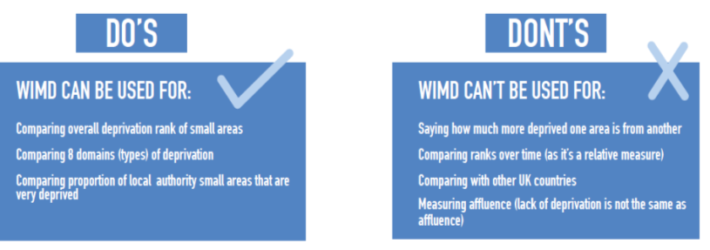
Prior to main publication
Close collaboration…. User needs integral to decisions about methodology and communication of results…..
Need for effective communication and guidance- ensuring Index used correctly.
Two weeks prior to WIMD launch, published Infographic, Guidance Document and FAQs
What does WIMD Measure?
Do’s and Dont’s
How does WIMD 2014 differ from earlier WIMDs?
Positive feedback – opportunity for users to digest guidance before main publication
Notes:
We had close collaboration with policy colleagues and users, and the needs of users were integral to decisions about methodology and communication of results
One of the key messages that we received from talking to internal and external users, and from discussions at the Dissemination group was the importance of effective communication and strong guidance. Scope for Index to be misunderstood.
Therefore, a key focus for us was publishing effective guidance documentation…..
Two weeks prior to launch, we published…..
Publicised these guidance products- opportunity for users to digest guidance before main publication. Received positive feedback.

Slide 13
Main WIMD 2014 Products
www.wales.gov.uk/wimd
Welsh Index of Multiple Deprivation 2014 - Publication
WIMD 2014 – Executive Summary
Data Sets (StatsWales)
Excel table (summary)
Deprivation in rural areas (statistical article and technical papers)
New WIMD Interactive Tool. www.wales.gov.uk/wimd/interactive
Technical Information
+ earlier guidance documentation
Communication via direct e-mails to distribution lists, website, twitter, networks, groups
Media briefing. Internal presentations for staff, various user groups,
Major conference (Spring 2015) – Tackling Poverty: From evidence to action (over 200 delegates )
Notes:
A range of different products were published:
Guidance documentation
A comprehensive publication explaining how WIMD is calculated, and summarising key results
Data tables on StatsWales
A new interactive tool that allows users to view results for a selection of areas.
A statistical article on ‘WIMD – Deprivation in Rural Areas’. This was in direct response to user feedback and consultation responses.
At a later date we also published a full technical report.
We worked hard on communication – - via direct e-mails, tweets, etc. We will come back to look at reaction at the end.
Also held a media briefing, and did presentations for internal and external users, including a major conference in Spring 2015.

Slide 14
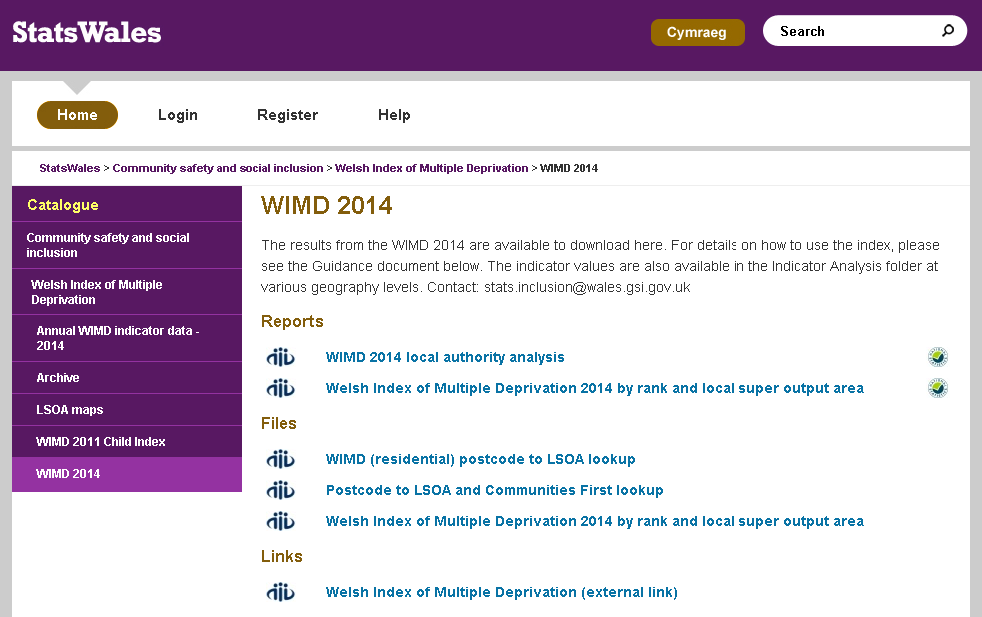
StatsWales
https://statswales.wales.gov.uk/Catalogue/Community-Safety-and-Social-Inclusion/Welsh-Index-of-Multiple-Deprivation/WIMD-2014
Notes:
This link takes us to the StatsWales portion of our website, where all the actual data from WIMD is found.
Here you can download the overall and domain ranks from WIMD, analysis at local authority level, and the raw indicator data that gets fed into the index.

Slide 15
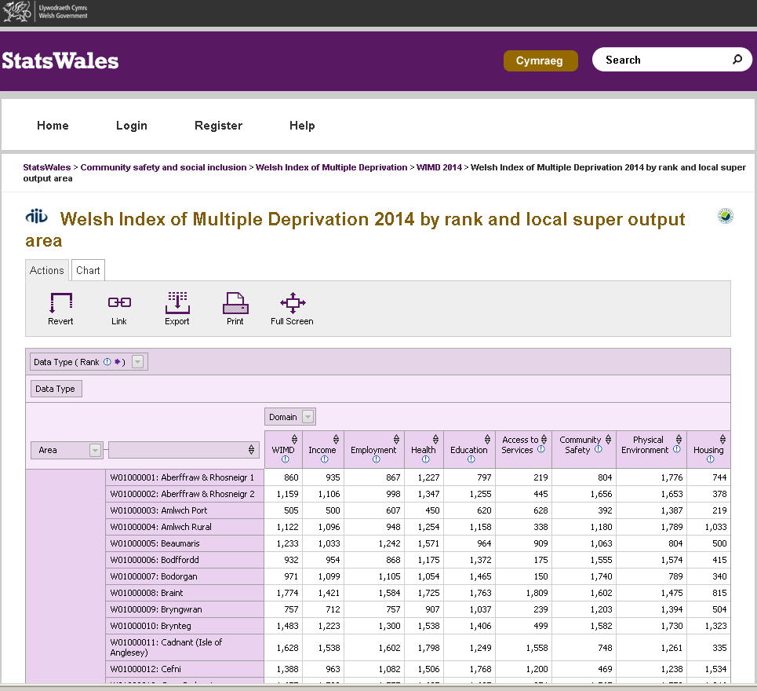
Notes:
Ranks data – can be manipulated using various dimensions. Can export.
Also publish underlying indicator data on StatsWales.

Slide 16
WIMD Interactive Tool

Slide 17
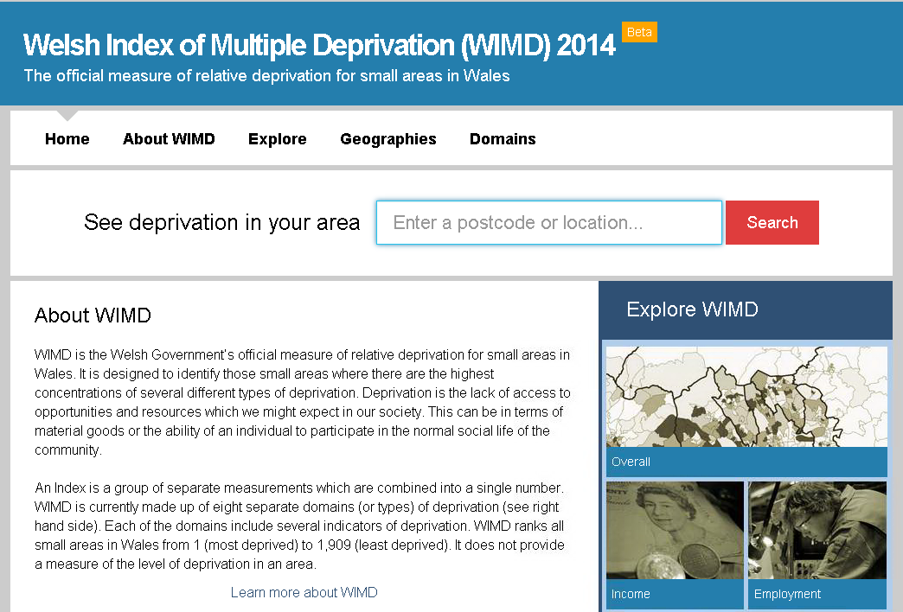
Interactive Product
CF24 0AB
http://wimd.wales.gov.uk/
Notes:
Following the link at the bottom of this screen, you’ll find this homepage.
You can simply search by postcode or (sometimes)location in this search box.

Slide 18
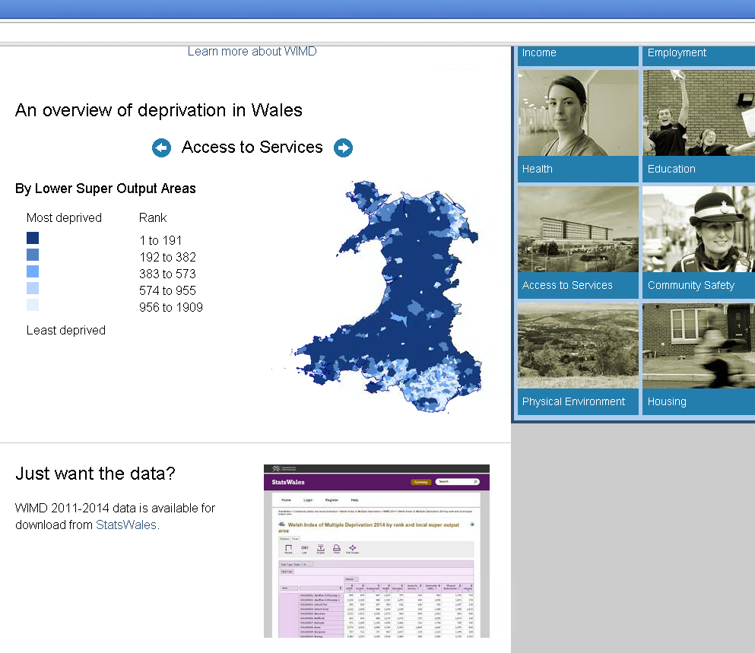
Notes:
You can also view summary maps on the home page eg deprivation map for each of the domains. Here we have A2S.

Slide 19
CF24 0AB
http://wimd.wales.gov.uk/
Notes:
You can simply search by postcode or (sometimes)location in this search box. As an example, we’ll show you the results for a postcode that’s close to our Welsh Government office buildings.
Type postcode into box.

Slide 20
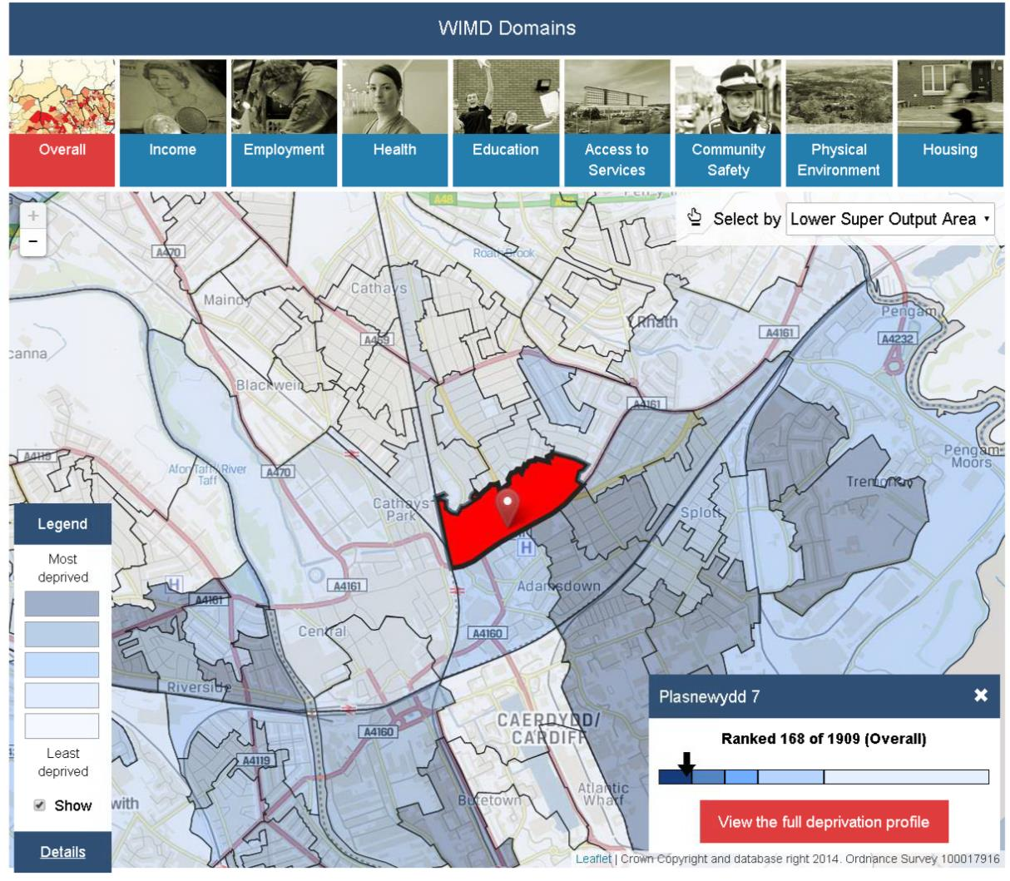
Notes:
The website places a marker in the current postcode, so that we can see which LSOA it lies in.
It turns out we’re in Plasnewydd 7, which is shown in red on the map.
In the bottom right hand corner, we can see that this LSOA is the168th most deprived in Wales, placing it in the top 10% most deprived (you will see that the arrow points towards the darker blue box which represents the most deprived 10%).
By clicking across the domain boxes at the top of the page, we can see the individual domain ranks for Plasnewydd 7 too.
We’ll now show the result of clicking that red button on the lower right (which says ‘View the full deprivation profile’).

Slide 21
Notes:
This page gives us a fuller profile for the LSOA. It gives us information on the local authority, health board, communities first area, constituency area etc. You can click on these to find results for those particular areas.
On this page we also have a barcode display. In this example, each black line represents one LSOA within the given geography – in this case Cardiff local authority. The left side represents the most deprived, and the right the least. Immediately underneath the barcode you will see 10 equal sized blue boxes – representing the deciles. Underneath these are the other groups used – most deprived 10% through to the least deprived 50%.
In our example, our LSOA (shown in red) is on the left hand side (within most deprived 10%). You will also note that many of the LSOAs in Cardiff are in the most deprived 10% of LSOAs in Wales, with many in the least deprived 10% too. This distribution is different to some of the more rural local authorities.

Slide 22
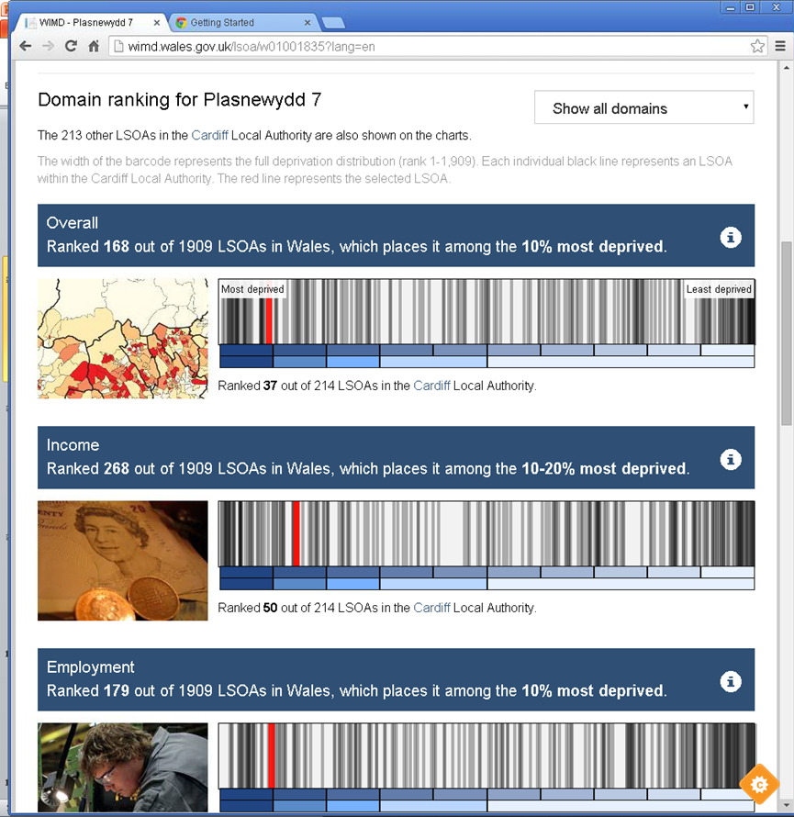
Notes:
Here we look at more bar codes for Cardiff – and for our LSOA.
In addition to the overall index – shown in the top bar code we can also look at the bar code for each domain individually. The Income and Employment domain barcodes are shown here – and are similar to the overall (which is what you would expect).

Slide 23
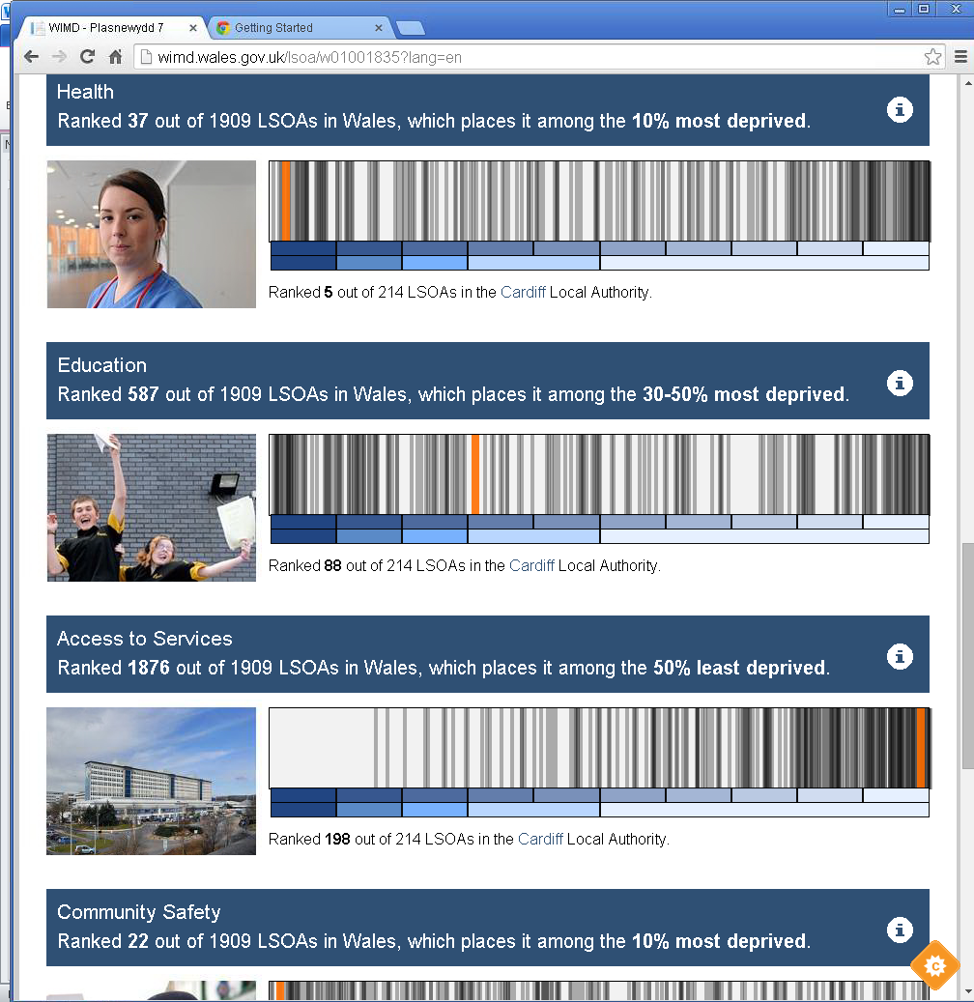
Notes:
And here are some of the others domains…….
We see that for A2S for example, our LSOA is within the least deprived 10% of LSOAs in Wales. The other LSOAs in Cardiff also tend towards the least deprived end too.
So these pages have shown us how we can consider data for one particular LSOA. This is particularly helpful for the casual user who only wants results for their LSOA, or a handful of LSOAs (and it means they can use their postcode rather than having to know their LSOA).

Slide 24
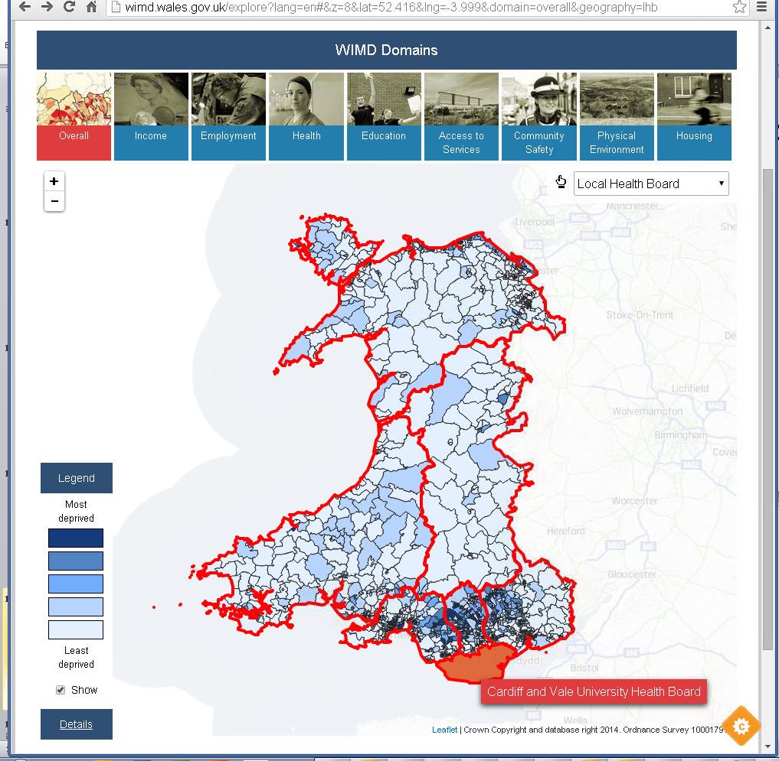
Notes:
We can also look at the deprivation maps for particular geographies….
In this example, we have overlayed the Local Health Board boundaries on top of our LSOA deprivation map.
We can select one health board area to examine in more detail. Here we are selecting the Cardiff and Vale University Health Board…..

Slide 25
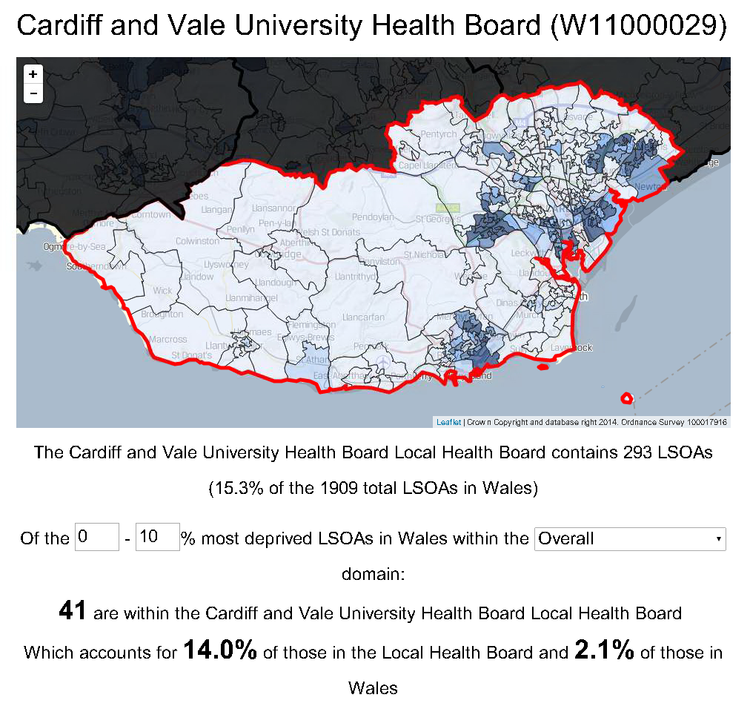
Notes:
This page provides summary information on deprivation within this geographical area. There is flexibility to change some of the parameters.

Slide 26
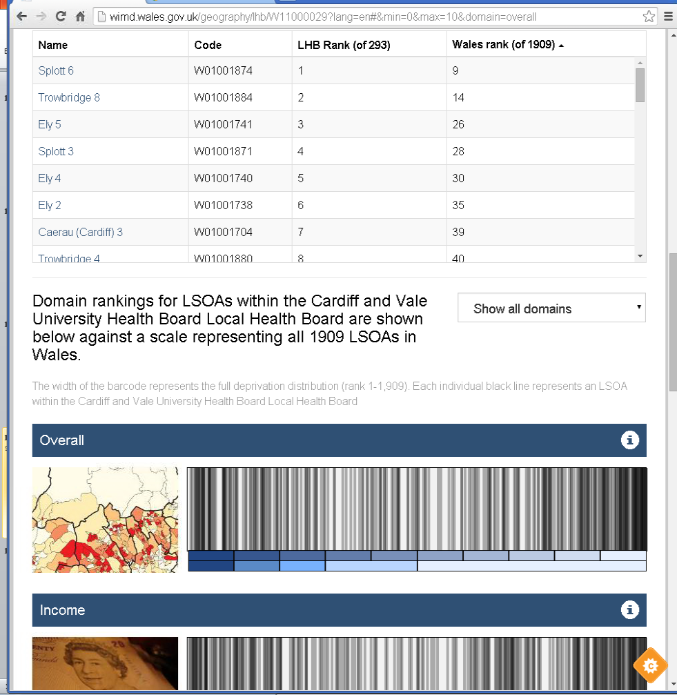
Notes:
Further down the same page, we’re also given a list of all of the LSOAs in question, so you can easily find the names or codes of, say the LSOAs within your geography that are within the most deprived 10% in Wales.
Many WIMD users are interested in the Index for their particular area – be that a local authority, community first area or health board. This tool allows this type of user to easily examine results for their area – and it presents a ready-made profile for them. (something many users will not be comfortable in doing from StatsWales data tables).

Slide 27
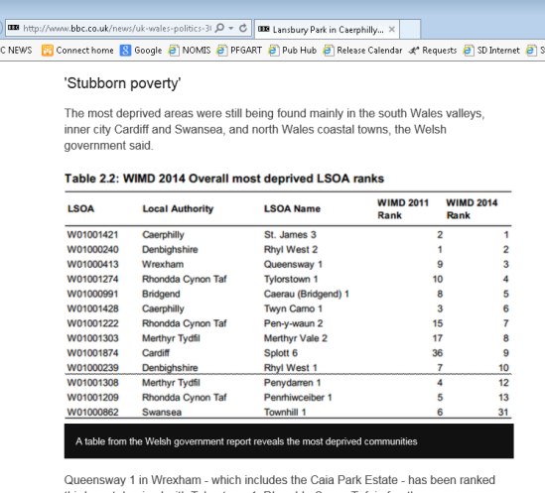
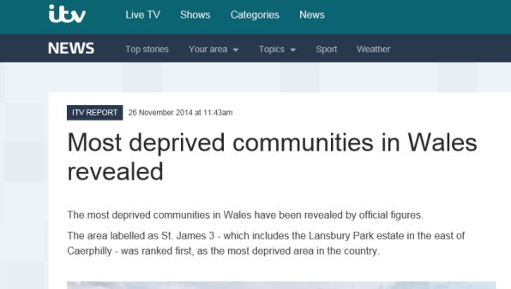
User Response & Media Coverage
Positive feedback from range of users on dissemination products
Guidance materials and technical media briefing → balanced informed media reporting (with direct use of infographic and other publication material)
Notes:
We were pleased with the response to our publication – we received positive feedback from a range of users on the guidance documentation and on the interactive tool.
On the morning of the publication, we also held a technical media briefing for a small number of journalists. We were conscious that the publication of a new index would always attract media coverage, and our aim was to ensure that the Index was properly understood.
We felt that the media briefing was worthwhile as it led to balanced and informed media briefing. We were particularly pleased to see the infographic and some other publication material used within written press stories. The BBC Wales reporting for example, made a point of emphasising the limitations of WIMD and using many of the phrases that we regularly used.

Slide 28
Further responses to publication
Over 5,000 web hits on day of publication
3 or 4 independent websites built their own app using data on first day of publication
Anti-poverty champions in LAs amongst those welcoming range of outputs including the guide on rural areas
Charity worker – “ can we have more user friendly sites like this,…… it’s a good sign when statistics become fun”
Schools ringing to say they are using it in considering the character of their local population and in classroom teaching
Church organisations using WIMD to target resources

Slide 29
Recent work and future plans
Notes:
Key results for the overall index

Slide 30
Recent Publications
Area Analysis of Child Deprivation 2014 (6 indicators)
Income (Income Domain)
Limiting Long-Term Illness (Health Domain)
Low Birth Weight (Health Domain)
Key Stage 4 Level 2 Inclusive (Education Domain)
Repeat Absenteeism (Education Domain)
Overcrowded Households (Housing Domain)
A Guide to Analysing Indicator Data
Accessing WIMD Indicator Data
Data for other UK countries
Dos and Don’ts
Example Analyses
Case Study
Analysis of the Access to Services Domain in WIMD by type of settlement
Notes:
At the end of last year, we published the “Area Analysis of Child Deprivation 2014”. This statistical article analyses 2014 indicator data for the 0 – 18 age group for the six indicators on the slide.
As well as the child article and age split StatsWales tables, we also published “A Guide to Analysing Indicator Data”.
This article gives guidance on analysing the Welsh Index of Multiple Deprivation indicator data, including a guide to what indicator data has been published, how to access it, “do's and don'ts” for analysis, and links to existing analysis. For example, indicator data can be compared over time (though care should be taken with any definitional changes), take care with changes to geography boundaries.
Oct 2015 bulletin “Analysis of the Access to Services Domain in WIMD by type of settlement”, looking at travel times used in the construction of ranks as well as the ranks themselves

Slide 31
Future Plans
No date yet for next Index
Indicator data updated annually where possible
Investigating new/improved data for next Index
Housing
Crime
Income and Employment (benefit data)
links with other 4 Nations in considering developmental areas.
Notes:
No date has yet been decided for the next update - Possibly longer than usual 3 year gap due to data developments we are hoping to happen first
Continue annual indicator update. One of our key messages to users is that the WIMD ranks provide information on relative multiple deprivation, but that the underlying indicator data should be used to analyse changes in deprivation levels over time. We will continue to publish all the underlying indicator data at various geographies. Also looking to continually improve and expand the indicator data eg addition of age splits for some indicators late 2015, planning on adding built up areas geography this year, considering other articles following on from child article.
Work on potential improvements to the next WIMD need to be started sooner rather than later, these areas have been identified as priority areas for improvement.
Housing: We acknowledge that the existing housing domain is poor. Work needs to be undertaken to asses whether improved indicators can be developed (for example can existing administrative or potential survey data be modelled to LSOA level)?
Crime: The current process for receiving and processing crime data directly from each police authority is extremely resource intensive. We need to investigate whether the data required for WIMD could be obtained directly from ONS/Home Office.
Income and Employment Data: Data used for WIMD 2014 related to the period prior to the roll-out of Universal Credits. We need a clear understanding of the impact of UC on the existing indicators, and to review whether slightly different indicators may be more appropriate.
Also a 4 nations Index of Deprivation working group – useful forum for working together and considering developmental areas.
RSS south wales group are organising an event for summer/autumn on poverty stats, and WIMD is likely to be discussed there, so maybe worth mentioning under future development / user engagement.

Slide 32
Lessons Learned
Work with key users throughout
Get feedback on what is required
Plan communication and developments ahead
Let users know what you will be publishing
Provide really clear advice on use
Presentation and dissemination important to engage users and have policy impact
Learn from others – use each others skills

Slide 33
Development of Welsh Index of Multiple Deprivation 2014 statistical outputs
Luned Jones
Knowledge and Analytical Services
Welsh Government
20 April 2016
Stats.inclusion@wales.gsi.gov.uk
Notes:
33

