Slide 1
An investigation into the two-stage meta-analytic copula modelling approach for evaluating time-to-event surrogate endpoints which comprise of one or more events of interest
Pharm Stat. 2017 Sep;16(5):322-333
Natalie Dimier and Sue Todd
University of Reading

Slide 2
Agenda
Context
Motivation for the research
Investigation
Set-up
Results
Conclusions
Remaining Questions

Slide 3
Context: Surrogate Endpoints
There is increasing need to improve efficiency in drug development
Sample size and expected trial duration driven by choice of primary endpoint
Increasing survival times of patients => higher trial costs
Public demand for quicker treatment availability
Use of surrogate endpoints has been commonly proposed to allow treatments to be developed faster and subsequently made more affordable for payers
According to section 507(e)(9) of the Federal Food, Drug, and Cosmetic Act¹
Therefore need accurate prediction of:
Individual-level surrogacy: the ability of the surrogate to predict the true outcome for a patient
Trial-level surrogacy: the ability of treatment effect on the surrogate to predict treatment effect on the true outcome
“[t]he term ‘surrogate endpoint’ means a marker, such as a laboratory measurement, radiographic image, physical sign, or other measure, that is not itself a direct measurement of clinical benefit, and:
(A) is known to predict clinical benefit and could be used to support traditional approval of a drug or biological product; or
(B) is reasonably likely to predict clinical benefit and could be used to support the accelerated approval of a drug or biological product in accordance with section 506(c).’’
1. https://www.fda.gov/Drugs/DevelopmentApprovalProcess/DevelopmentResources/ucm613636.htm

Slide 4
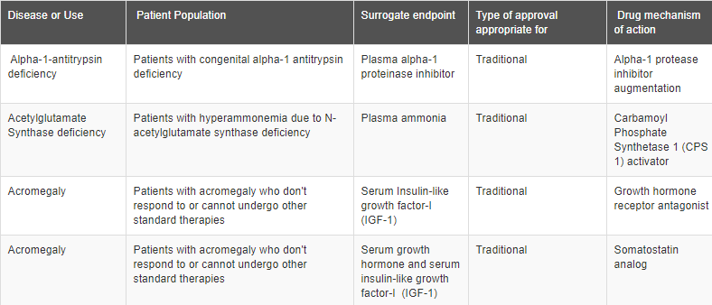
Context: Recent FDA Actions
FDA have recognised the need for surrogate endpoints and have taken recent actions to increase their use, including:
Publishing a table of all surrogate endpoints used as a basis for regulatory approval
Proposing use of Type C meetings to engage with sponsors who would like to employ a biomarker as a surrogate endpoint that has not been used previously
Hosting a workshop to develop a framework for defining evidentiary criteria for surrogate endpoints
https://www.fda.gov/Drugs/DevelopmentApprovalProcess/DevelopmentResources/ucm613636.htm

Slide 5
Context: Why Meta-Analysis?
Original methodology proposed for evaluation of potential surrogate endpoints was based on individual trials
Prentice criteria¹, proportion of treatment effect explained², relative effect³, adjusted association³
Meta-analytical approaches subsequently proposed to
Increase accuracy of the evaluation process (decrease Type II error and/or improve precision)
Assess consistency of the relationship between treatment effects on surrogate and true endpoints across different trials
Assess sensitivity of results to key factors, such as treatment class or patient population
Improve potential to extrapolate to future clinical trials
In practice, trials can vary substantially in their design => many considerations for meta-analysis:
Do patient populations need to be identical across trials?
Can a common definition of the surrogate endpoint be found?
Is it reasonable to pool
All types of treatment in the same analysis?
All patient subgroups (young/old, newly diagnosed/relapsed, different prognoses)?
Any measurement techniques for the surrogate and long-term endpoints?
Importantly, how to identify potential trials to be included?
1. Stat Med. 1989 Apr;8(4):431-40, 2. Statistics in Medicine, 11, 167—178 (1992), 3. Biometrics. 1998 Sep;54(3):1014-29

Slide 6
Context: Proposed Methodology
The work published by Dimier and Todd examined an approach proposed by Burzykowski et al. (2001)¹, which assesses surrogacy through parameters of the joint distribution of the surrogate and true endpoints (modelled using a copula function)
R²_{indiv} (τ): association between surrogate and true endpoints after adjustment for trial and treatment effects
R²_{trial}: coefficient of determination for predicting the effect of treatment on the true endpoint given the effect of treatment on the surrogate
Stage One:
Estimate treatment effects on the surrogate (S) and true (T) endpoints within each trial, and
Estimate association between S and T, adjusting for the trial and treatment effects
Stage Two:
Fit a random effects model to obtain coefficient of determination between the treatment effects estimated from Stage One
1. Applied Statistics, 50:405-422, 2001.

Slide 7
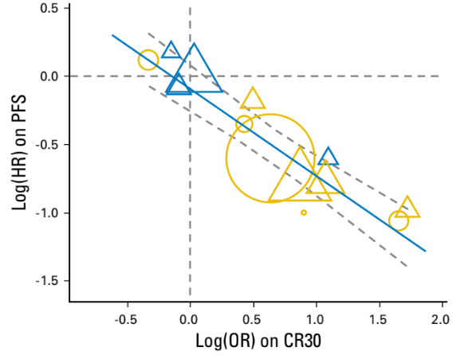
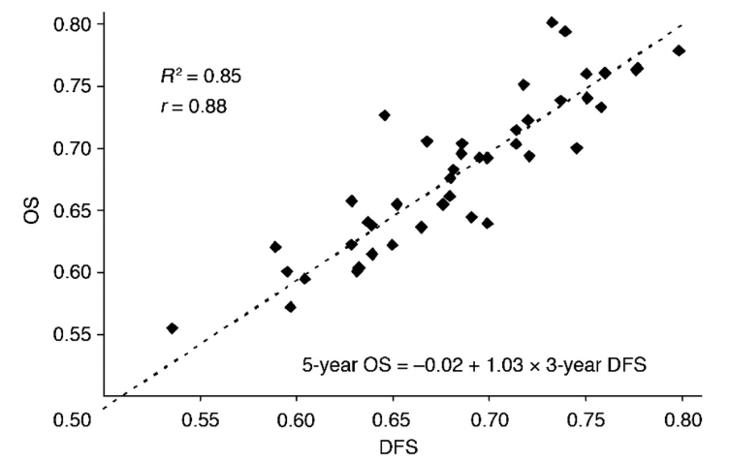
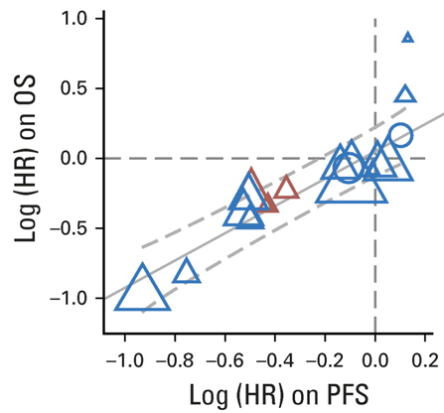
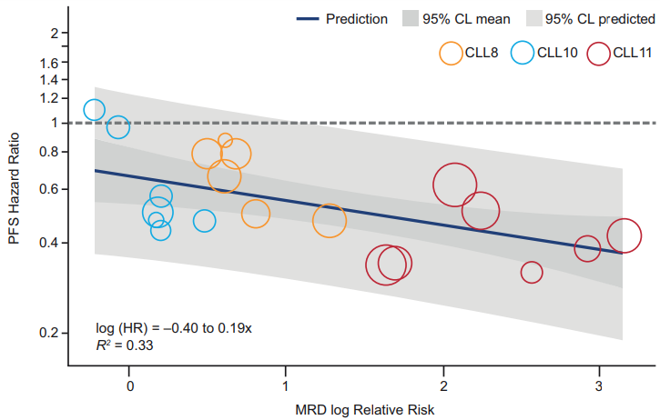
Motivation #1: Small number of trials
A sufficient number of trials are needed to reliably explore the relationship between treatment effects on surrogate and true endpoints
Extrapolation of results relies on a large amount of data, to capture differences in:
Treatment regimen
Therapeutic classes of drugs
Patient populations or subgroups
Recent successful examples have included
FLASH¹: 3,837 patients from 13 randomised trials
ACCENT² (original database): >20,000 patients from 18 trials
SEAL³: 7,507 patients from 13 randomised trials
Individually, pharmaceutical companies are unlikely to have such substantial data
Example⁴: Evaluation of Minimal Residual Disease as a surrogate for progression-free survival in Chronic Lymphocytic Leukemia using three trials
Important to understand whether the methodology performs well with small numbers of trials
1. FLASH
2. ACCENT
3. SEAL
4. MRD in CLL
J Clin Oncol. 2017 Feb 10;35(5):552-560; 2. Chin Clin Oncol. 2013 Jun; 2(2): 18; 3. J Clin Oncol. 2018 Jul 5:JCO2018779124; 4. Blood. 2018 Mar 1;131(9):955-962

Slide 8
Motivation #2: Endpoint Symmetry
Copula functions make the assumption that S and T are symmetric, i.e. that one cannot be longer than the other
Surrogate endpoints that include the true outcome as an event of interest violate this assumption
To maximise the number of events, decrease trial durations, and improve clinical relevance of results, endpoints that consider multiple events of interest are commonly used to assess clinical benefit
For example, progression-free survival (PFS), defined as time to the earliest of disease progression or death, includes information relating to overall survival
PFS commonly used as a surrogate endpoint in oncology
Many other endpoints across different diseases will suffer the same limitation
Important to understand the impact of this violation on the interpretation of surrogacy results

Slide 9
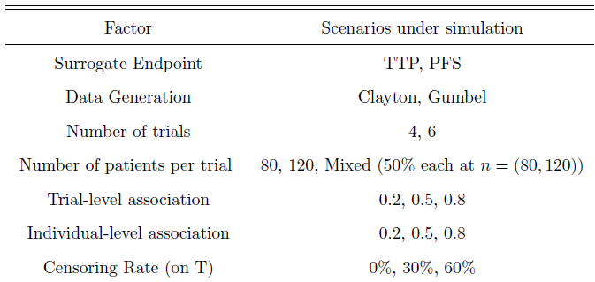
Investigation: Set-up
When using a surrogate that includes the event of interest for the true endpoint
TTP: time from randomisation to disease progression; censored at death
PFS: time from randomisation to disease progression or death; event at death
Overall Survival (OS): time from randomisation to death; true endpoint of interest
When there are a very small number of trials with very few patients
4-6 trials independently generated, each containing 80-120 patients
Under ideal conditions and under model misspecification
Use of a copula function can control the strength and shape of dependency between endpoints, but may lead to overly precise estimation of model parameters
Two different copula functions used, to evaluate the sensitivity of the estimation to different dependency structures

Slide 10
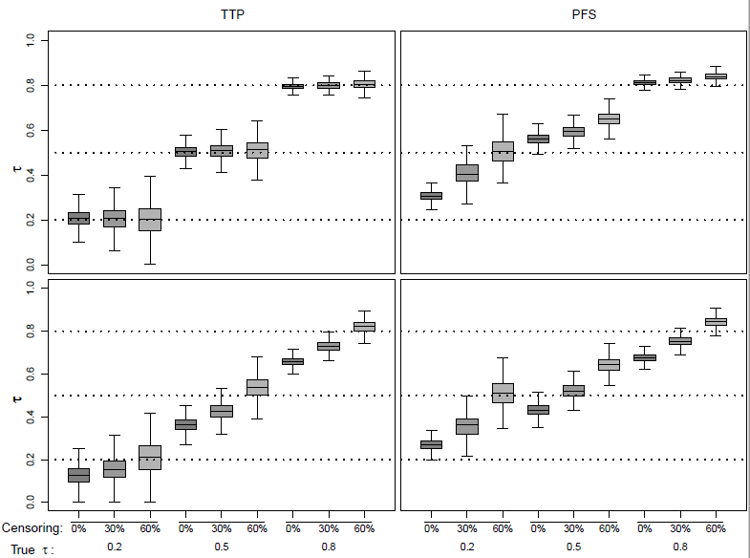
Investigation: Results (Individual-Level Surrogacy)
TTP (left hand side):
Clayton:
Low average relative bias
High variability for low‐medium levels of association, particularly under censoring
Gumbel:
Increased variability
Underestimation unless censoring is high
Truly high association estimated with low variability
PFS (right hand side):
Clayton and Gumbel:
Good estimation of truly high association
Poor estimation of low association; estimated τ as high as 0.7 => false conclusion that PFS is predictive of OS
Large variability for low association causes overlap between low and medium association levels, hampering interpretation
Clayton Copula
Gumbel Copula
Figure 1 in the paper

Slide 11
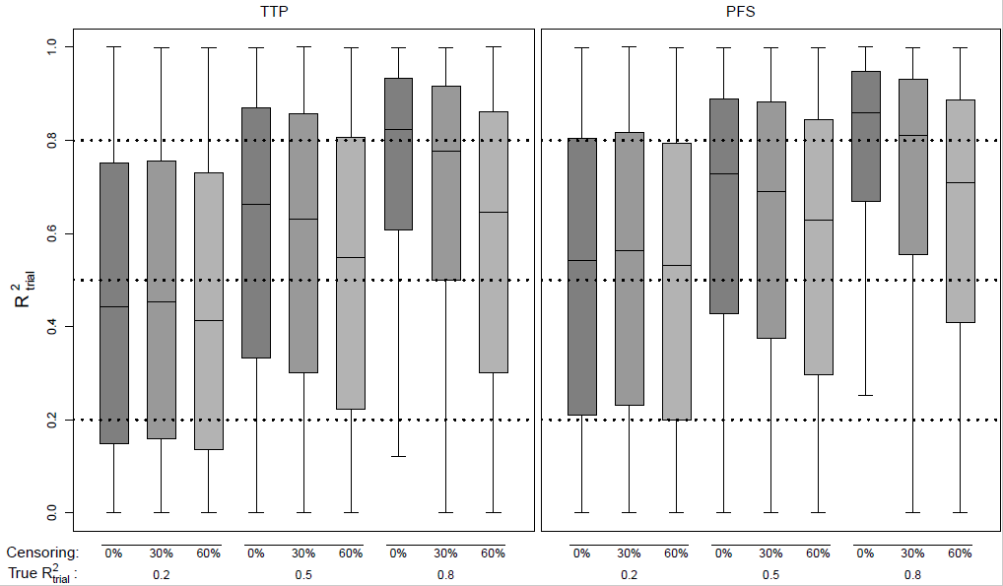
Investigation: Results (Trial-Level Surrogacy)
Clayton Copula
For both TTP and PFS and both copula functions, quite often the case that the true association is over or underestimated
Slight trend upwards as the true underlying association increases, but high variability
Additional simulations were run for larger samples containing 20 trials of 500 patients, showing that estimation is much improved through inclusion of a larger number of studies with larger sample sizes
For trial-level meta‐analyses of the size investigated here, the method did not allow for clear data interpretation of R²trial and cannot be recommended
Figure 2 in the paper

Slide 12
Conclusions
Method performed well in estimating individual-level surrogacy for the TTP endpoint, but caution is required when considering endpoints that incorporate information from the true clinical endpoint, such as PFS
There is a need for careful selection of both the copula family and the dependence structure, as results can be highly confounded by incorrect assumptions
With the limited numbers of trials explored in our study (4-6), the method cannot be considered appropriate for assessing the level to which the treatment effect on the surrogate can predict the unobserved treatment effect on the overall clinical endpoint
Testing of larger sample sizes suggested that inclusion of additional data improves estimation
It remains uncertain what could be considered a sufficient sample size
Complements work of Renfro et al.¹ who assess the use of investigational centres as sub-units of trials
A large amount of data are not frequently available for individual companies => strongly encourage engagement from industry and academia to collaborate in surrogate endpoint evaluation
1. Comput Stat Data Anal. 2014 Oct 1;78:1-20

Slide 13
Remaining Questions
What is an acceptable threshold for trial-level surrogacy?
Some precedence now for R²_{trial} >0.8 with a lower confidence interval >0.6, but is this appropriate for all disease settings?
What is known to predict clinical benefit versus reasonably likely to predict clinical benefit?
How to incorporate variability across clinical trials used in the meta-analysis?
Even if starting with large meta-analytic database, evaluation of specific treatment regimen, therapeutic classes or patient subgroups can lead to a ‘small sample’ situation
How much extrapolation is justifiable?
How much data is enough data?
(How) can we split larger trials into multiple units?
Some suggestion that six trials is sufficient, but this seems dependent on other factors

Slide 14
BACK-Up

Slide 15
Copula Model
Joins multivariate distribution functions to their uniform marginal distribution functions
A function $C_{θ}\left(u,v\right)$ which, for each pair $u$ and $v$ lying in [0,1], generates a number in [0,1] with
$C_{θ}\left(u,v\right)$ = 0 if $u$=0 or $v$=0
$C_{θ}\left(u,1\right)$ = $u$ and $C_{θ}\left(1,v\right)$= $v$
$C_{θ}\left(u,v\right)$ is increasing in both $u$ and $v$
$θ$ is the ‘dependence parameter’
Examples:
Clayton: $C_{θ}\left(u,v\right)= {(u^{1−θ}+ v^{1−θ}−1)}^{\frac{1}{1−θ}}$ for $θ$>1
Hougaard: $C_{θ}\left(u,v\right)=exp⁡[−\{{({−\log\left(u\right))}^{\frac{1}{θ}}+{(−log⁡(v))}^{\frac{1}{θ}}\}}^{θ}$] for 0< $θ$<1
Choice of copula determines the underlying dependence structure
Clayton copula induces late dependence between $s$ and $t$ (when marginal survivor functions are assumed)
Hougaard copula induces early dependence between $s$ and $t$ (when marginal survivor functions are assumed)

Slide 16
Doing now what patients need next

