Slide 1

Cancer Survival in England: a collaboration between PHE and ONS
John Broggio, Cancer Analytical Lead
Notes:
NCRAS is part of PHE which provides intelligence to drive improvement in standards of cancer care and clinical outcomes. It is within Health Improvement Directorate that brings together organisations with specialist expertise and many years’ experience in the collection and analysis of public health data, management of public health knowledge and provision of policy advice.

Slide 2
What is cancer survival?
A statistic that measures the mortality of cancer patients compared to the mortality of the general population in which cancer is the only cause of death
A measure that summarises a cohort of cancer patients pathways, from diagnosis to outcome in an overall estimate
Notes:
It does not tell you if patient died from cancer, how many patients died from cancer, the proportion of cancer patients who did.
LEB: avoid reading the slides if possible – doesn’t tell you proportion… this will be a surprise to people, explain this more maybe?
It is because……

Slide 3
Why are cancer survival statistics important?
One of the key measures of the effectiveness of cancer services
Inform the NHS Outcomes Framework
https://digital.nhs.uk/data-and-information/publications/clinical-indicators/nhs-outcomes-framework/current
Provide reliable/accessible information to a wide range of groups
Notes:
Used to plan cancer prevention services and cancer treatment: : how good the system is in disease detection and whether people have rapid access to effective treatment.

Slide 4
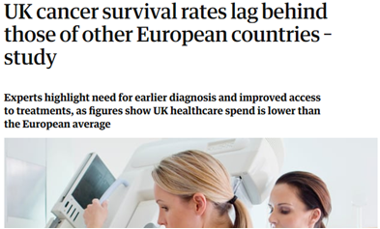
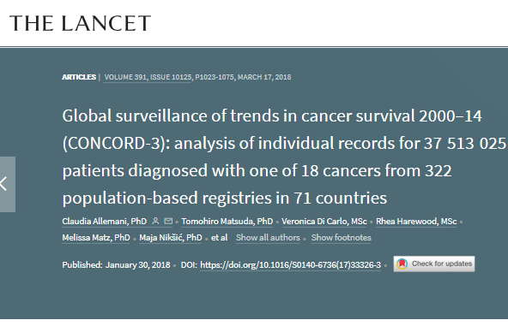
Who are NCRAS?
International comparisons (OECD countries)
(Guardian, 18 July 2017)
the Independent Cancer Task Force set out six strategic priorities to help improve cancer survival
      reducing CCG-variation
      ambition to increase one-year survival to 75% by 2020 for all-cancers combined
Notes:
The lancet article published in Jan 2018.
Independent Cancer Task Force set out six strategic priorities to help improve cancer survival in England. The implementation of these recommendations is being monitored by government bodies and these statistics form an important measure. CCGs – clinical commissioning groups formed in 2013 and replace the PCTs

Slide 5
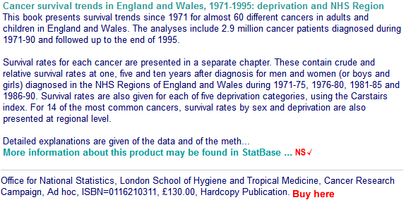
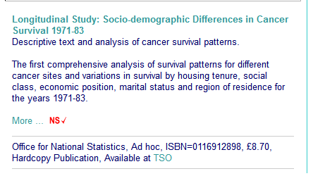
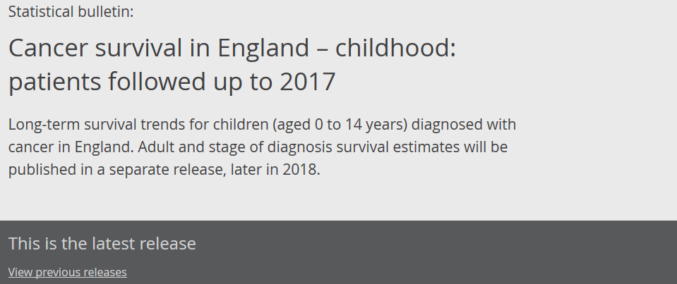
Overview of Survival
Office for National Statistics has been publishing cancer survival statistics annually:
https://www.ons.gov.uk/peoplepopulationandcommunity/healthandsocialcare/conditionsanddiseases/bulletins/cancersurvivalinengland
Notes:
The National Archives: Longitudinal Study in 2000 and Survival trends in 2001…
- not clear that partners have changed over that time – now addressed

Slide 6


Users
Health-policy makers
Cancer Charities
Government bodies
Clinical Commissioning Groups (CCGs)
Academia/ research
Media
John Broggio

Slide 7
ONS and PHE collaboration
Collate, quality assures
8 regional cancer registries
Health Analysis and Life Events
Publishes
cancer incidence and cancer survival
Collect, quality assures and store regional cancer data from England

Slide 8

ONS and PHE collaboration
National Cancer Registration and Analysis Service
Collects, quality assures and stores all cancer data from England
Publishes
cancer incidence and cancer survival
Notes:
PHE was formed in 2013 and all cancer registries were merged (also using a national registration system in 2012)
Graphics look a bit blobby/messy with different colours and backgrounds

Slide 9
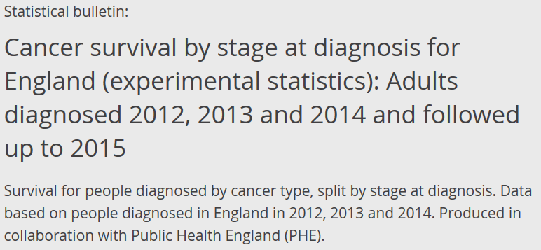


PHE and ONS collaboration
2016
2017
2018
Cancer survival in England
Adults , Childhood and Stage (June 2017)
Index of cancer survival for Clinical Commissioning Groups (CCGs) in England (Nov 2017)
Geographic patterns of cancer survival in England
NHS Region, Cancer Alliance and STPs (Feb 2018)
Cancer survival in England
Childhood (June 2018)
Notes:
Timeline
What is index of cancer survival: single number that summarises the overall pattern of cancer survival

Slide 10
PHE and ONS collaboration
Benefits
Data quality assured and stored by NCRAS
Reduced work duplication
Reduced cross-government sensitive data transfer
Increased transparency of methods used
Bulletins, QMIs and impact papers revised by the partnership
Improved timeliness (e.g. childhood published 8 months earlier)
Work carried out within the Civil Service
Notes:
ONS could archive theirs making financial savings;
QMI – Quality and methodology Information

Slide 11




PHE and ONS collaboration
Communication strategies adopted to facilitate the collaboration:
Weekly calls supplemented by f2f meetings at key points
Trello for working across organisations
Shared PID drive in PHE for working across locations
Workshops across government, NHS England and other key stakeholders to keep the output focussed & relevant
Working with world leading academic teams to ensure remaining at the forefront of methodologies and developing new applications of existing statistical frameworks to survival analysis
Notes:
This is referring to Kwok with UoLeicester & Marta Blangiardo (hierarchical Bayesian for alternative CCG methodology)
and ONS with UoLeicester & LSHTM on lifetables

Slide 12
Current methodology – children
All cause survival
(Actuarial) Kaplan-Meier method (sts list).
Assumes that all patients mortality is related to the disease.
No lifetables needed.
Notes:
is an estimate of the probability of surviving all causes of death.

Slide 13
Current methodology – adults
Net survival
The survival that would be observed if the only possible underlying cause of death was the disease under study.
Estimated using either cause-specific or relative survival setting.
Used in population-based cancer studies.
Based on the assumption of independent competing causes of death.
Defined as the ratio of the proportion of observed survivors in a cohort of cancer patients to the proportion of expected survivors in a comparable set of the general population.
Uses lifetables.
Notes:
Policy-based statistic (sounds negative?)
This is the probability of surviving cancer in the absence of other causes of death. It is a measure that is not influenced by changes in mortality from other causes and, therefore, provides a useful measure for tracking survival across time, and comparisons between racial/ethnic groups or between registries.
Using cause-specific mortality requires that reliably coded information on cause of death is available

Slide 14
Current methodology – adults
Net survival
    Maja Pohar Perme et al (2012) proposed an improvement to the survival estimator that reduces the bias
Use the Pohar-Perme estimator (stns)
Notes:
Policy-based statistic (sounds negative?)
This is the probability of surviving cancer in the absence of other causes of death. It is a measure that is not influenced by changes in mortality from other causes and, therefore, provides a useful measure for tracking survival across time, and comparisons between racial/ethnic groups or between registries.
Using cause-specific mortality requires that reliably coded information on cause of death is available

Slide 15
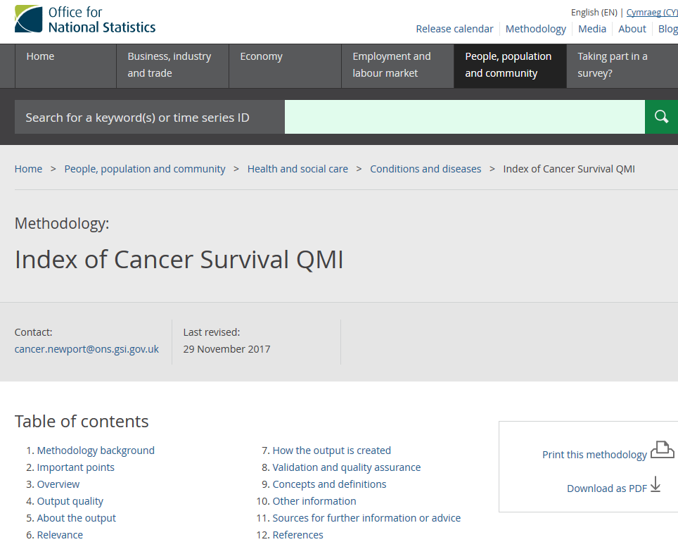
Net survival
Issue: Small numbers in the 207 CCGs
Due to small numbers we estimate net cancer
survival for small areas (such as CCGs and
STPs) using flexible parametric modelling
with restricted cubic splines (stpm2)
developed by Royston and Parmar (2002).
Notes:
Policy-based statistic (sounds negative?)
This is the probability of surviving cancer in the absence of other causes of death. It is a measure that is not influenced by changes in mortality from other causes and, therefore, provides a useful measure for tracking survival across time, and comparisons between racial/ethnic groups or between registries.
Using cause-specific mortality requires that reliably coded information on cause of death is available

Slide 16
Methodology: implementation
Produced SQL query to extract all cancer data 1971 onwards.
Coded all survival methods in Stata 15.
Use of high performance machines.
To consolidate the skills in these survival estimation techniques, the team attended a 5-day course at the London School of Hygiene and Tropical Medicine “Cancer Survival: Principles, Methods, Applications” (July 2017).
Developed robust quality assurance (QA) processes that included implementing parallel runs of the analyses and QA framework.
Notes:
fuzzy explanation of the team.
PHE team did, and both did
QA: dual run, QA framework which includes internal comparison and external to other published results and previous years

Slide 17
Methodology: Innovation
We reproduced previous methods but introduced the use of the International Classification of Survival Standard (ICSS) weighting system to age-standardise the net survival estimates (Corazziari I et al. 2004).
Important advantages of the use of ICSS weights are:
they are used internationally
allow international comparisons as they are not country or diagnostic period specific.
they are methodologically recommended as they account for the fact that different cancer sites have different age distributions
Notes:
Perhaps explain some slides, this one 24 by just saying what you did in general terms. e.g. 'we age-standardised because…..' then leave the detail on the slide
Age-standardisation: technique used to allow populations to be compared when the age profiles of the populations are quite different
In the previous publications, the weights were based on the England and Wales cancer incidence during 1986-1990, but these were not publicly available and did not allow consistent comparison with other countries.
Methodologically recommended (e.g. many types of cancer, like lung cancer, are more commonly diagnosed as age increases; but others, like Hodgkin’s lymphoma, are more commonly found in younger people).

Slide 18
Methodology: Innovation
Range of the geographies published was extended to include the NHS Sustainability and Transformation Partnerships (STPs) geographies in the CCG bulletin.
Extend the range of survival estimates produced for England to include survival by stage for the first time.
Explicitly state the definitions of criteria used to determine which estimates should be published (suppression rules).
Improved robustness of the CCG-level analysis models by using both the Akaike Information Criterion (AIC) and the Bayesian Information Criteria (BIC) for model selection.
Notes:
where previously only the AIC was used.

Slide 19
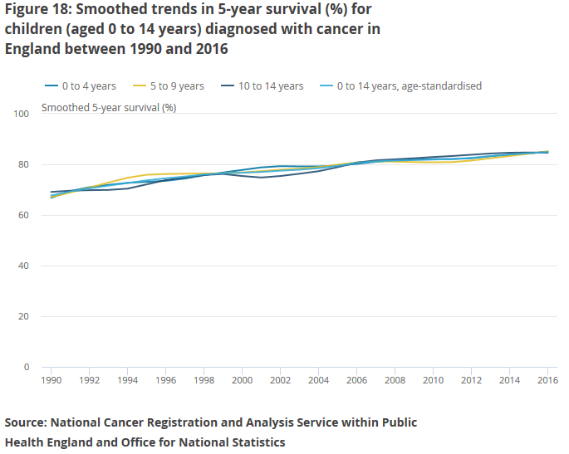
Outputs
Notes:
5 year survival : 1990 - 83.9 and 2016 - 93.5

Slide 20
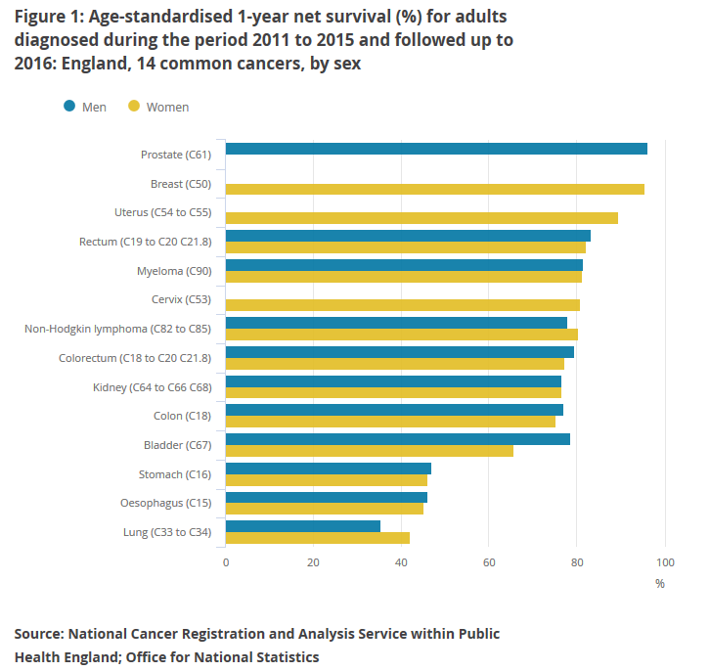
Outputs

Slide 21
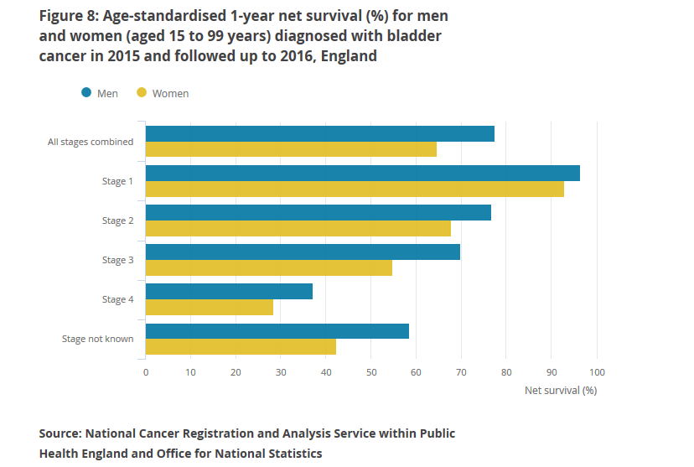
Outputs

Slide 22
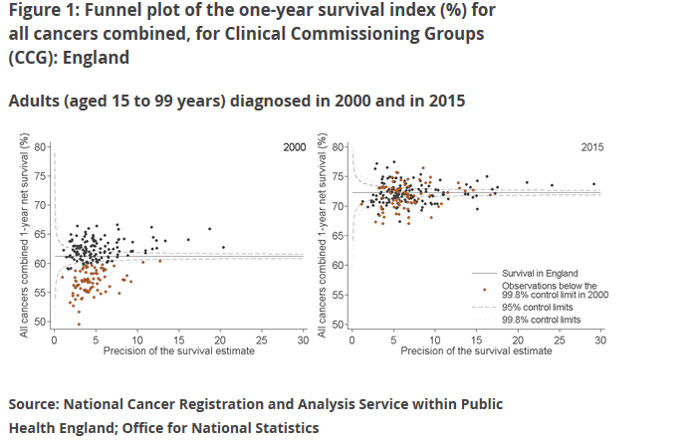
Outputs
Notes:
Point out that axis does not start at 0. Improvement from 61.2 to 72.3.
Explain what colour means!

Slide 23
Next steps
Producing and using regularly updated lifetables.
Co-produce the survival estimates across ONS & PHE.
Publish and implement a new method: hierarchical Bayesian modelling framework to allow comparisons between the CCGs and have “static” estimates.
Extend survival by stage to more cancer sites.
Further improve our timeliness.
Notes:
Static estimates : is a really important, subtle point that by cutting some of the other slides you should be able to get across

Slide 24
NCRAS | HALE
Carolynn Gildea John Broggio Kwok Wong Marta Emmett | Andy King, Sarah Caul Leah Butler Jasveer Kaur, Sophie John Matthew Peet, Lorna Ushaw Neil Bannister
This work uses data provided by patients and collected by the NHS as part of their care and support. All personal data is handled confidentially by Office for National Statistics (ONS) and Public Health England (PHE), in accordance with relevant legislation and codes of conduct.

Slide 25
References
Corazziari I, et al. 2004. “Standard cancer patient population for age standardising survival ratios”. European Journal of Cancer 15: 2307-2316.
Kaplan EL, Meier P. 1958. “Nonparametric Estimation from Incomplete Observations.” Journal of the American Statistical Association 53: 457-481.
Pohar Perme M, Stare J, Estève J. 2012. “On estimation in relative survival”. Biometrics 68:113 -20.
Royston P, Parmar MK. 2002. “Flexible parametric proportional-hazards and proportional-odds models for censored survival data, with application to prognostic modelling and estimation of treatment effects”. Statistics in Medicine 21(15): 2175-2197.

