Slide 1
Professional Statisticians’ Forum Meeting
GradStat awardees – the RSS and you

Slide 2
Supporting you through professional membership
Ricky McGowan – Professional Affairs & Accreditation Manager

Slide 3
Supporting your journey
GradStat Mentoring Scheme
Mid-Term Assessments (MTA’s)
Professional Statistician Forum (PSF) Events
Continual Professional Development tools and examples
CStat & CSci
Graduate Statistician
Student
Fellow

Slide 4
MTA’s - Mid-Term Assessment
All Graduate Statisticians (GradStats) can apply for a mid-term assessment or MTA via our website.
Complete the MTA application form to tell us about your statistical career to date and current Cstat holders will advise you whether the nature of the work and your own development appears suitable for progression to Chartered Statistician (CStat), and when you might apply for that status.
It usually takes at least five years to gain enough professional experience so we recommend an MTA should be carried out two and a half years after you have started your career. We automatically contact GradStats members at this stage. However, GradStat members can submit MTA forms at any time should they require feedback of this kind.

Slide 5
GradStat mentoring scheme
Launched in August 2008 following a survey of Graduate Statisticians indicated a need for a mentoring service
Useful for any GradStat to gain independent perspective from a mentor
Especially valuable to those working either as a lone statistician or in an organisation employing very small numbers of statisticians
Only GradStats can participate in the scheme and other information on GradStat requirements can be found at www.rss.org.uk/gradstat

Slide 6
GradStat mentoring scheme
Aims to provide help and advice to GradStat members on:
CPD requirements and opportunities
Documenting their professional experience and development
Making a strong application for Chartered Statistician (CStat) status

Slide 7
GradStat mentoring scheme
Scheme does not cover:
Career development advice outside the statistical profession – though CPD for a statistician will not be purely statistical
Advice on statistical problems a GradStat may encounter in their work

Slide 8
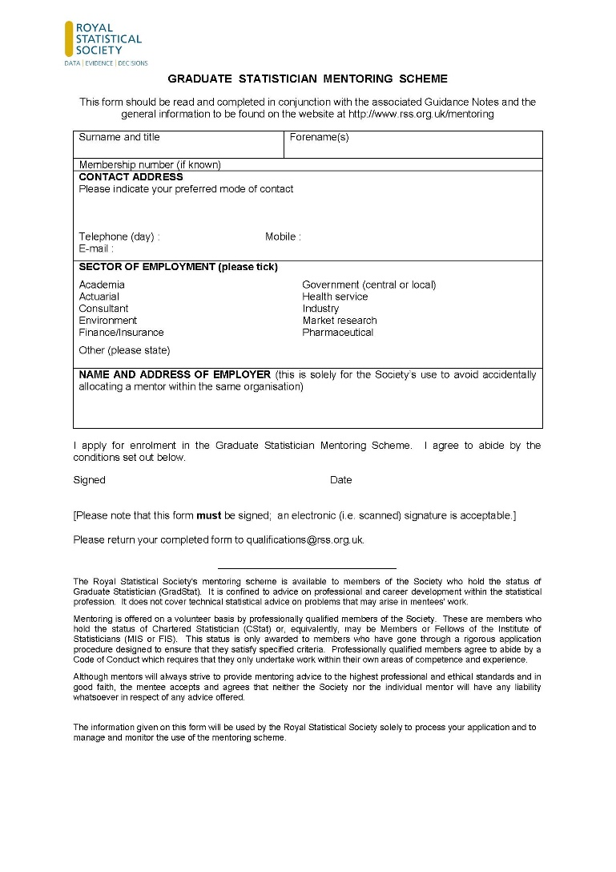
Application process for mentees
Mentee completes short application form

Slide 9
How does it work?
Once assigned, a mentor and mentee agree how often to meet and key issues to discuss
Mainly virtual (e-mail/Skype/phone) but some face to face meetings (e.g. at RSS conference)
Support with mid-term assessment and completing CStat application (including CPD summary)

Slide 10
Ricky McGowan
Professional Affairs & Accreditation Manager
r.mcgowan@rss.org.uk

