Slide 1

Designing studies for individual participant data (IPD) meta-analysis
Centre for
Trials Research
Canolfan
Ymchwil Treialon
Dr Rebecca Playle
Centre for Trials Research
@CTRCardiffUni College of Biomedical and Life Sciences

Slide 2
Contents
Centre for
Trials Research
Canolfan
Ymchwil Treialon
What is individual participant data (IPD) meta-analysis?
What is the BRAINTRAIN study?
  What is Neurofeedback?
  Designing a study with IPD meta-analysis in mind
  Statistical challenges
  Lessons learnt

Slide 3
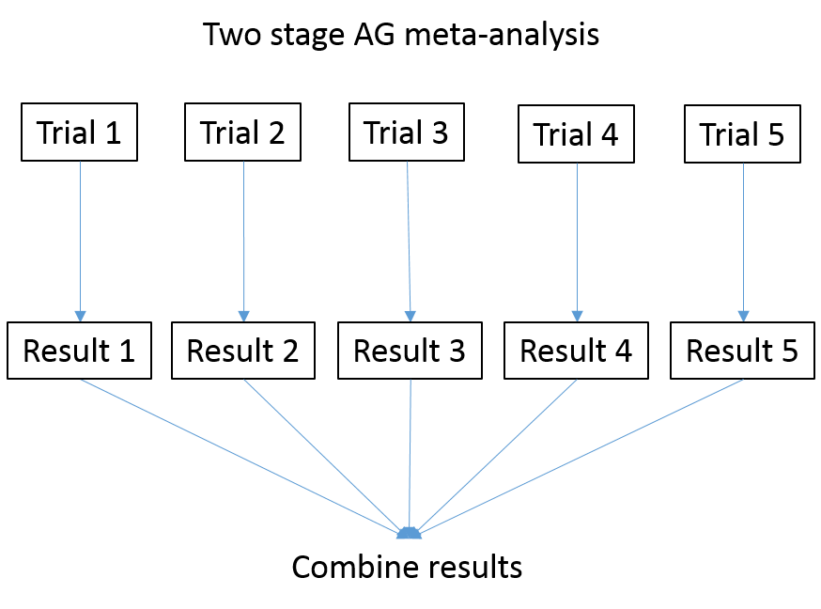
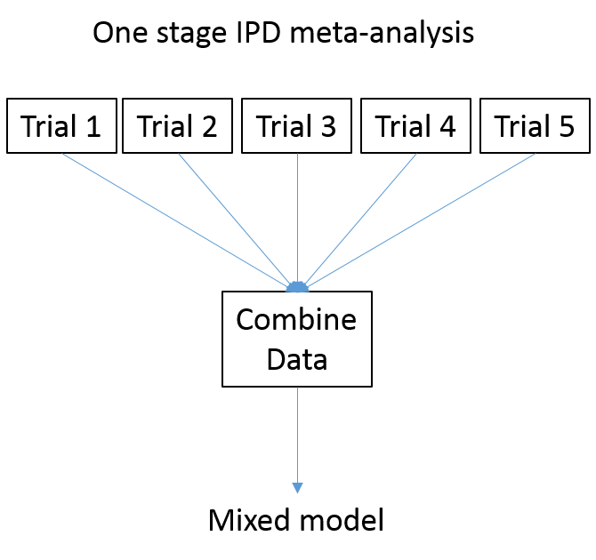
Meta-analysis methods
Centre for
Trials Research
Canolfan
Ymchwil Treialon
Meta-analyses that are based on individual participant data (IPD) use the same basic approach as traditional meta-analyses
Aggregate data (AD) meta-analysis
IPD meta-analysis
One stage or two stage IPD meta-analysis

Slide 4
Meta-analysis interpretation
Centre for
Trials Research
Canolfan
Ymchwil Treialon
Summary data are calculated for each individual study and combined using a weighted average of the common measure of effect
An overall estimate of effect size is produced
Fixed effect or random effect models are used depending the variability of the individual trial results
Where trials vary greatly this may be a reason NOT to combine results
Forest plot
Favours
Intervention
Favours
Control
-1.5 -1.0 -0.5 0 0.5 1.0 1.5
Standardised mean difference

Slide 5
Meta-analysis interpretation
Centre for
Trials Research
Canolfan
Ymchwil Treialon
Individual effect
Summary data are calculated for each individual study and combined using a weighted average of the common measure of effect
An overall estimate of effect size is produced
Fixed effect or random effect models are used depending the variability of the individual trial results
Where trials vary greatly this may be a reason NOT to combine results
Forest plot
Confidence interval
Favours
Intervention
Favours
Control
-1.5 -1.0 -0.5 0 0.5 1.0 1.5
Standardised mean difference

Slide 6
Meta-analysis interpretation
Centre for
Trials Research
Canolfan
Ymchwil Treialon
Results from individual studies
Summary data are calculated for each individual study and combined using a weighted average of the common measure of effect
An overall estimate of effect size is produced
Fixed effect or random effect models are used depending the variability of the individual trial results
Where trials vary greatly this may be a reason NOT to combine results
Forest plot
Favours
Intervention
Favours
Control
-1.5 -1.0 -0.5 0 0.5 1.0 1.5
Standardised mean difference

Slide 7
Meta-analysis interpretation
Centre for
Trials Research
Canolfan
Ymchwil Treialon
Summary data are calculated for each individual study and combined using a weighted average of the common measure of effect
An overall estimate of effect size is produced
Fixed effect or random effect models are used depending the variability of the individual trial results
Where trials vary greatly this may be a reason NOT to combine results
Forest plot
Favours
Intervention
Favours
Control
-1.5 -1.0 -0.5 0 0.5 1.0 1.5
Standardised mean difference

Slide 8
Meta-analysis interpretation
Centre for
Trials Research
Canolfan
Ymchwil Treialon
Summary data are calculated for each individual study and combined using a weighted average of the common measure of effect
An overall estimate of effect size is produced
Fixed effect or random effect models are used depending the variability of the individual trial results
Where trials vary greatly this may be a reason NOT to combine results
Forest plot
Favours
Intervention
Favours
Control
Overall effect
Fixed effects
Random effects
-1.5 -1.0 -0.5 0 0.5 1.0 1.5
Standardised mean difference

Slide 9
Approaches to IPD meta-analysis
Centre for
Trials Research
Canolfan
Ymchwil Treialon
There are two approaches to IPD meta-analysis
  One stage approach
    A stratified or mixed model is used to analyse the raw data clustered within study in a single model
    More complex but flexible
    Mixed models impose a strong assumption of normality on between study (random) effects which may not hold
  Two stage approach
    Study results are obtained from merged raw data and then pooled using a traditional meta-analysis model e.g. inverse-variance weighted
    No normality assumption
    More straightforward, quicker to converge
    Allows incorporation of aggregate data alongside IPD data

Slide 10
The trouble with IPD meta-analysis
Centre for
Trials Research
Canolfan
Ymchwil Treialon
Extensive persuasion bribery collaboration is required in order collate data sets from each study team often long after the original study was completed
The data needs to be checked for consistency with published results
Not all data sets will have all the covariates required
Designing studies with IPD meta-analysis in mind may offer a way to avoid this post hoc data collation

Slide 11

The BRAINTRAIN Study
Centre for
Trials Research
Canolfan
Ymchwil Treialon

Slide 12
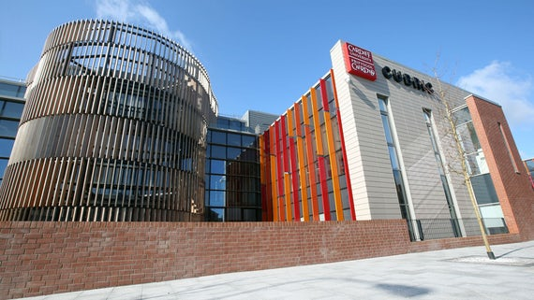
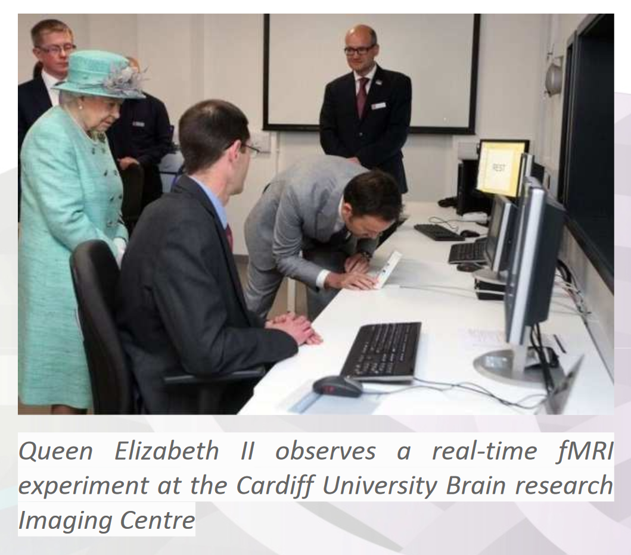
The BRAINTRAIN Study
Centre for
Trials Research
Canolfan
Ymchwil Treialon
In 2013 David Linden (Professor of Translational Neuroscience) came to the CTR to discuss an idea about using neurofeedback to treat a range of clinical conditions
That’s him with the Queen at CUBRIC

Slide 13
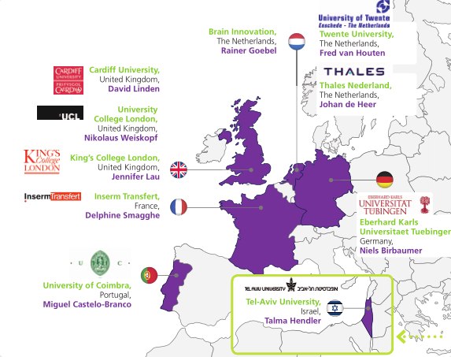
The BRAINTRAIN Study
Centre for
Trials Research
Canolfan
Ymchwil Treialon
David had already begun setting up a consortium with partners across Europe in Cardiff, Coimbra, Tubingen, Oxford and Tel Aviv

Slide 14
A little bit more about neurofeedback
Centre for
Trials Research
Canolfan
Ymchwil Treialon

Slide 15
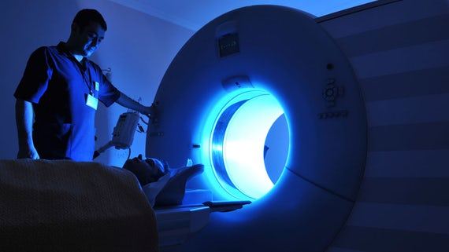
A little bit more about neurofeedback
Centre for
Trials Research
Canolfan
Ymchwil Treialon
MRI scanners in CUBRIC scan brain activity
Patients with depression and addiction have been studied in Cardiff

Slide 16
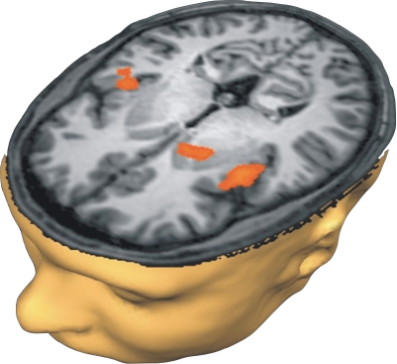
A little bit more about neurofeedback
Centre for
Trials Research
Canolfan
Ymchwil Treialon
Using an MRI scanner brain activity is monitored in real-time
Areas of interest in those with addiction are involved in reward and craving
Monitor changes in brain activity in response to seeing images eg alcohol
Ventral Striatum
Right Insula
Left Insula
Ihssen et al. (2011). Cerebral Cortex

Slide 17

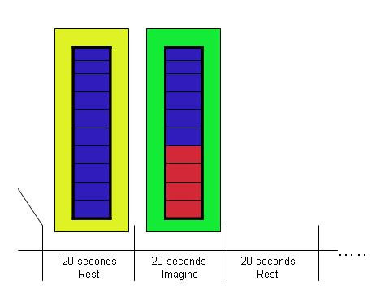



A little bit more about neurofeedback
Centre for
Trials Research
Canolfan
Ymchwil Treialon
8-sec picture viewing blocks (2 sec per item)
Real time feedback as ‘thermometer’
Brain responses to visual cues

Slide 18
A little bit about neurofeedback
Centre for
Trials Research
Canolfan
Ymchwil Treialon
In alcohol addiction there are dysfunctional responses (craving) to environmental alcohol cues even after treatment
Can neurofeedback help patients to control cue reactivity and craving?
Patients are taught to self regulate their own brain activity using feedback of brain imaging signals
Previous studies had suggested that the technique may help those with depression and Parkinson’s disease
20 sec down-regulation
Real time feedback using picture size variation

Slide 19
The BRAINTRAIN consortium
Centre for
Trials Research
Canolfan
Ymchwil Treialon
Across the consortium other teams were developing the use of fMRI and neurofeedback in other conditions
The University of Coimbra were using neurofeedback with the aim of improving social attention in subjects with Autism measured by monitoring eye tracking in virtual scenarios

Slide 20
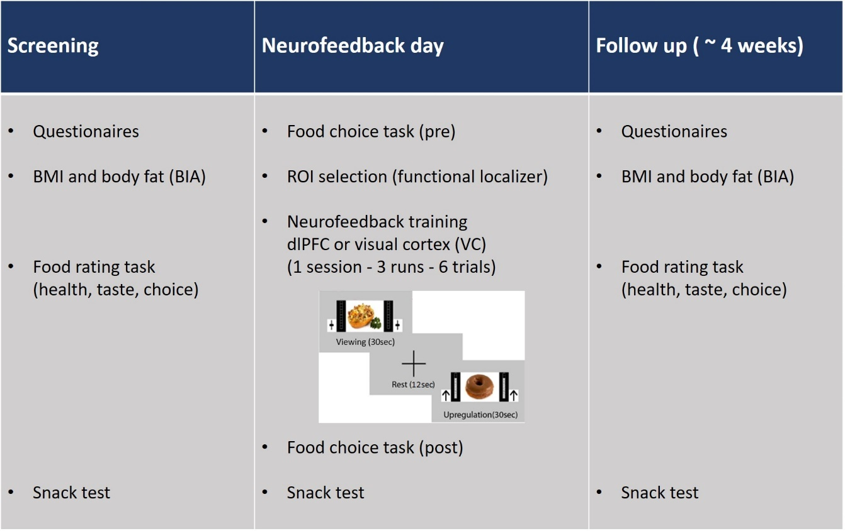
The BRAINTRAIN consortium
Centre for
Trials Research
Canolfan
Ymchwil Treialon
Across the consortium other teams were developing the use of fMRI and neurofeedback in other conditions
The University of Tubingen were using neurofeedback with the aim of reducing food cravings

Slide 21
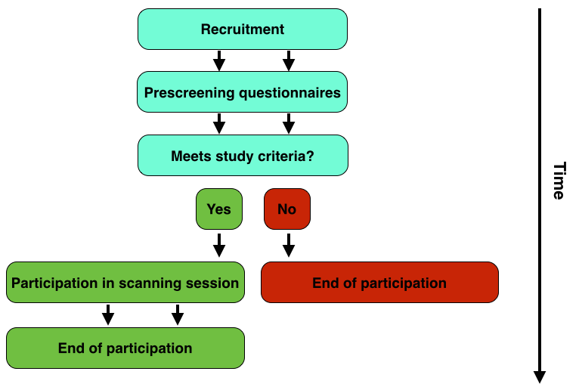
The BRAINTRAIN consortium
Centre for
Trials Research
Canolfan
Ymchwil Treialon
Across the consortium other teams were developing the use of fMRI and neurofeedback in other conditions
The University of Oxford / KCL were using neurofeedback with the aim of reducing anxiety

Slide 22
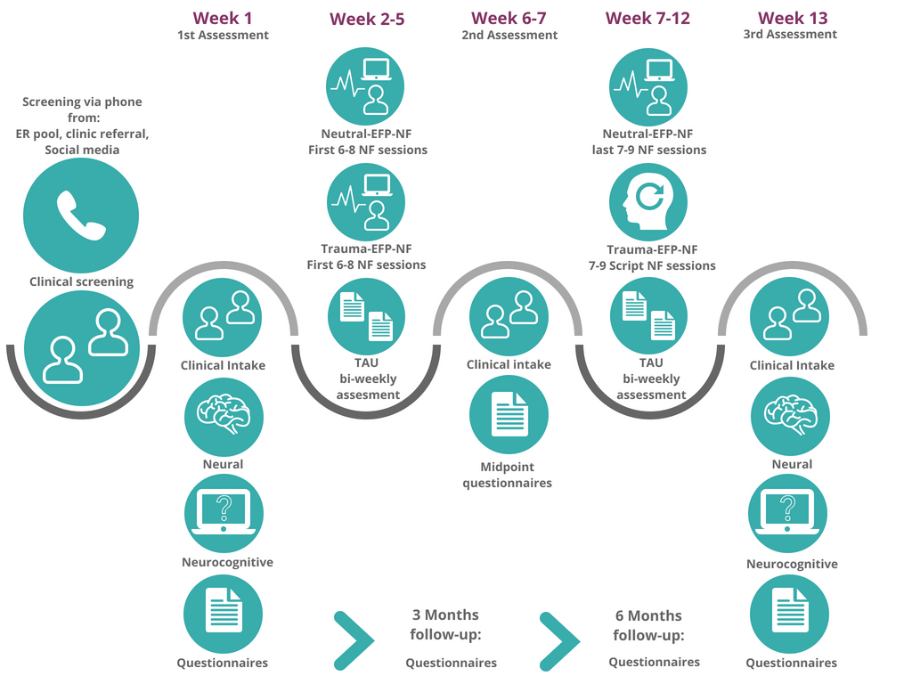
The BRAINTRAIN consortium
Centre for
Trials Research
Canolfan
Ymchwil Treialon
Across the consortium other teams were developing the use of fMRI and neurofeedback in other conditions
Tele Aviv University were using neurofeedback with the aim of reducing symptoms of PTSD

Slide 23

The BRAINTRAIN grant application
Centre for
Trials Research
Canolfan
Ymchwil Treialon
Series of work packages with the aim of developing neurofeedback methods, brain imaging and the software required
WP4 was the clinical trials work package
CTR to provide advice and oversight of study design and statistics; design and host the central database; carry out IPD meta-analysis
Individual teams were responsible for the design and analysis of their own studies
Taking imaging into the therapeutic domain:
Self-regulation of brain systems for mental disorders
BRAINTRAIN

Slide 24
WP4 study design
Centre for
Trials Research
Canolfan
Ymchwil Treialon
In early grant application drafts we wrote:
“ 5 feasibility randomised trials will be carried out in the each of the following conditions; Alcohol dependence, binge eating, PTSD, Autism and Anxiety ”
“ a meta-analysis will combine the results of the five trials for the standardised effects of each primary clinical outcome and common core secondary outcomes ”

Slide 25
Meta-analysis of feasibility trials?!
Centre for
Trials Research
Canolfan
Ymchwil Treialon

Slide 26
Meta-analysis of feasibility trials?!
Centre for
Trials Research
Canolfan
Ymchwil Treialon
Meta-analysis generally used to combine the results of definitive trials to give a pooled effect
Here we wanted to combine the results of 5 small feasibility trials to pool their effects
  Is this sensible?
  What would it tell us?

Slide 27
Statistical challenges
Centre for
Trials Research
Canolfan
Ymchwil Treialon
Difficult to balance the feasibility objectives of individual trials with statistical analysis of combined effects

Slide 28
The teams had their own ideas…
Centre for
Trials Research
Canolfan
Ymchwil Treialon
“having all the teams carry out RCTs is not set in stone and some teams may want to do one group feasibility work”
The submitted grant:
Cardiff (Alcohol dependence): Feasibility RCT
Oxford (Anxiety): Single group (before / after) study
Tel Aviv (PTSD): Feasibility RCT
Coimbra (Autism): Single group study
Tubingen (Binge eating): Feasibility RCT

Slide 29
The teams had their own ideas…
Centre for
Trials Research
Canolfan
Ymchwil Treialon
“having all the teams carry out RCTs is not set in stone and some teams may want to do one group feasibility work”
The submitted grant:
Cardiff (Alcohol dependence): Feasibility RCT
Oxford (Anxiety): Single group (before / after) study
Tel Aviv (PTSD): Two Feasibility RCTs
Coimbra (Autism): Two single group studies
Tubingen (Binge eating): Feasibility RCT

Slide 30
Study design workshop
Centre for
Trials Research
Canolfan
Ymchwil Treialon
Early on in the study we invited the teams to Cardiff for a workshop on study design
We covered:
  Early phase designs
  Protocol writing and approvals
  Sample size estimation (briefly)
  Randomisation (briefly)
  Statistical analysis and SAPs (briefly)
  SOPs and templates provided

Slide 31
Study design workshop
Centre for
Trials Research
Canolfan
Ymchwil Treialon
Early on in the study we invited the teams to Cardiff for a workshop on study design
We covered:
  Early phase designs
  Protocol writing and approvals
  Sample size estimation (briefly)
  Randomisation (briefly)
  Statistical analysis and SAPs (briefly)
  SOPs and templates provided
We were not able to persuade Oxford and Coimbra to randomise

Slide 32
Study design workshop
Centre for
Trials Research
Canolfan
Ymchwil Treialon
Early on in the study we invited the teams to Cardiff for a workshop on study design
We covered:
  Early phase designs
  Protocol writing and approvals
  Sample size estimation (briefly)
  Randomisation (briefly)
  Statistical analysis and SAPs (briefly)
  SOPs and templates provided
Tel Aviv wanted to run a two arm RCT and a three arm RCT!

Slide 33
Statistical challenges
Centre for
Trials Research
Canolfan
Ymchwil Treialon
Difficult to balance the feasibility objectives of individual trials with statistical analysis of combined effects
How to combine the results of randomised and non randomised studies?

Slide 34
Statistical challenges
Centre for
Trials Research
Canolfan
Ymchwil Treialon
Difficult to balance the feasibility objectives of individual trials with statistical analysis of combined effects
How to combine the results of randomised and non randomised studies?
How to combine the result of two and three arm RCTs?

Slide 35
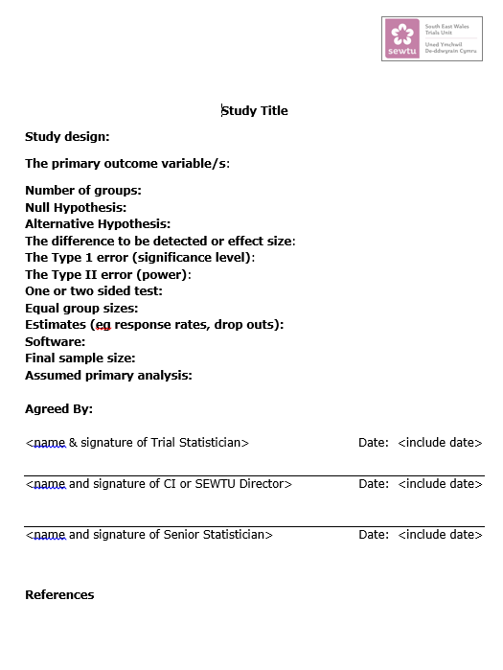
Sample size
Centre for
Trials Research
Canolfan
Ymchwil Treialon
At the study design workshop we provided each team with our standard template for sample size estimation
This template was designed with a RCT in mind
Primary outcome and difference are stated

Slide 36
Sample size
Centre for
Trials Research
Canolfan
Ymchwil Treialon
At the study design workshop we provided each team with our standard template for sample size estimation
This template was designed with a RCT in mind
Primary outcome and difference are stated
Lesson learnt:
  Amend for feasibility to reduce the temptation to test
  for efficacy!

Slide 37
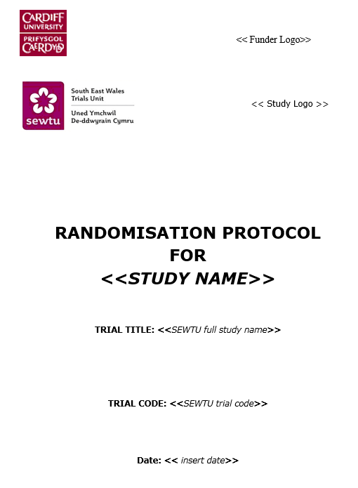
Randomisation
Centre for
Trials Research
Canolfan
Ymchwil Treialon
The teams were provided our template for randomisation
Required support
  Method?
  Minimisation – balancing factors
  Back up procedures

Slide 38
Randomisation
Centre for
Trials Research
Canolfan
Ymchwil Treialon
The teams were provided our template for randomisation
Required support
  Method?
  Minimisation – balancing factors
  Back up procedures
CTR wrote the randomisation protocol for each RCT
  Each RCT used age and gender
  1 other condition specific factor
  Important to have a consistent approach across studies

Slide 39

Statistical analysis plans
Centre for
Trials Research
Canolfan
Ymchwil Treialon
The teams were provided with our template SAP and later on template tables for the report
Needed support
  Completing the relevant sections
  CONSORT charts
  Methods of analysis
  Presentation of results

Slide 40
Statistical analysis plans
Centre for
Trials Research
Canolfan
Ymchwil Treialon
The teams were provided with our template SAP and later on template tables for the report
Needed support
  Completing the relevant sections
  CONSORT charts
  Methods of analysis
  Presentation of results
Lesson leant:
Amend for feasibility to reduce the
temptation to perform lots of hypothesis tests

Slide 41
RCT comparator group?
Centre for
Trials Research
Canolfan
Ymchwil Treialon
Early on, discussions with teams about the RCTs often centred on the type of comparator to use as control
Options were:
  A sham neurofeedback
  Treatment as usual (TAU)
Cardiff and Tel Aviv opted for TAU while Tubingen opted for sham neurofeedback
Additionally Tel Aviv opted for one a 3 arm trial and one 2 arm trial

Slide 42
Statistical challenges
Centre for
Trials Research
Canolfan
Ymchwil Treialon
Difficult to balance the feasibility objectives of individual trials with statistical analysis of combined effects
How to combine the results of randomised and non randomised studies?
How to combine the result of two and three arm RCTs?
Care should be used when interpreting the meta-analysis due to differing control conditions

Slide 43
Database design and meta-data
Centre for
Trials Research
Canolfan
Ymchwil Treialon
The teams wrote their own data management plans, meta-data and database specification
We had some previous examples and CTR templates that we could share
The teams were inexperienced in these processes and found this difficult and time consuming
Lesson learnt:
This process requires oversight to ensure consistency and quality

Slide 44
Outcome measurement
Centre for
Trials Research
Canolfan
Ymchwil Treialon

Slide 45
Outcome measurement
Centre for
Trials Research
Canolfan
Ymchwil Treialon
Feasibility outcomes
Clinical outcomes for each study
Secondary outcomes (core outcomes)

Slide 46
1. Feasibility outcomes
Centre for
Trials Research
Canolfan
Ymchwil Treialon
Range of stop go criteria
Discussed with each team
Agreed as overarching criteria for BRAINTRAIN
 | Definition | Success criteria for progression
Eligibility | % of screened participants eligible for the study | >50% 30-50% <30% | Go Mitigating strategies STOP
Recruitment / Consent | % of eligible participants consented into the study | >80% 50-80% <50% | Go Mitigating strategies STOP
Retention (primary end point) | % of consented participants with outcome data the primary endpoint | >80% 50-80% <50% | Go Mitigating strategies STOP
Intervention uptake | % of consented participants commencing the intervention (at least one intervention session completed) | >90% 60-90% <90% | Go Mitigating strategies STOP
Adherence/ Completion | % of consented participants completing all intervention sessions | >80% 50-80% <50% | Go Mitigating strategies STOP

Slide 47
2. Clinical Outcomes
Centre for
Trials Research
Canolfan
Ymchwil Treialon
Cardiff: Proportion of days abstinent
Tubingen: snack test (total calories)
Tel Aviv: PCL score, CAPs score (PTSD symptom assessments x2)
Coimbra: JAAT and FEEST (attention assessments x2)
Oxford STAI anxiety score

Slide 48
2. Clinical Outcomes
Centre for
Trials Research
Canolfan
Ymchwil Treialon
Cardiff: Proportion of days abstinent (binary)
Tubingen: snack test (total calories)
Tel Aviv: PCL score, CAPs score (PTSD symptom assessments x2)
Coimbra: JAAT and FEEST (attention assessments x2)
Oxford STAI anxiety score
Used IPD meta-analysis for linear modelling and AD meta-analysis to pool log odds ratio and SMD from RCTs

Slide 49
2. Clinical Outcomes
Centre for
Trials Research
Canolfan
Ymchwil Treialon
Cardiff: Proportion of days abstinent (binary)
Tubingen: snack test (total calories)
Tel Aviv: PCL score, CAPs score (PTSD symptom assessments x2)
Coimbra: JAAT and FEEST (attention assessments x2)
Oxford STAI anxiety score
The outcomes for the RCTs were converted to standardised effects for meta-analysis…but we can’t combine standardised pre-post change effects from single group studies with RCTs

Slide 50
Statistical challenges
Centre for
Trials Research
Canolfan
Ymchwil Treialon
Difficult to balance the feasibility objectives of individual trials with statistical analysis of combined effects
How to combine the results of randomised and non randomised studies?
How to combine the result of two and three arm RCTs?
Care should be used when interpreting the meta-analysis due to differing control conditions
Combining binary and linear outcomes as well as pre-post changes

Slide 51

3. Secondary core outcomes
Centre for
Trials Research
Canolfan
Ymchwil Treialon
TCQ Thought control questionnaire
TCAQ Thought control and ability questionnaire
WASI Wechsler abbreviated intelligence scale
POMS Profile of mood states
HADS Hospital anxiety and depression scale
STAI State trait anxiety inventory
BDI Beck depression inventory
CERQ Cognitive emotion regulation questionnaire
NEO Five factor Inventory (Neuroticism, Extraversion, Openness,
agreeableness Conscientiousness)

Slide 52
3. Secondary core outcomes
Centre for
Trials Research
Canolfan
Ymchwil Treialon
Challenge 1 – not all questionnaires were suitable for all populations
Challenge 2 – different versions were validated in different languages
Challenge 3 – teams had to write their own site specific meta data
Some checking of the differing versions was required before combining the results was deemed valid

Slide 53
3. Secondary ‘core’ outcomes
Centre for
Trials Research
Canolfan
Ymchwil Treialon
 | Cardiff | Tubingen | Tel Aviv (T) | Tel Aviv (P) | Coimbra (fMRI) | Coimbra (BCI) | Oxford
TCQ |  |  |  |  |  |  | x
TCAQ |  |  |  |  |  |  | x
WASI
POMS | x | x |  |  | x | x
HADS | x | x |  |  | x | x
BDI | x | x | x | x | x | x
STAI |  |  | x | x |  |  | x
CERQ |  |  | x | x |  |  | x

Slide 54
Combining secondary outcomes
Centre for
Trials Research
Canolfan
Ymchwil Treialon
HADS and STAI both measure anxiety
  Re-scaled to lie on 0-100 and combined into a single anxiety outcome
BDI was measured by all RCTs and Coimbra
POMS was measured by Cardiff and Germany RCTs and Coimbra
How to display effects from RCTs and effects from before / after studies together?
  Is this sensible?

Slide 55
How to display RCT and single arm study results for core outcomes?
Centre for
Trials Research
Canolfan
Ymchwil Treialon
Selecting the intervention arm only of the RCTs and displaying with the change scores may give a misleading impression of the studies

Slide 56
How to display RCT and single arm study results for core outcomes?
Centre for
Trials Research
Canolfan
Ymchwil Treialon
Forest plot of treatment effects for RCTs
Effects have ‘reversed’
Should we add the before after change to this?

Slide 57
How to display RCT and single arm study results for core outcomes?
Centre for
Trials Research
Canolfan
Ymchwil Treialon
The importance of having a control group is highlighted

Slide 58
Approach for IPD meta-analysis
Centre for
Trials Research
Canolfan
Ymchwil Treialon
Primary analysis (RCTs)
  Two stage random effects (inverse weights) IPD meta-analysis
  STATA: ipdmetan (reml,hksj)
  The Hartung-Knapp Sidik-Jonkman se correction allows the uncertainty of the study heterogeneity (tau) to be accounted for when there are a small number of studies to be combined
Sensitivity analyses
  One stage model stratified by trial
  One stage model mixed (2-level mixed model)
STATA admetan combines and plots the single arm study change estimates

Slide 59
Conclusions and further work
Centre for
Trials Research
Canolfan
Ymchwil Treialon
Neurofeedback was feasible and stop / go criteria were ‘go’ for all studies in terms of recruitment, randomisation (where applicable) and follow-up
Pooled treatment effects from the single arm studies favoured intervention but without a control arm we cannot assume this effect would be replicated in a RCT
Efficacy for PTSD looks promising, further trials are planned
Analysis of the classification of participants as successful up/down regulators ongoing

Slide 60





Thank you
Centre for
Trials Research
Canolfan
Ymchwil Treialon
@CTRCardiffUni
Questions?
@CTRCardiffUni College of Biomedical and Life Sciences

Slide 61
Centre for
Trials Research
Canolfan
Ymchwil Treialon
@CTRCardiffUni
@CTRCardiffUni College of Biomedical and Life Sciences

Slide 62
Lessons learned
Centre for
Trials Research
Canolfan
Ymchwil Treialon
Negatives | Positives | Lessons learned
Teams were experts in their field but inexperienced trialists | Turned basic scientists into trialists? Coimbra have now set up their own trial unit | More training for the teams and time provided for DM, TM and stats support Centralised DM TM Stats?
CTR under-resourced for all tasks | The collaboration was a success | Increased ‘oversight time’
Templates were set up for RCTs rather than feasibility studies | Detailed signed off protocols for all processes were eventually completed. TIDieR checklist and IDEAL framework developed and adapted for neurofeedback. | Adapted templates, core protocol for safety reporting
All studies were late opening and recruited slowly this delayed obtaining the data required for meta-analysis | Gave me time to go on the IPD course by Richard Riley in Keele just in time (Chao Huang left for Hull) | Make sure staff are trained in methods
Data required merging from several sources rather than all being in our database | IS team developed new protocols for these multi platform studies | Early, more detailed consultation on data collection and entry
Study teams keen to use hypothesis testing on their feasibility studies | Discussion on reporting at face to face meetings | Clarity of results reporting from the outset
Teams keen to publish quickly without offering authorship / sight of papers | Papers are now being circulated | Clarity of authorship qualification / publication guidance

Slide 63
Lessons learned
Centre for
Trials Research
Canolfan
Ymchwil Treialon
Negatives | Positives | Lessons learned
Teams were experts in their field but inexperienced trialists | Turned basic scientists into trialists? Coimbra have now set up their own trial unit | More training for the teams and time provided for DM, TM and stats support Centralised DM TM Stats?
CTR under-resourced for all tasks | The collaboration was a success | Increased ‘oversight time’
Templates were set up for RCTs rather than feasibility studies | Detailed signed off protocols for all processes were eventually completed. TIDieR checklist and IDEAL framework developed and adapted for neurofeedback. | Adapted templates, core protocol for safety reporting
All studies were late opening and recruited slowly this delayed obtaining the data required for meta-analysis | Gave me time to go on the IPD course by Richard Riley in Keele just in time (Chao Huang left for Hull) | Make sure staff are trained in methods
Data required merging from several sources rather than all being in our database | IS team developed new protocols for these multi platform studies | Early, more detailed consultation on data collection and entry
Study teams keen to use hypothesis testing on their feasibility studies | Discussion on reporting at face to face meetings | Clarity of results reporting from the outset
Teams keen to publish quickly without offering authorship / sight of papers | Papers are now being circulated | Clarity of authorship qualification / publication guidance

Slide 64
Lessons learned
Centre for
Trials Research
Canolfan
Ymchwil Treialon
Negatives | Positives | Lessons learned
Teams were experts in their field but inexperienced trialists | Turned basic scientists into trialists? Coimbra have now set up their own trial unit | More training for the teams and time provided for DM, TM and stats support Centralised DM TM Stats?
CTR under-resourced for all tasks | The collaboration was a success | Increased ‘oversight time’
Templates were set up for RCTs rather than feasibility studies | Detailed signed off protocols for all processes were eventually completed. TIDieR checklist and IDEAL framework developed and adapted for neurofeedback. | Adapted templates, core protocol for safety reporting
All studies were late opening and recruited slowly this delayed obtaining the data required for meta-analysis | Gave me time to go on the IPD course by Richard Riley in Keele just in time (Chao Huang left for Hull) | Make sure staff are trained in methods
Data required merging from several sources rather than all being in our database | IS team developed new protocols for these multi platform studies | Early, more detailed consultation on data collection and entry
Study teams keen to use hypothesis testing on their feasibility studies | Discussion on reporting at face to face meetings | Clarity of results reporting from the outset
Teams keen to publish quickly without offering authorship / sight of papers | Papers are now being circulated | Clarity of authorship qualification / publication guidance

Slide 65
Lessons learned
Centre for
Trials Research
Canolfan
Ymchwil Treialon
Negatives | Positives | Lessons learned
Teams were experts in their field but inexperienced trialists | Turned basic scientists into trialists? Coimbra have now set up their own trial unit | More training for the teams and time provided for DM, TM and stats support Centralised DM TM Stats?
CTR under-resourced for all tasks | The collaboration was a success | Increased ‘oversight time’
Templates were set up for RCTs rather than feasibility studies | Detailed signed off protocols for all processes were eventually completed. TIDieR checklist and IDEAL framework developed and adapted for neurofeedback. | Adapted templates, core protocol for safety reporting
All studies were late opening and recruited slowly this delayed obtaining the data required for meta-analysis | Gave me time to go on the IPD course by Richard Riley in Keele just in time (Chao Huang left for Hull) | Make sure staff are trained in methods
Data required merging from several sources rather than all being in our database | IS team developed new protocols for these multi platform studies | Early, more detailed consultation on data collection and entry
Study teams keen to use hypothesis testing on their feasibility studies | Discussion on reporting at face to face meetings | Clarity of results reporting from the outset
Teams keen to publish quickly without offering authorship / sight of papers | Papers are now being circulated | Clarity of authorship qualification / publication guidance

Slide 66
Lessons learned
Centre for
Trials Research
Canolfan
Ymchwil Treialon
Negatives | Positives | Lessons learned
Teams were experts in their field but inexperienced trialists | Turned basic scientists into trialists? Coimbra have now set up their own trial unit | More training for the teams and time provided for DM, TM and stats support Centralised DM TM Stats?
CTR under-resourced for all tasks | The collaboration was a success | Increased ‘oversight time’
Templates were set up for RCTs rather than feasibility studies | Detailed signed off protocols for all processes were eventually completed. TIDieR checklist and IDEAL framework developed and adapted for neurofeedback. | Adapted templates, core protocol for safety reporting
All studies were late opening and recruited slowly this delayed obtaining the data required for meta-analysis | Gave me time to go on the IPD course by Richard Riley in Keele just in time (Chao Huang left for Hull) | Make sure staff are trained in methods
Data required merging from several sources rather than all being in our database | IS team developed new protocols for these multi platform studies | Early, more detailed consultation on data collection and entry
Study teams keen to use hypothesis testing on their feasibility studies | Discussion on reporting at face to face meetings | Clarity of results reporting from the outset
Teams keen to publish quickly without offering authorship / sight of papers | Papers are now being circulated | Clarity of authorship qualification / publication guidance

Slide 67
Defining success of neurofeedback
Centre for
Trials Research
Canolfan
Ymchwil Treialon
Can participants up or down-regulate their brain activity?

Slide 68
Defining success of neurofeedback
Centre for
Trials Research
Canolfan
Ymchwil Treialon
Study | Classification definition
Cardiff | Comparing up/downregulation with respective mirror runs (data outstanding)
Tel Aviv | The criterion for success / failure was whether the average (across sessions) effect size of the NF score was larger or smaller than zero. Effect size was calculated as: (mean baseline - mean NF) divided by ((sqrt (baseline var + NF var)) / (N baseline + N NF - 2))
Tubingen | To classify individual regulation success we used criteria akin to Scharnowski, Hutton, Josephs, Weiskopf, & Rees (2012), i.e. to be considered as successful regulator, participants needed to fulfil two criteria (1) they had to show a signal increase (i.e. positive %-signal-change during regulation compared to passive viewing) in the last two training runs. (2) They had to show an overall signal increase during upregulation, i.e., average %-signal-change of the three NF runs had to be positive.
Oxford | NF regulation success was defined as a shift in functional connectivity, from a positive to a more negative correlations
Coimbra | Definition and data outstanding

