Slide 1
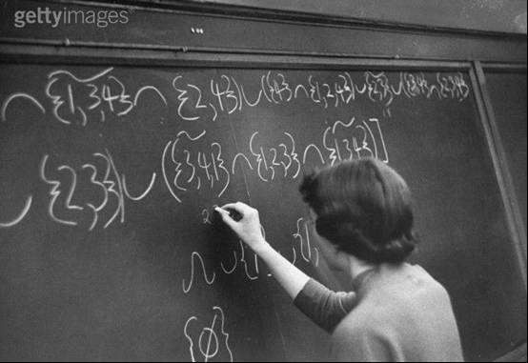
HOW TO WRITE NUMBERS
Alan Jackson
Royal Statistical Society

Slide 2
How to Write Numbers
Part III: The use of words or figures when writing numbers

Slide 3
How to Write Numbers
This course on how to write numbers is in three parts:
grammar and the correct use of words,
system for summarising percentages,
the use of words or figures when writing numbers.

Slide 4
How to Write Numbers
This part is on:
grammar and the correct use of words,
system for summarising percentages,
the use of words or figures when writing numbers.

Slide 5
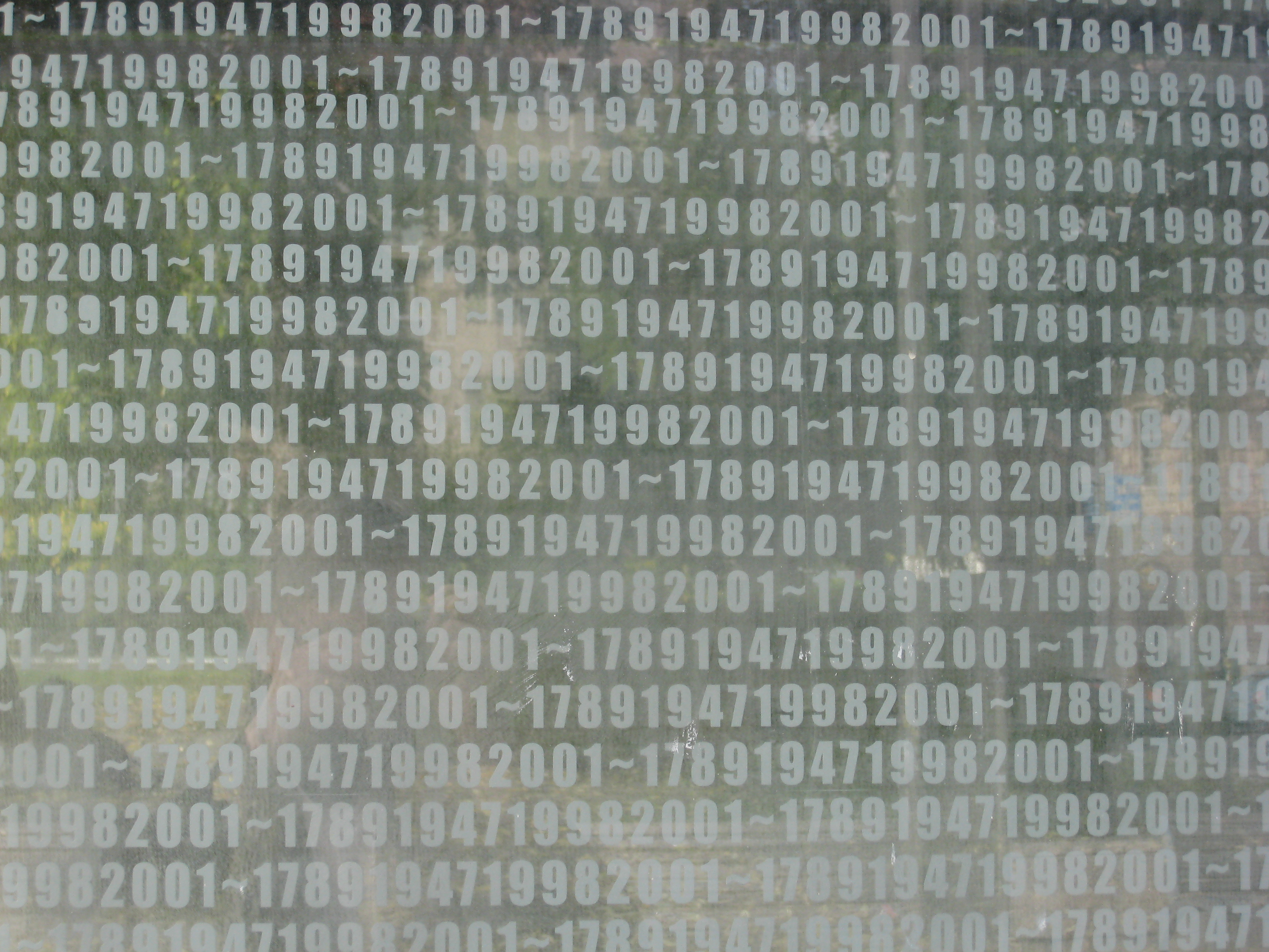
Words or Figures?
Erzsébet Square, Budapest

Slide 6
Word or Figures?
words or figures?
professional publishers have rules for deciding whether to use words or figures when writing numbers;
that is, whether to write twenty – one or 21
the rules are complicated, there are lots of them, and they don’t always agree
they are meant for general writing (novels, poems, short stories, …)
not for statistical reports or other writing that uses lots of numbers

Slide 7
Word or Figures?
words or figures?
the general principle is that numbers written as words can be difficult to read if there are a lot of them
but numbers written as figures can look unsightly if they are dotted here and there in large amounts of text
there has to be a compromise

Slide 8
Word or Figures?
words or figures?
there’s a rule which says that numbers from one to twelve should be written as words
and numbers greater than twelve should be written as figures
(sometimes the cut- off point is ten)
but expressions like “one in 15 men and one in eight women” look a bit odd

Slide 9
Word or Figures?
words or figures?
The following slides give some rules which will make writing which includes numbers easier to read.
any number can be written in figures
6
123,456,789
66

Slide 10
Word or Figures?
words or figures?
a number can be written in words if it can be written as one word
six
sixteen
sixty

Slide 11
Word or Figures?
words or figures?
round numbers can be written as two words
six hundred
sixty thousand

Slide 12
Word or Figures?
words or figures?
round numbers over a million are often clearer written as a figure followed by a word
the number of billiard players is 27 million
they spend £1.2 billion a year on playing the game

Slide 13
Word or Figures?
words or figures?
if you do have to write a long number, put a hyphen between the tens and the units
in snooker, the six colours score twenty – seven points
the maximum break at snooker is one hundred and forty – seven

Slide 14
Word or Figures?
words or figures?
put commas in numbers with four or more figures
write 54,321
not 54321

Slide 15
Word or Figures?
words or figures?
start decimals with a zero if they are less than one
write 0.75
not .75

Slide 16
Word or Figures?
words or figures?
Try to avoid starting sentences with a figure: change the wording if you have to.
so avoid things like: “147 is the maximum break at snooker.”
write: “The maximum break at snooker is 147.”
but you can start a bullet point with a figure
• 3 out of 4 billiard players also play snooker.

Slide 17
Word or Figures?
words or figures?
don’t mix words and figures for numbers in the same expression
write: of billiard players with degrees, 1 in 12 specialised in quantum mechanics or of billiard players with degrees, one in twelve specialised in quantum mechanics
but not: of billiard players with degrees, one in 12 specialised in quantum mechanics

Slide 18
Word or Figures?
The next slide contains a passage with lots of numbers written as words. It’s fairly awkward to read.
The passage on the slide following it contains exactly the same information but the numbers have been written as figures. It’s a bit easier to read.

Slide 19
“Billiards was played regularly by over five million people in the nineteen thirties, but it is now played by fewer than thirty thousand. It is a game for two people played with three small balls on a large table. The table is twelve feet long and six feet wide. The aim is to score points, and the first player to score an agreed number of points wins the game. The winning totals are agreed at the start of the game, and are usually one hundred points, two hundred points, or five hundred points. The two players take it in turns to score and can carry on scoring until they miss. In the past huge scores (or breaks) were sometimes made using repetitive strokes.
The largest
was a break of four hundred and ninety-nine thousand one hundred and thirty-five which was scored at a rate of ten thousand per session for five weeks. Under current rules the largest break is four thousand one hundred and thirty-seven.”

Slide 20
“Billiards was played regularly by over 5,000,000 people in the 1930s, but it is now played by fewer than 30,000. It is a game for 2 people played with 3 small balls on a large table. The table is 12 feet long and 6 feet wide. The aim is to score points, and the first player to score an agreed number of points wins the game. The winning totals are agreed at the start of the game, and are usually 100 points, 200 points, or 500 points. The 2 players take it in turns to score and can carry on scoring until they miss. In the past huge scores (or breaks) were sometimes made using repetitive strokes.
The largest was a break of 499,135 which was scored at a rate of 10,000 per session for 5 weeks. Under current rules the largest break is 4,137.”

Slide 21
Word or Figures?
Compare the last two sentences.
All words—a bit awkward?
The largest was a break of four hundred and ninety-nine thousand one hundred and thirty-five which was scored at a rate of ten thousand per session for five weeks. Under current rules the largest break is four thousand one hundred and thirty-seven.”
Words changed to figures—a bit easier?
The largest was a break of 499,135 which was scored at a rate of 10,000 per session for 5 weeks. Under current rules the largest break is 4,137.

Slide 22
Word or Figures?
But it’s still possible to make the passage with figures a shade easier to read, by writing some of the figures—the ones that don’t change—as words.
The numbers highlighted in red on the next slide either don’t change or don’t change much.
Writing them as words makes the more important numbers stand out more.

Slide 23
“Billiards was played regularly by over 5,000,000 people in the 1930s, but it is now played by fewer than 30,000. It is a game for 2 people played with 3 small balls on a large table. The table is 12 feet long and 6 feet wide. The aim is to score points, and the first player to score an agreed number of points wins the game. The winning totals are agreed at the start of the game, and are usually 100 points, 200 points, or 500 points. The 2 players take it in turns to score and can carry on scoring until they miss. In the past huge scores (or breaks) were sometimes made using repetitive strokes. The largest was a break of 499,135 which was scored at a rate of 10,000 per session for 5 weeks. Under current rules the largest break is 4,137.”

Slide 24
“Billiards was played regularly by over 5 million people in the 1930s, but it is now played by fewer than 30,000. It is a game for two people played with three small balls on a large table. The table is twelve feet long and six feet wide. The aim is to score points, and the first player to score an agreed number of points wins the game. The winning totals are agreed at the start of the game, and are usually 100 points, 200 points, or 500 points. The two players take it in turns to score and can carry on scoring until they miss. In the past huge scores (or breaks) were sometimes made using repetitive strokes. The largest was a break of 499,135 which was scored at a rate of 10,000 per session for five weeks. Under current rules the largest break is 4,137.”

Slide 25
“Billiards was played regularly by over 5 million people in the 1930s, but it is now played by fewer than 30,000. It is a game for two people played with three small balls on a large table. The table is twelve feet long and six feet wide. The aim is to score points, and the first player to score an agreed number of points wins the game. The winning totals are agreed at the start of the game, and are usually 100 points, 200 points, or 500 points. The two players take it in turns to score and can carry on scoring until they miss. In the past huge scores (or breaks) were sometimes made using repetitive strokes. The largest was a break of 499,135 which was scored at a rate of 10,000 per session for five weeks. Under current rules the largest break is 4,137.”

Slide 26
